Slide 1
ERA5 TC forecasts 1979-2021
Mike Fiorino
Commander, United States Navy (retired)
B.S. (’75 PSU), M.S. (’78 PSU), Ph.D. (’87 NPS) all in Meteorology mfiorino@gmu.edu
George Mason University VA
University of Colorado Boulder CO
Earth System Research Laboratory, Boulder CO
National Hurricane Center, Miami FL
Joint Typhoon Warning Center, Pearl Harbor HI
Lawrence Livermore National Laboratory, Livermore CA
European Centre for Medium-Range Weather Forecasts, Shinfield Park, Berskshire, UK
Meteorological Research Institute – Japan Meteorological Agency, Tsukuba JAPAN
Space and Naval Warfare Systems Command, Arlington VA
NASA Goddard Space Flight Center, Greenbelt MD
National Centers for Environmental Prediction, Camp Springs MD
Naval Postgraduate School, Monterey CA
Fleet Numerical Meteorology and Oceanography Center, Monterey CA
Naval Research Laboratory, Monterey CA
Atlantic Oceanographic and Meteorological Laboratory, Miami FL
Pennsylvania State University, University Park PA

Slide 2
personal notes...
officially retired from US Navy and NOAA and Univ of CA (LLNL) and CO (CIRES).
affiliated with George Mason University for access to library and computing (similar to emeritus status, i.e., pro bono, courtesy of Jim Kinter COLA)
14th visit to Japan and turned 69, i.e., I’m an old guy living a 55+ community (Ave Maria FL largely unaffected by hurricane IAN)
my Alzheimer’s (dementia) prevention strategy:
  maintain real-time NWP/TC data flows from NCEP/ECMWF/JMA/CMC/CSU/JTWC/NHC... and webs at wxmap2.com
  毎日日本語をべんきょうしっています

Slide 3
topics or story lines
My entire NWP/TC s/w & data installed & working at climateb.aori.u-tokyo.ac.jp
  JTWC/NHC best tracks and forecast aids
  CMORPH precip, CIRA MTCSWA
  ERA5 forecasts and analyses
  wxmap2.com – frontend & subset of TC/NWP processing
TCs & NWP
  the importance of metrics
  recent results...
ERA5 TC forecasts – input to super Best Track
  Prob of Detection (PoD) in analyses and forecasts compared to ERA40

Slide 4
topics or story lines
My entire NWP/TC s/w & data installed & working at climateb.aori.u-tokyo.ac.jp
  JTWC/NHC best tracks and forecast aids (1947-2022)
  CMORPH precip, CIRA MTCSWA (1998-2022)
  ERA5 forecasts and analyses (1979-2021)
  real-time JTWC/NHC data (crontab)
  front-end and back-end processing
wxmap2.com – front end
  https://tcact.wxmap2.com TC activity sACEd
  https://maps.wxmap2.com WxMAPs
  https://tcgen.wxmap2.com TC genesis
  https://jtdiag.wxmap2.com TC diagnostics file
  https://tctrkveri.wxmap2.com TC tracks & verification

Slide 5
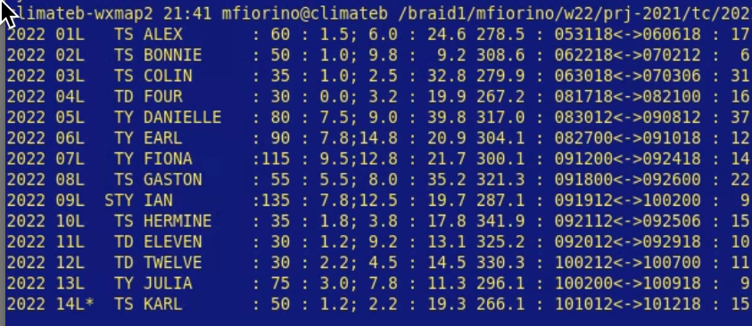
atLANTic – 2022

Slide 6
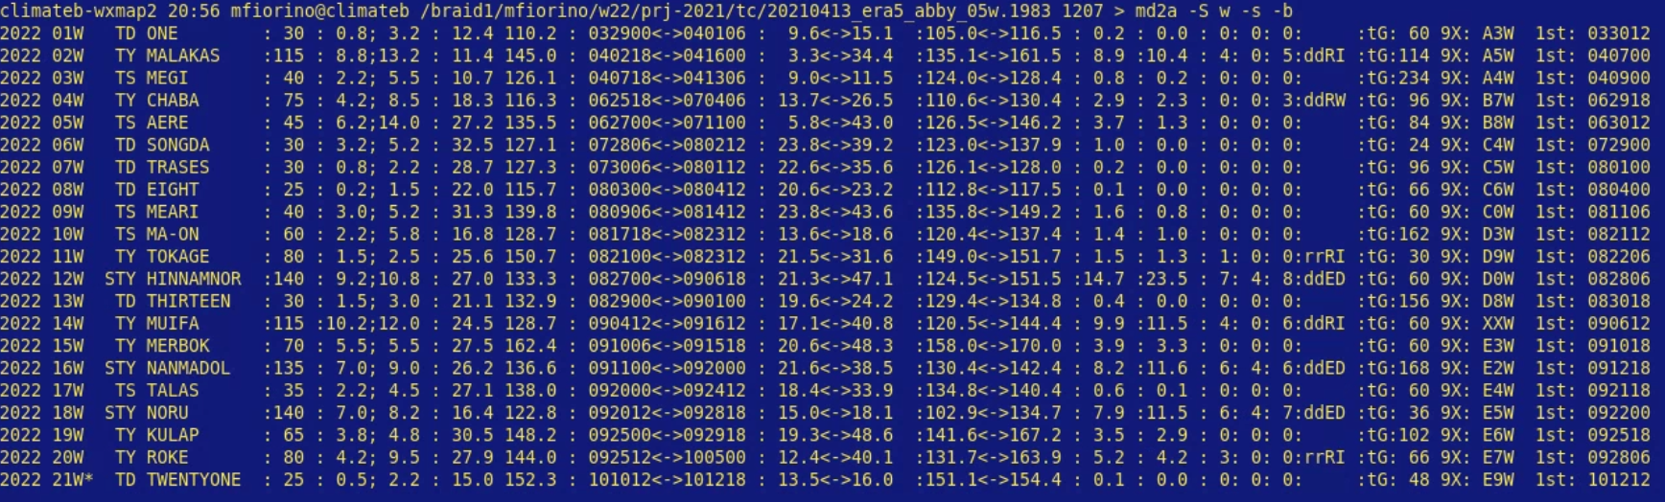
WPAC – 2022

Slide 7
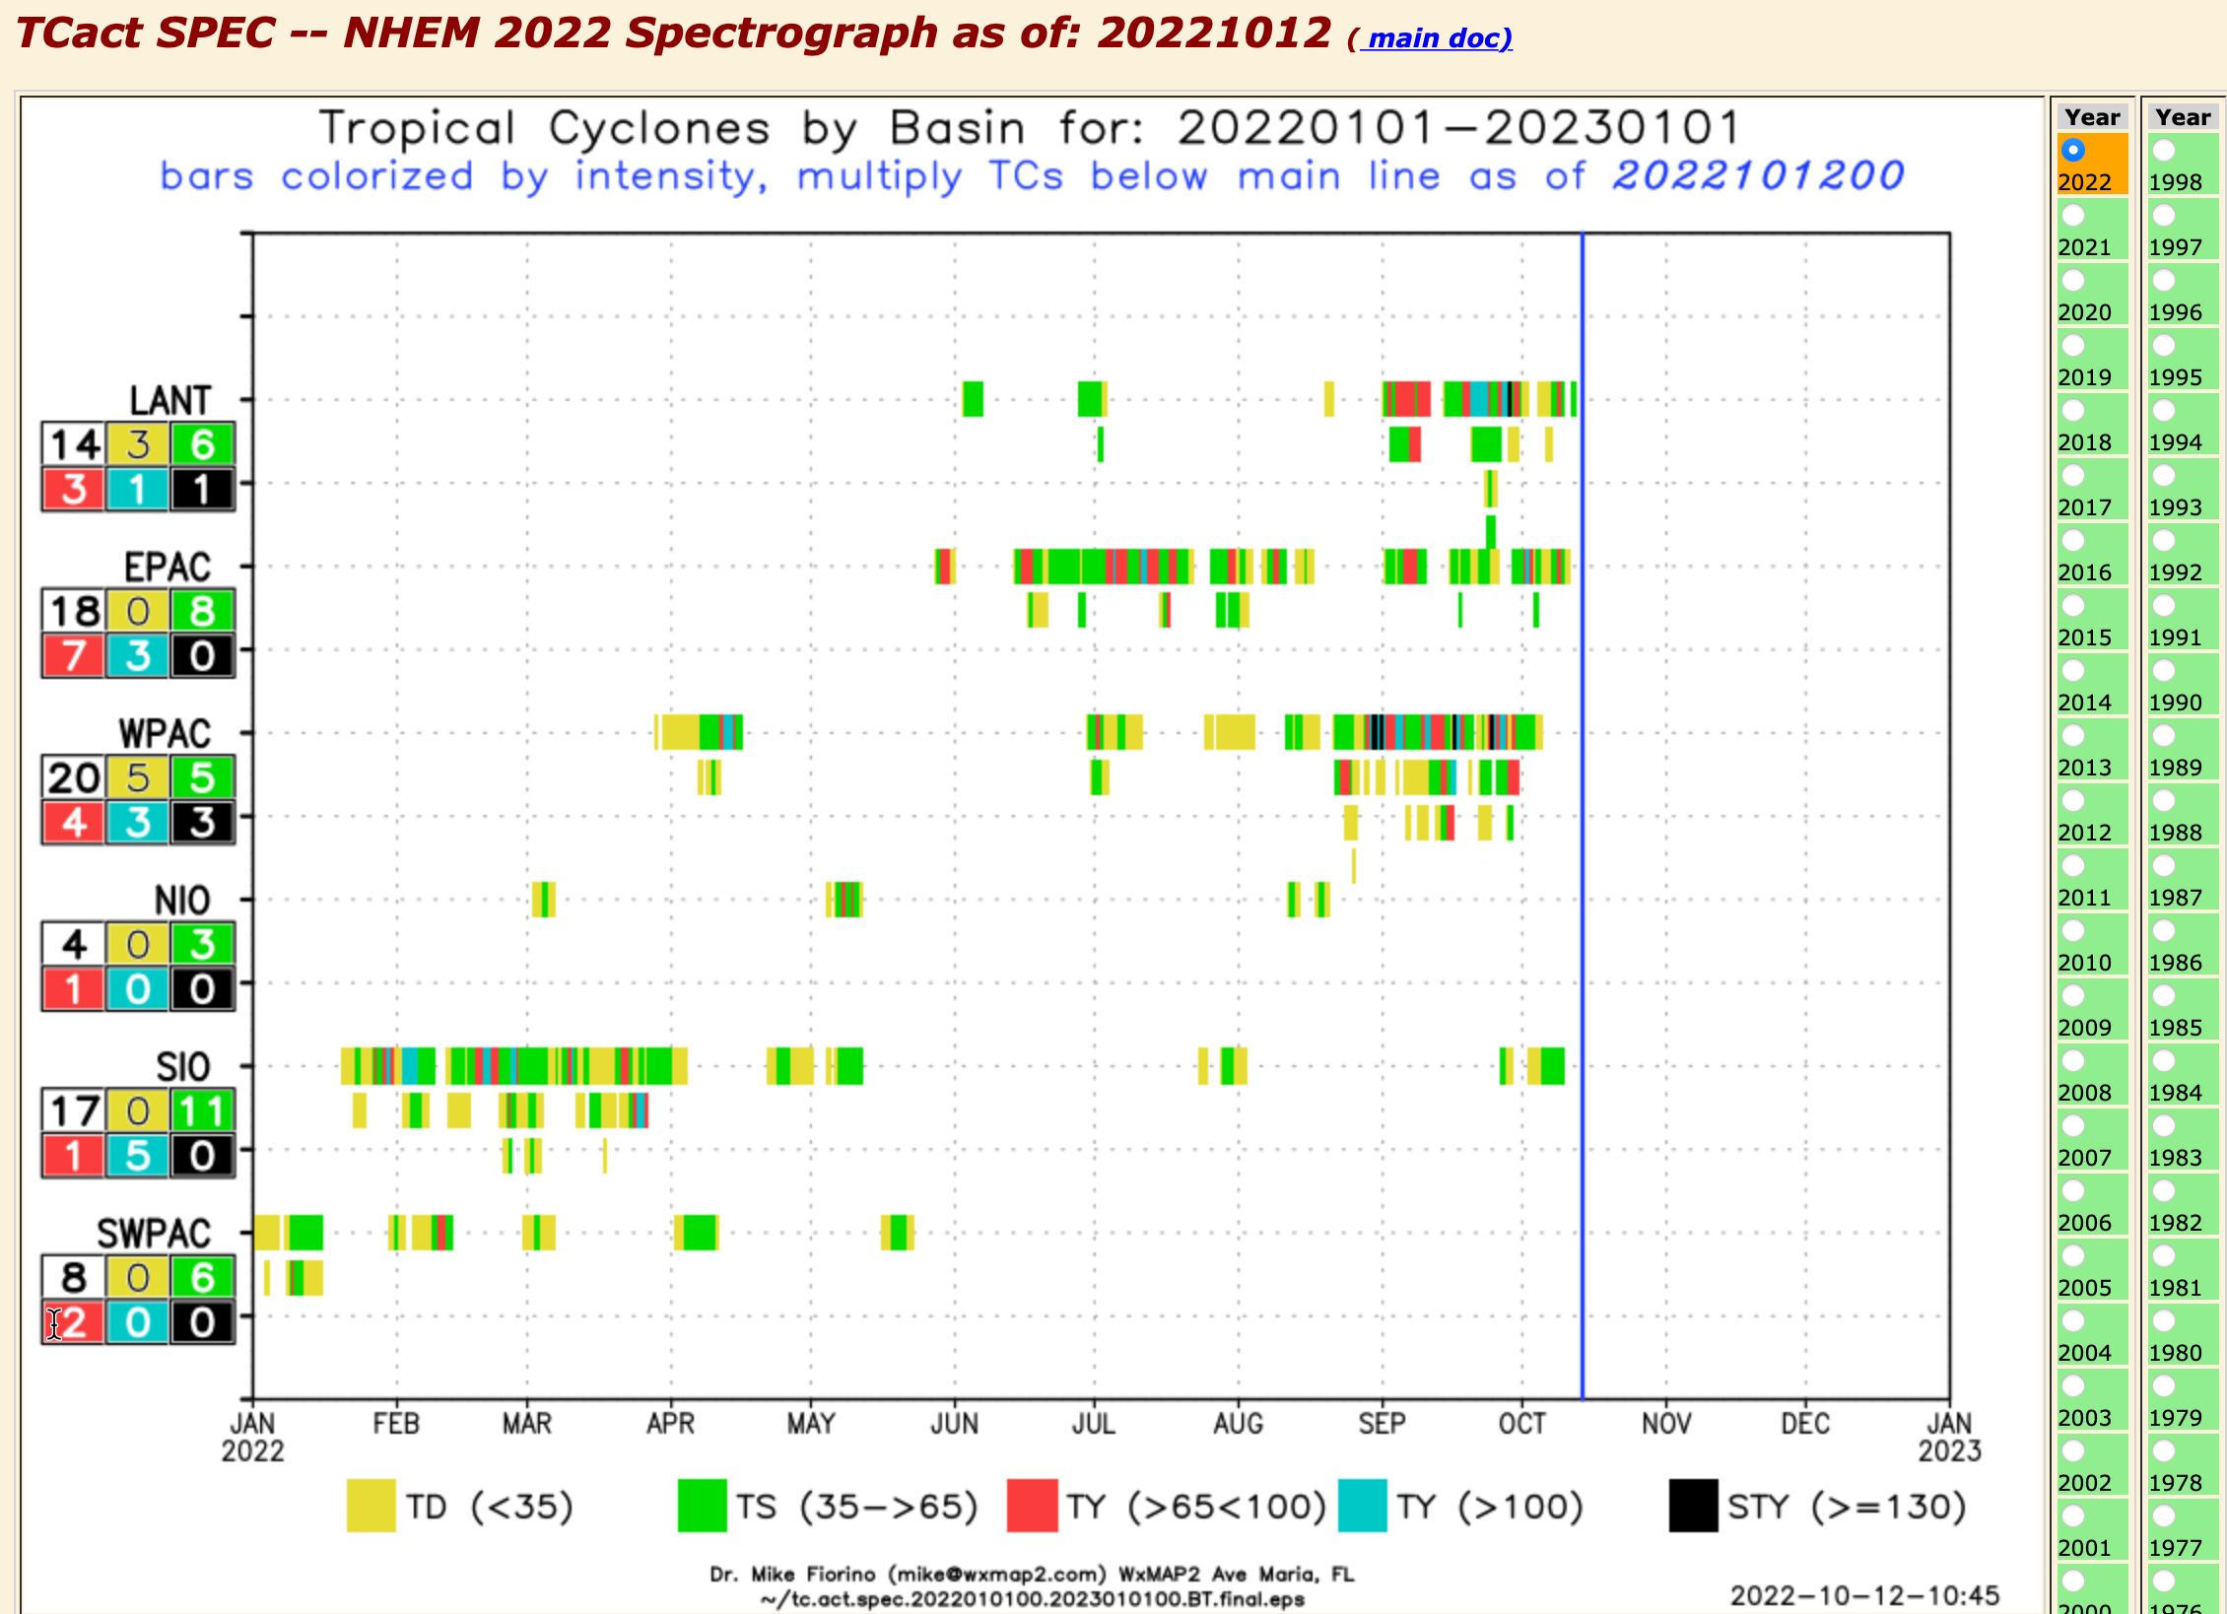
https://tcact.wxmap2.com

Slide 8
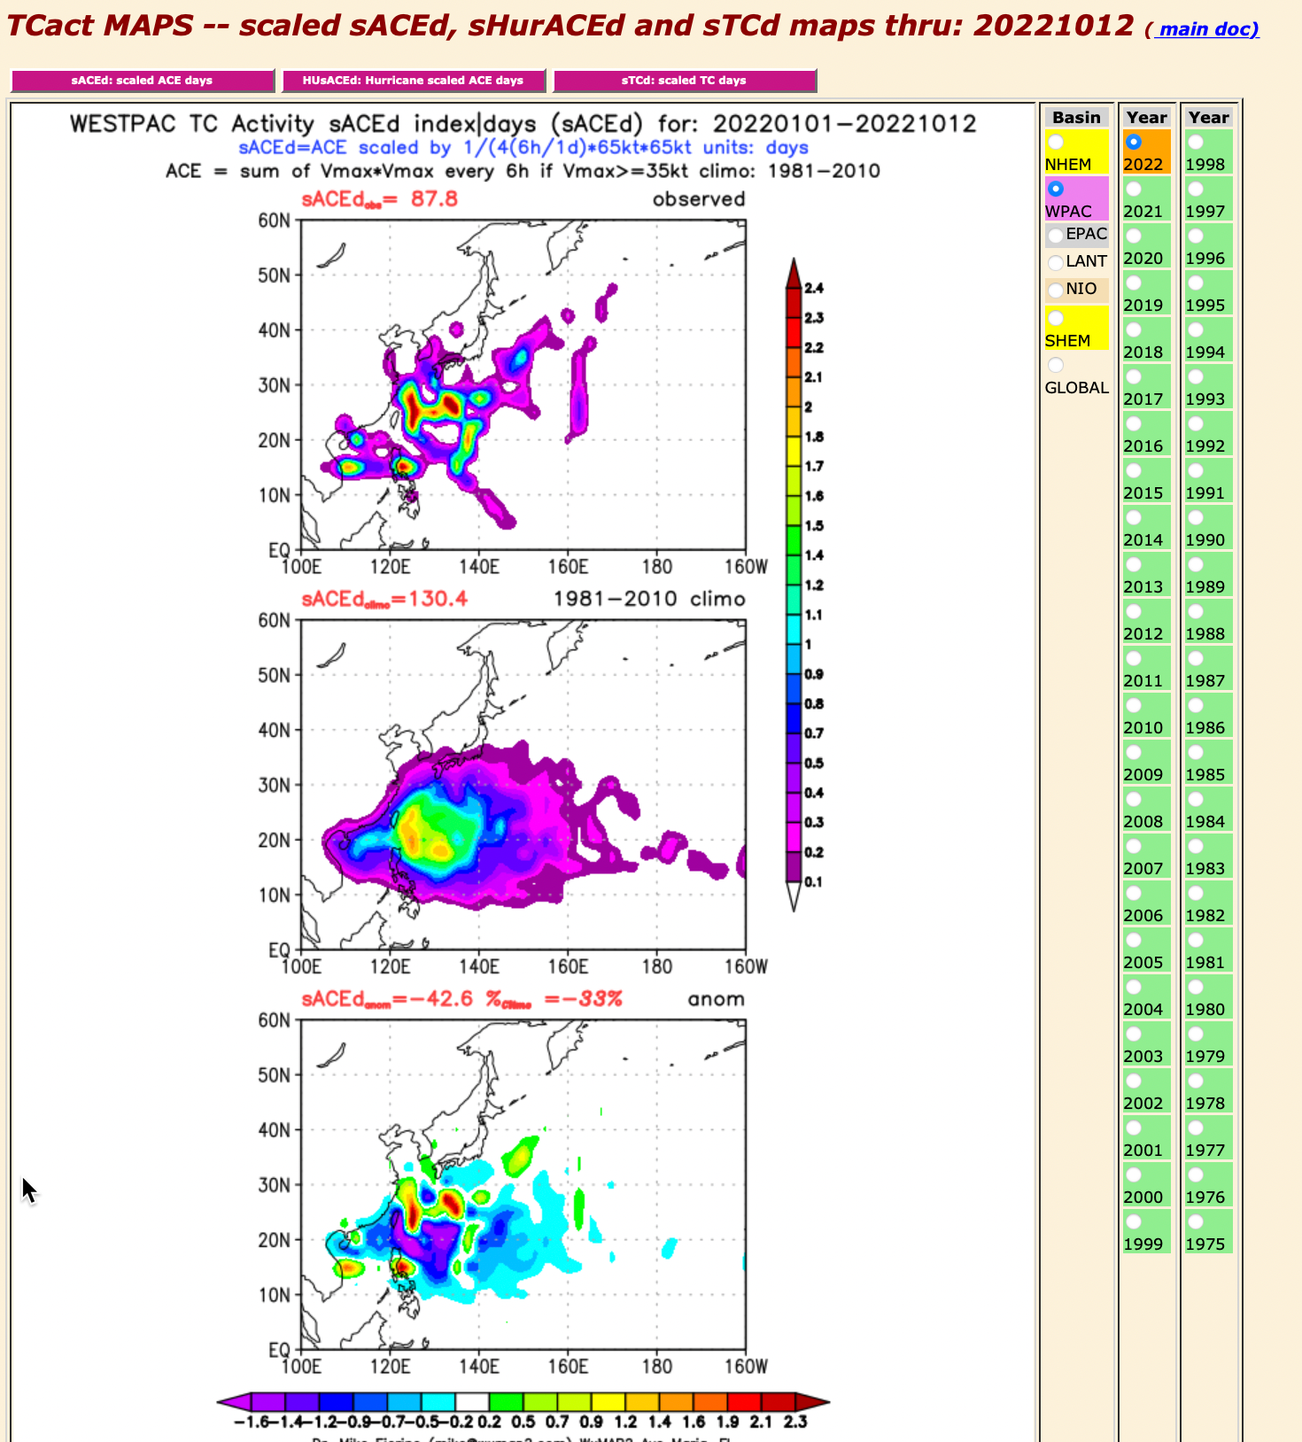
https://tcact.wxmap2.com

Slide 9
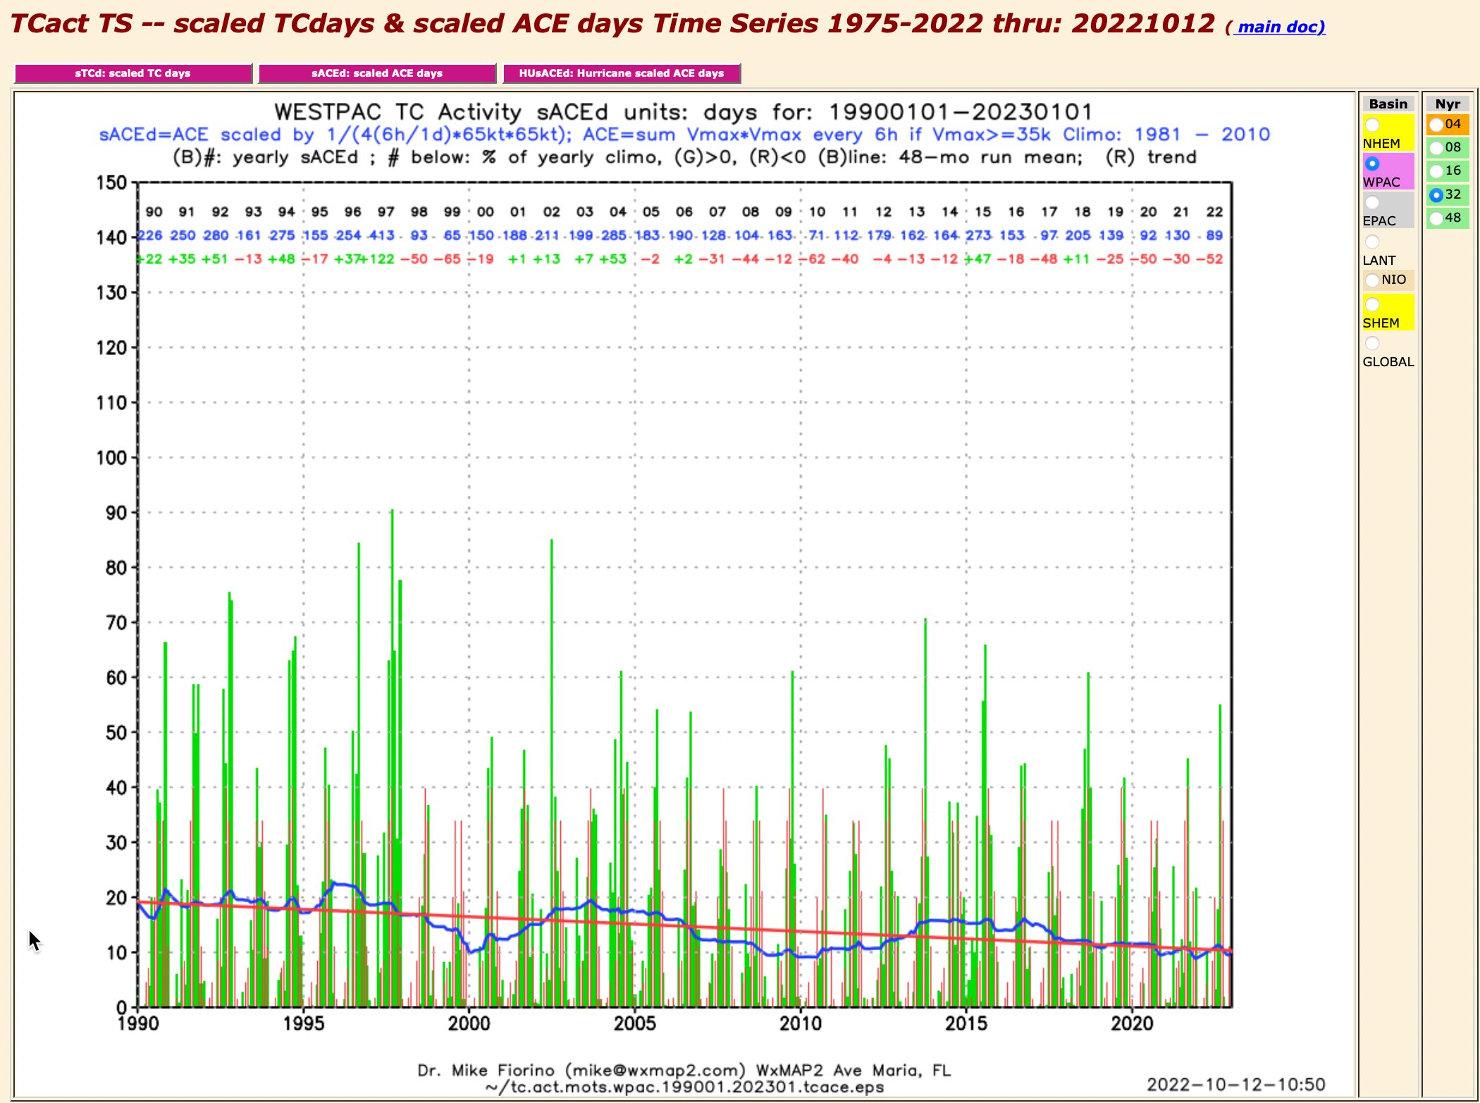
https://tcact.wxmap2.com

Slide 10
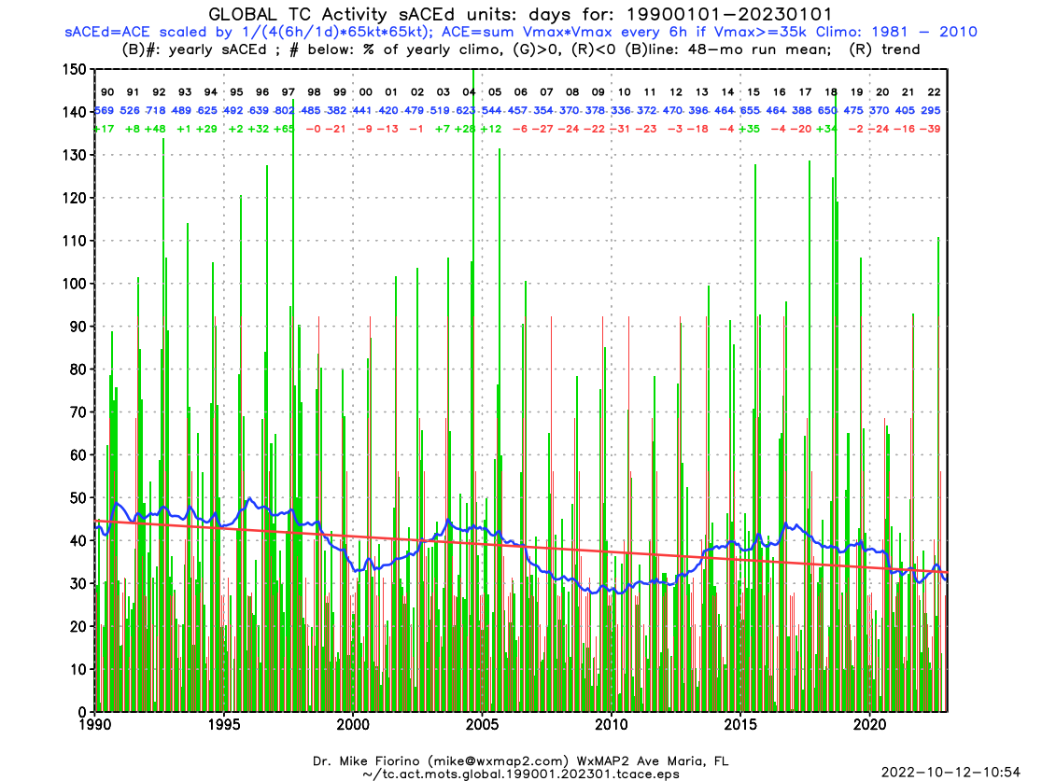
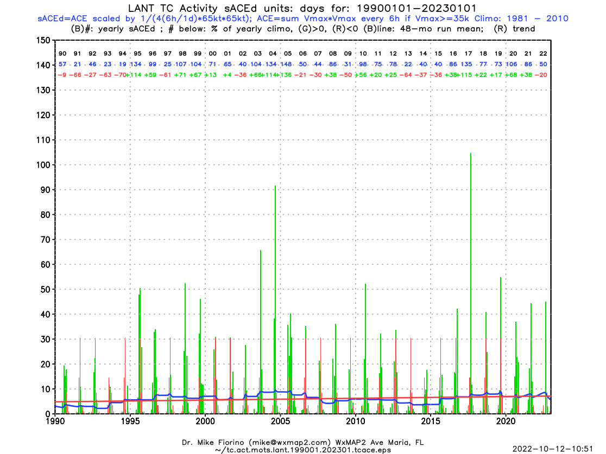
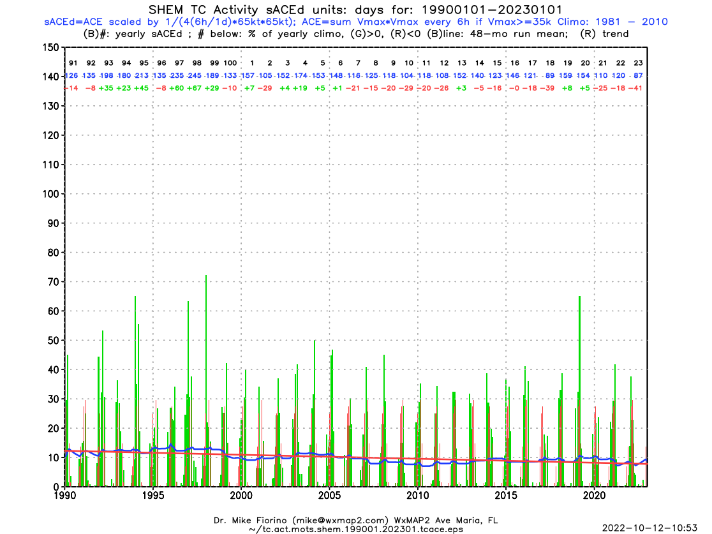
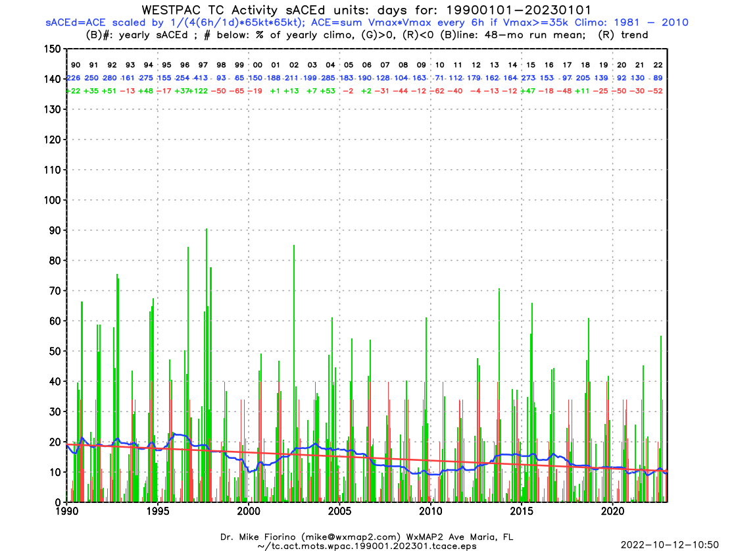
https://tcact.wxmap2.com

Slide 11
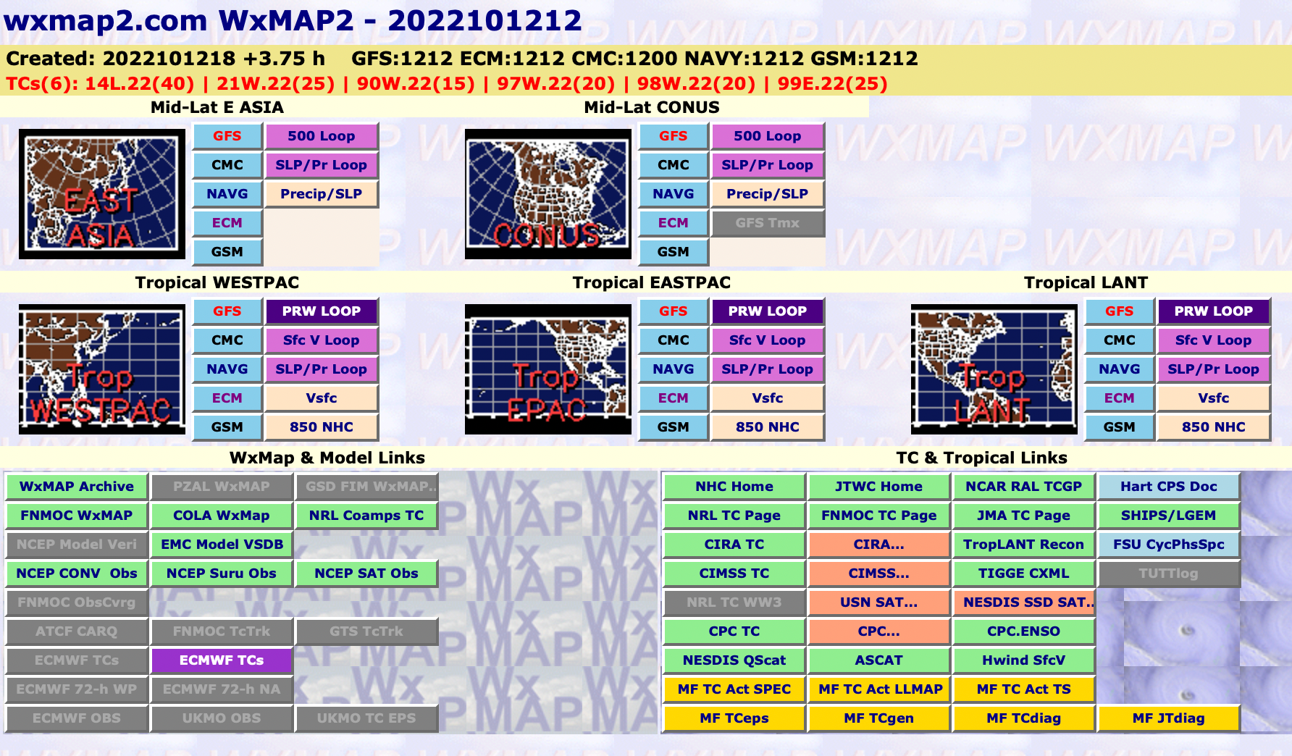
https://maps.wxmap2.com

Slide 12
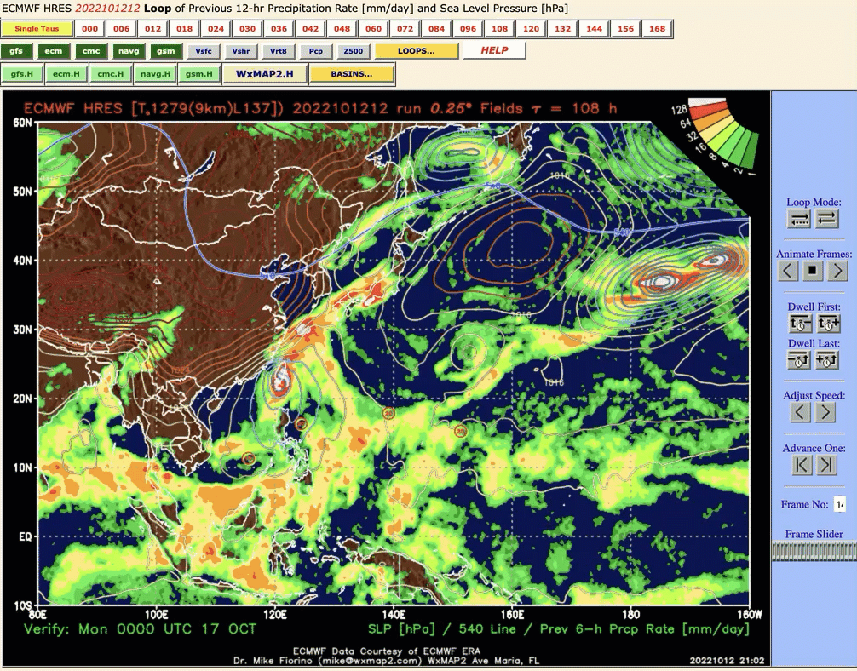
https://maps.wxmap2.com

Slide 13
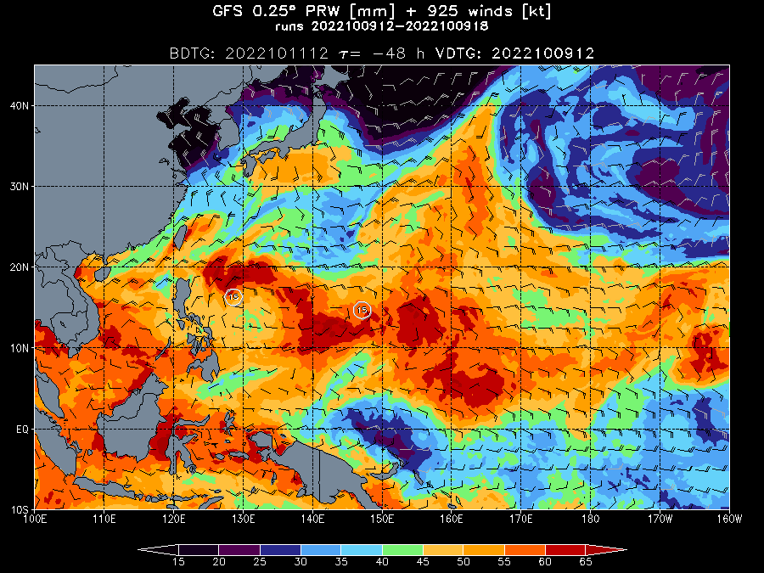
https://maps.wxmap2.com

Slide 14
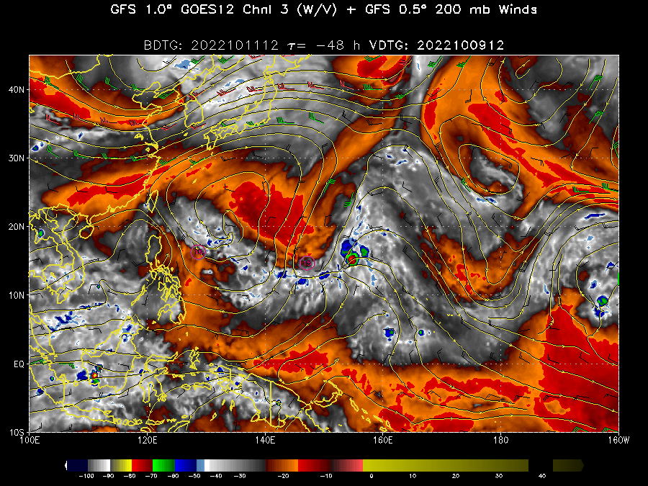
https://maps.wxmap2.com

Slide 15
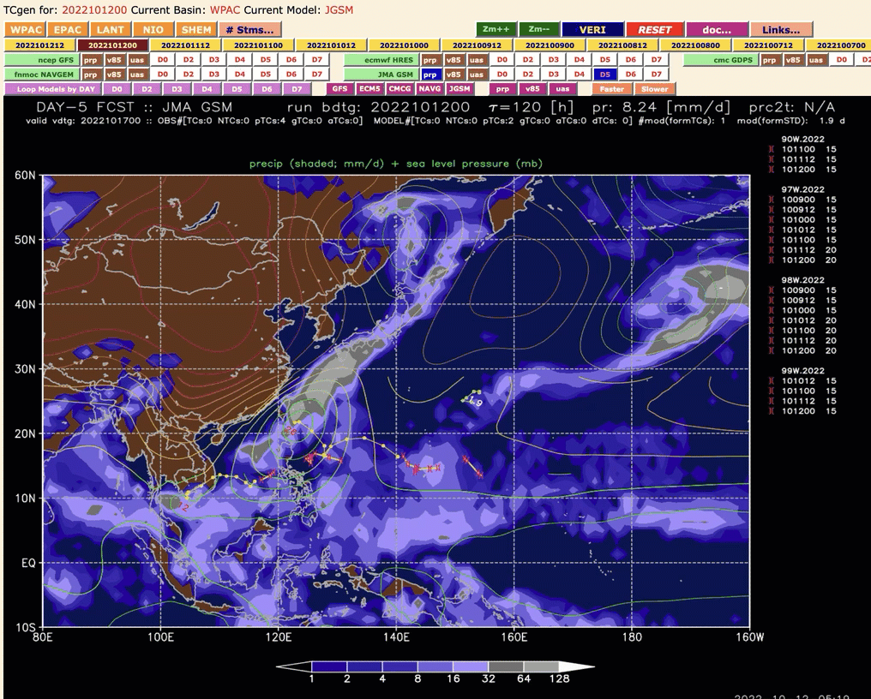
https://tcgen.wxmap2.com

Slide 16
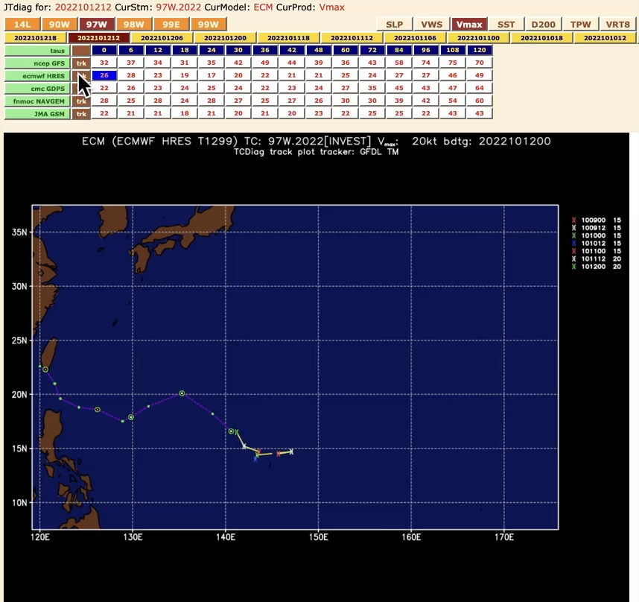
https://jtdiag.wxmap2.com

Slide 17
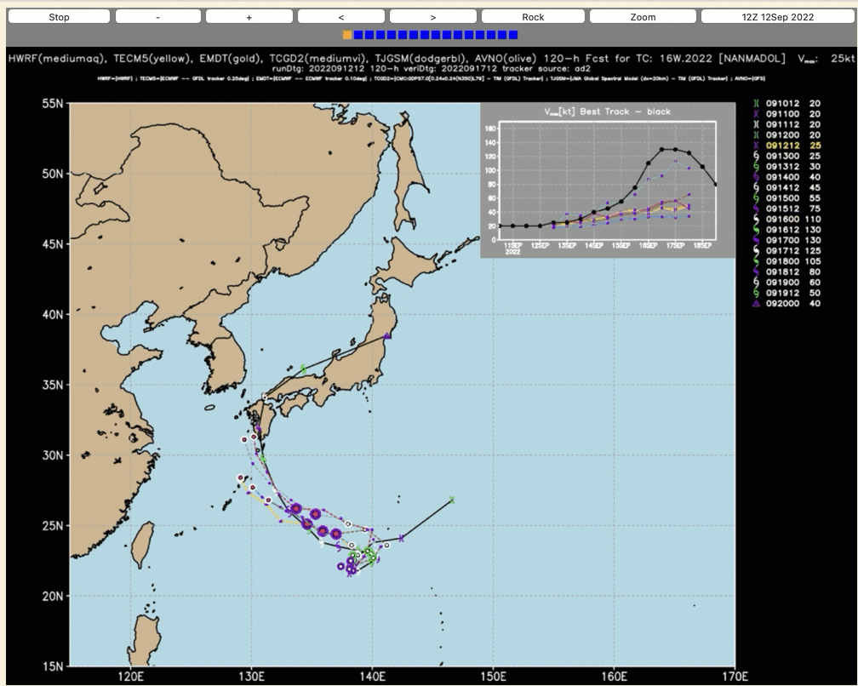
https://tctrkveri.wxmap2.com

Slide 18
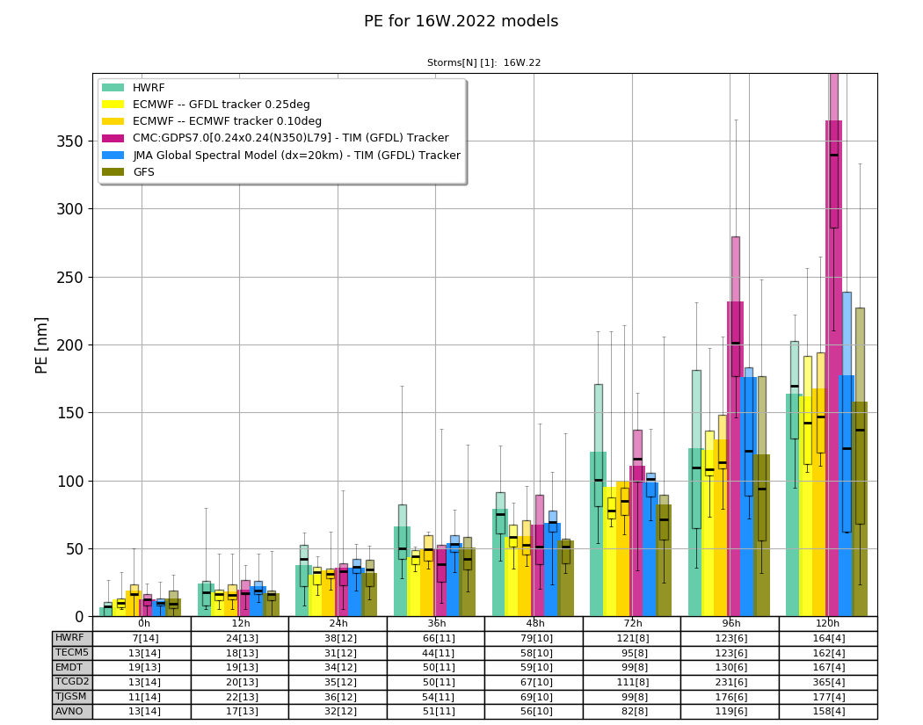
https://tctrkveri.wxmap2.com

Slide 19
topics or story lines
My entire NWP/TC s/w & data installed & working at climateb.aori.u-tokyo.ac.jp
  JTWC/NHC best tracks and forecast aids
  CMORPH precip, CIRA MTCSWA
  ERA5 forecasts and analyses
  wxmap2.com – frontend & subset of TC/NWP processing
TCs & NWP
  the importance of metrics
  recent results...
ERA5 TC forecasts – input to super Best Track
  Prob of Detection (PoD) in analyses and forecasts compared to ERA40

Slide 20
some words of wisdom…
“You’re only as good as what you measure”
CAPT Vic Addison, USN(ret)
2006 Commanding Officer FNMOC
“Forecasting is the acid test of an analysis”
Bob Kistler, NCEP
father of American Reanalysis
NCEP/NCAR R1

Slide 21
some more philosophy…
“You’re only as good as the metrics you choose and the quality of the calculation and analysis (diagnosis)”
the magic of NWP is converting diagnostics into lines of code
my raison d’etre – better diagnostics for better TC NWP

Slide 22
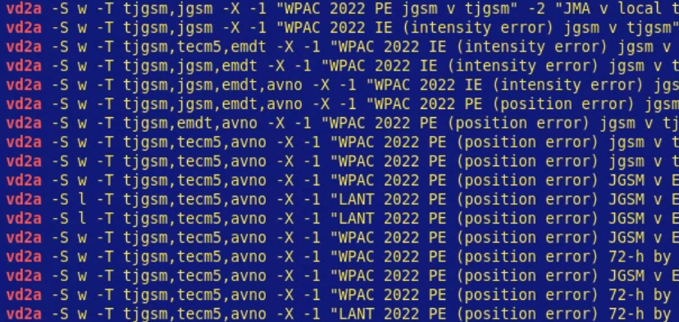
w2-tc-dss-vd2-anl.py – interactive TC verification
following analysis completed in 20 minutes
using interactive python tool…longer to powerpoint than make the graphics

Slide 23
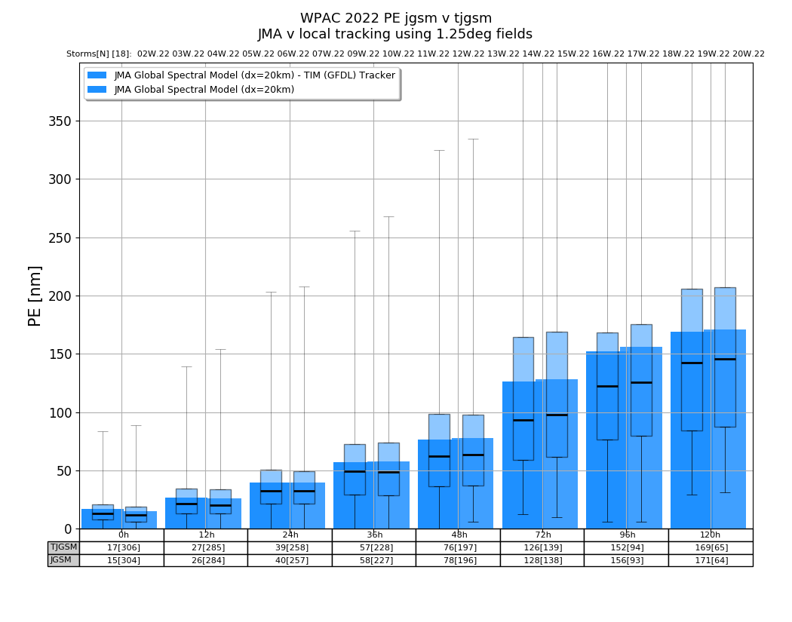
WPAC 2022 JGSM v TJGSM PE=Position Error local tracking using 1.25deg fields from JMA
PE almost identical ➔ position not dependent of grid resolution

Slide 24
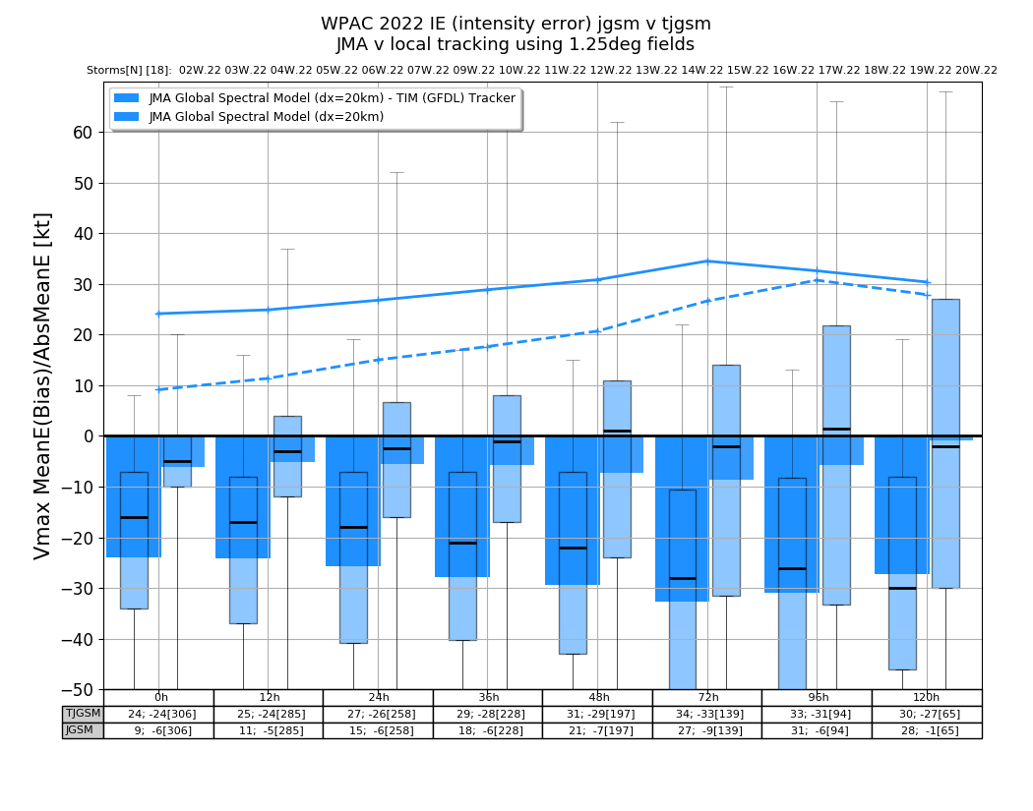
WPAC 2022 JGSM v TJGSM IE=Intensity Error local tracking using 1.25deg fields from JMA
very low bias from JMA tracking! ➔ strong dependence on grid resolution for intensity and structure

Slide 25
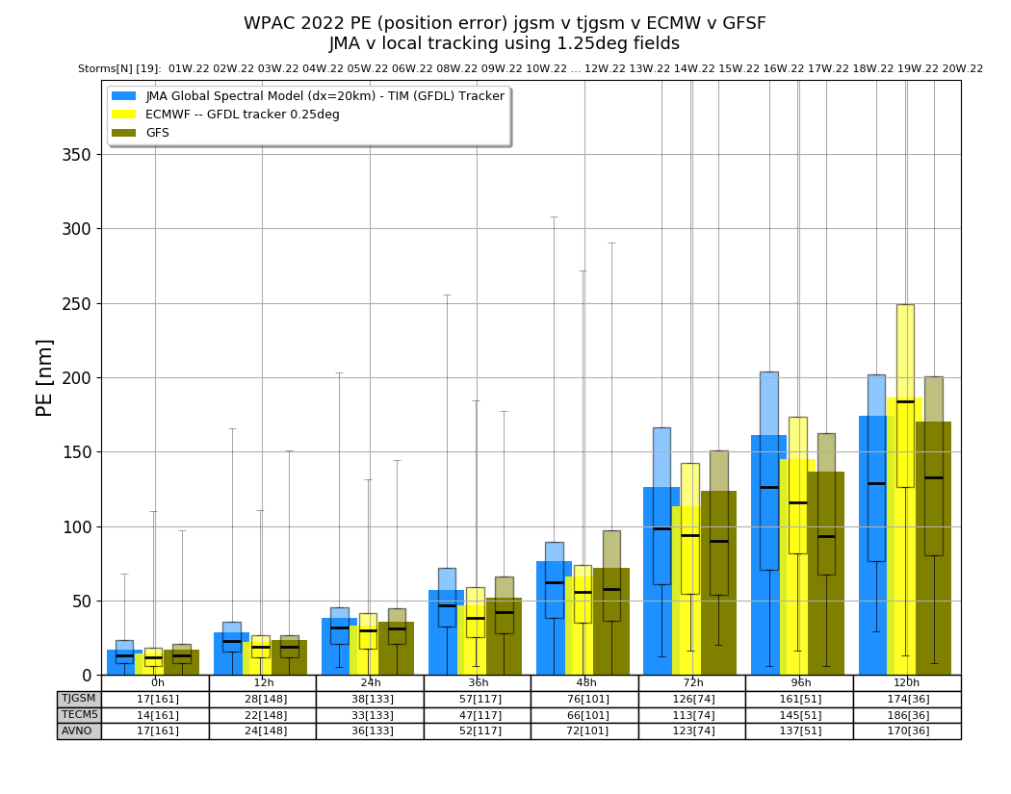
WPAC 2022 JGSM v ECMWF v GFS
mean PE of 120 nm @ 72 h
is very good

Slide 26
a few comments about the mean PE metric
it’s a de facto standard but of limited diagnostic value
track error is a misnomer; the metric is related to track but is NOT the track – the correct term is position error.
the box and whisker analysis gives much more information on the distribution of PE…especially the median (black line)
visual confusion – the means in the plot look continuous, but the storms that contribute to the mean ARE NOT! For example, TCs contributing to the 120-h mean are not the same as in the 24-h mean, i.e., the number of cases at 120 h is much less than for 24 h.

Slide 27
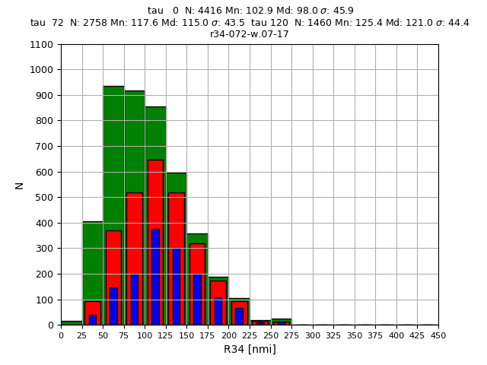
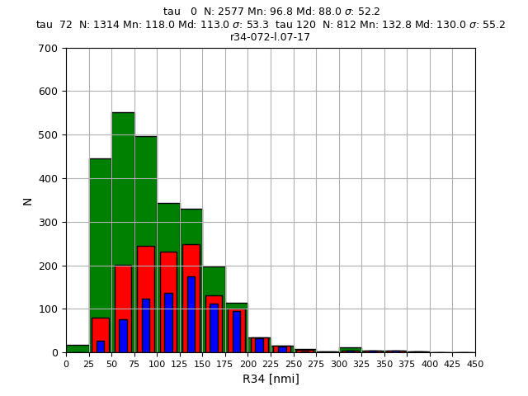
What is the difference between a 72-h mean PE and 120-h mean PE?
10-y R34 histograms (2008-2017) taus: 0 (G), 72 (R),120 (B)
only 1/2 the forecasts have a 72 h verifying position…
WPAC
100/62/33
98/118/121
LANT
100/50/31
88/113/130
only1/3 the forecasts have a 72 h verifying position…

Slide 28
What is the difference between a 72-h mean PE and 120-h mean PE? fundamentally different type of storms
LANT
  50% of the forecast TCs exist at d+3 days…
  d+5 TCs are larger than in WPAC
WPAC
  33% of the forecast TCs last d+5 days
  d+0 and d+3 TCs are larger than in LANT

Slide 29
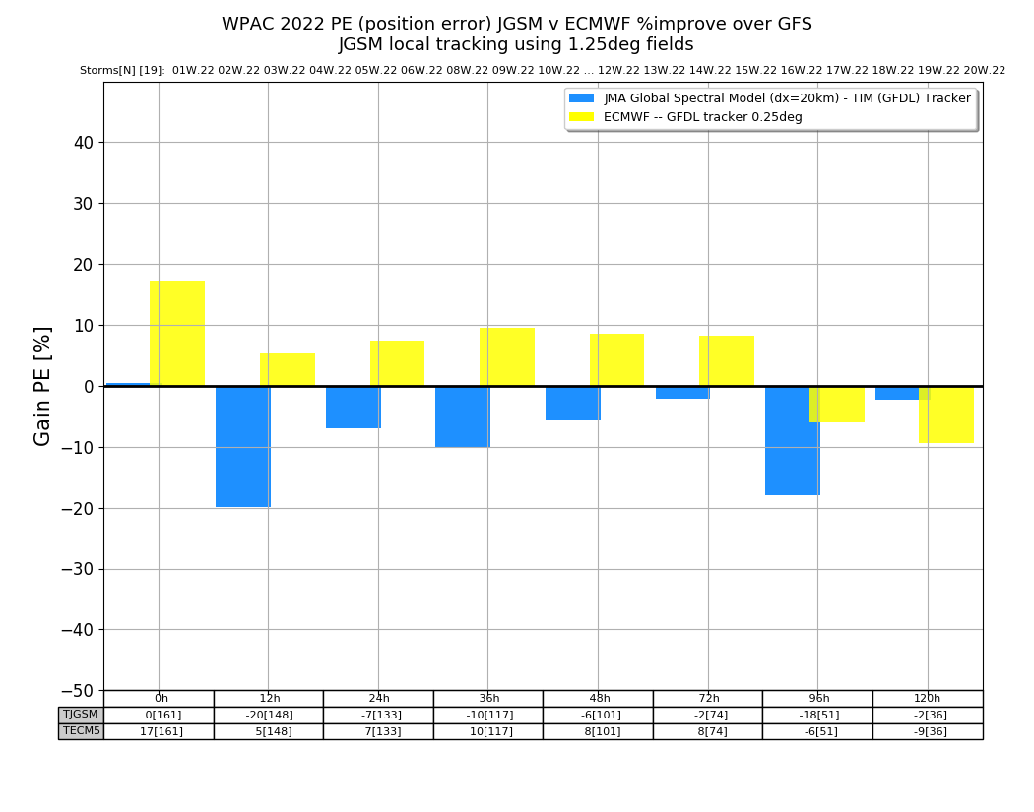
WPAC 2022 JGSM v ECMWF as %improve over GFS as a baseline
ECMWF better initial PE
GFS good >= 96h

Slide 30
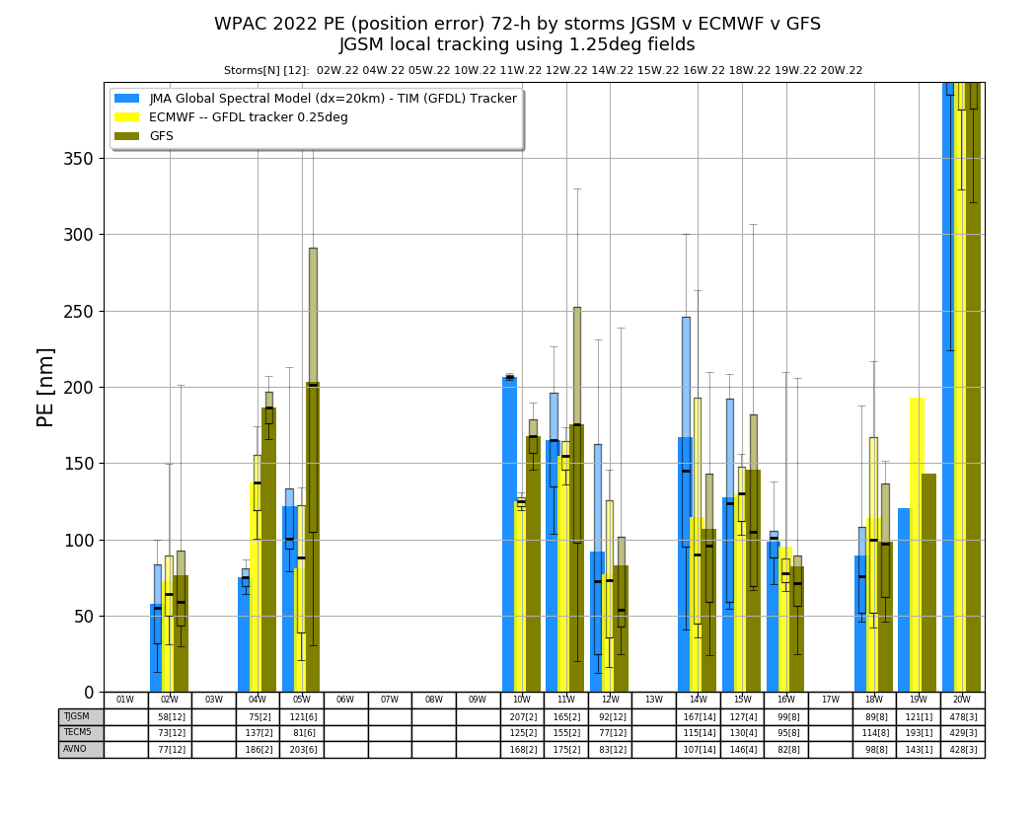
WPAC 2022 JGSM v ECMWF v GFS by TC
16W – NANMADOL
8/74 cases
02W – MALAKAS 12/74
JMA > ECMWF/GFS
14W – MUIFA 14/72
JMA < ECMWF/GFS

Slide 31
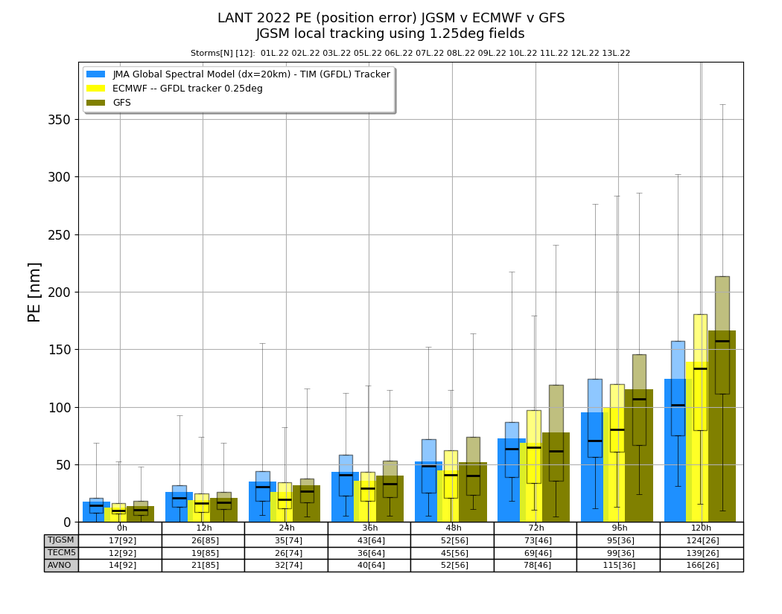
LANT 2022 JGSM v ECMWF v GFS
mean PE of 70 nm @ 72 h
is extremely good!!

Slide 32
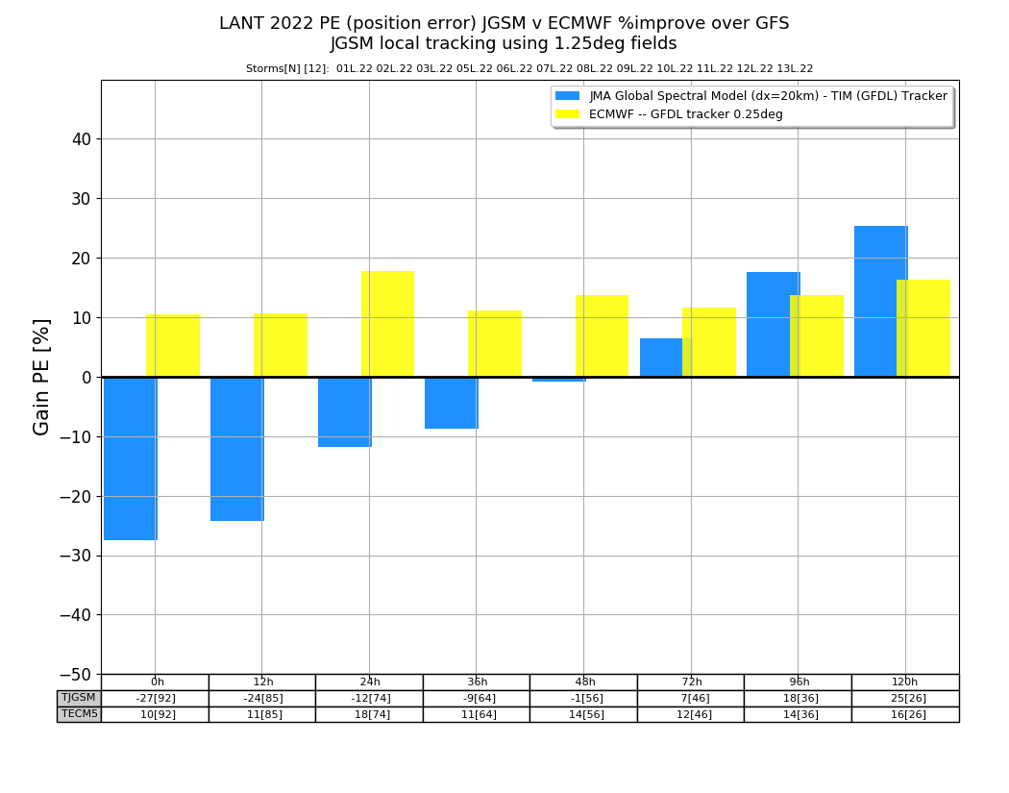
LANT 2022 JGSM v ECMWF v GFS
good news for JMA!
better than GFS >= 72h

Slide 33
topics or story lines
My entire NWP/TC s/w & data installed & working at climateb.aori.u-tokyo.ac.jp
  JTWC/NHC best tracks and forecast aids
  CMORPH precip, CIRA MTCSWA
  ERA5 forecasts and analyses
  wxmap2.com – frontend & subset of TC/NWP processing
TCs & NWP
  the importance of metrics
  recent results...
ERA5 analyses/forecasts – input to super Best Track
  twice daily runs of the ERA5 model to 240 h – not generally available
  run GFDL tracker on all TCs 1979-2021
  calculate the ‘diagnostic file’ – input to statistical TC intensity forecast aids with ‘storm’ and ‘environment’ variables (e.g., vertical wind shear)
  How good are the ERA5 TC forecasts?

Slide 34
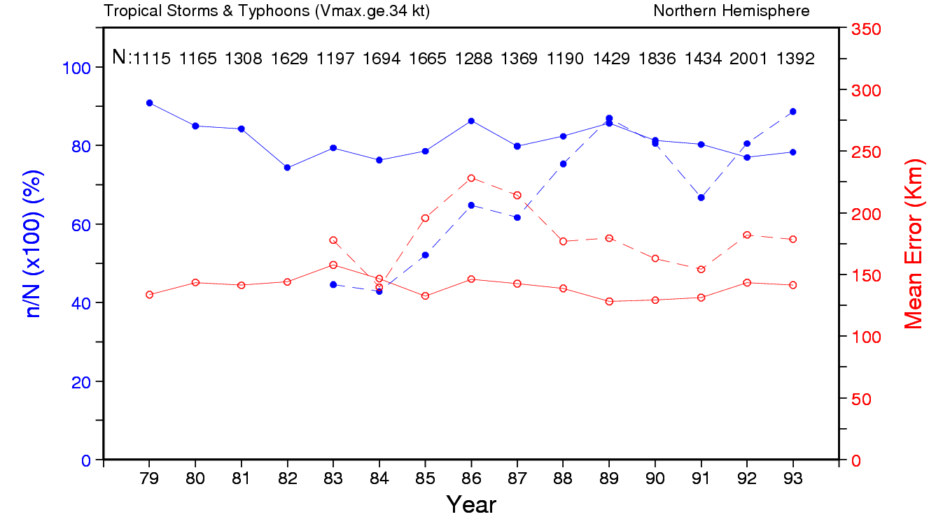
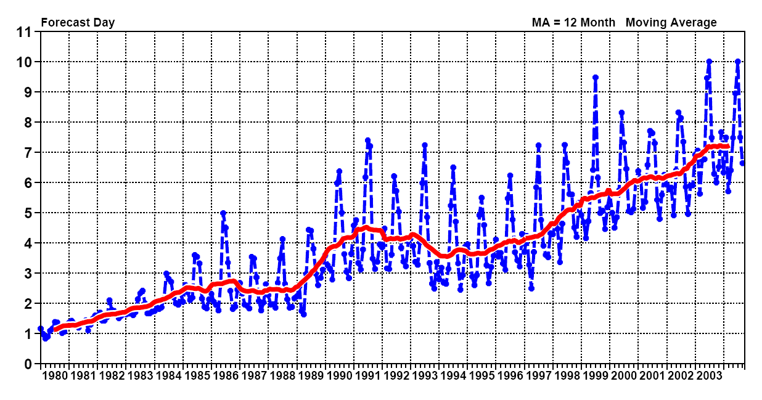
TC Detection in ERA-15 v ECMWF ops
ERA-15 ~85% 1979-93
Ops detection increases to 80+% ~1989
tropical wind skill increases from 2.5 to 4 days ~1989

Slide 35
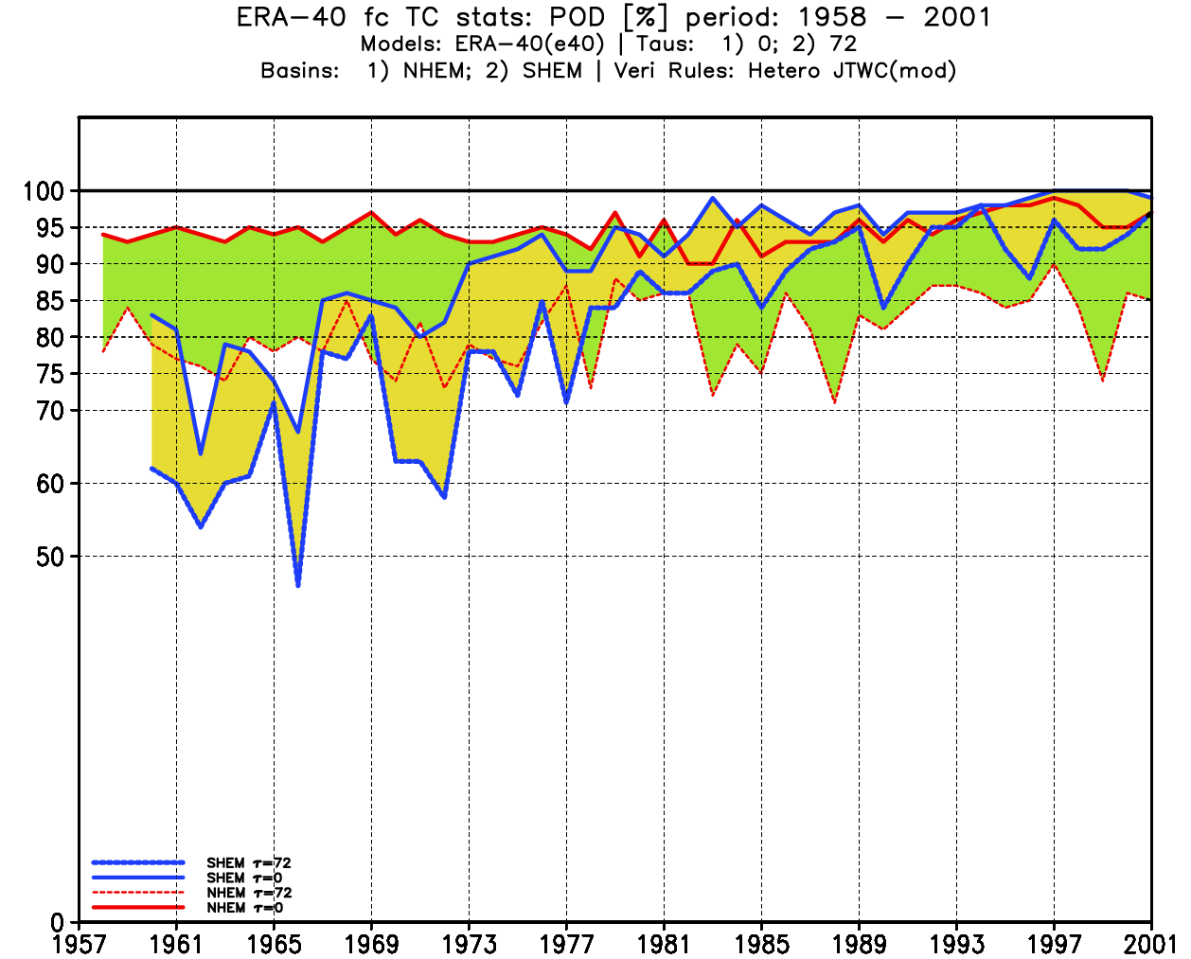
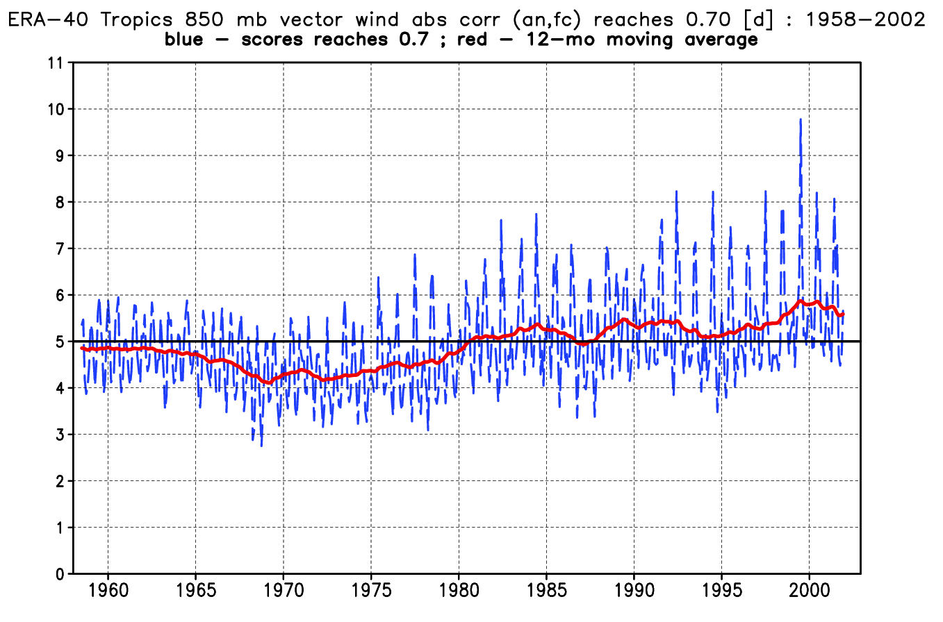
ERA-40 TC detection v tropical wind score
SHEM v NHEM ; tau=0 v tau=72 h

Slide 36
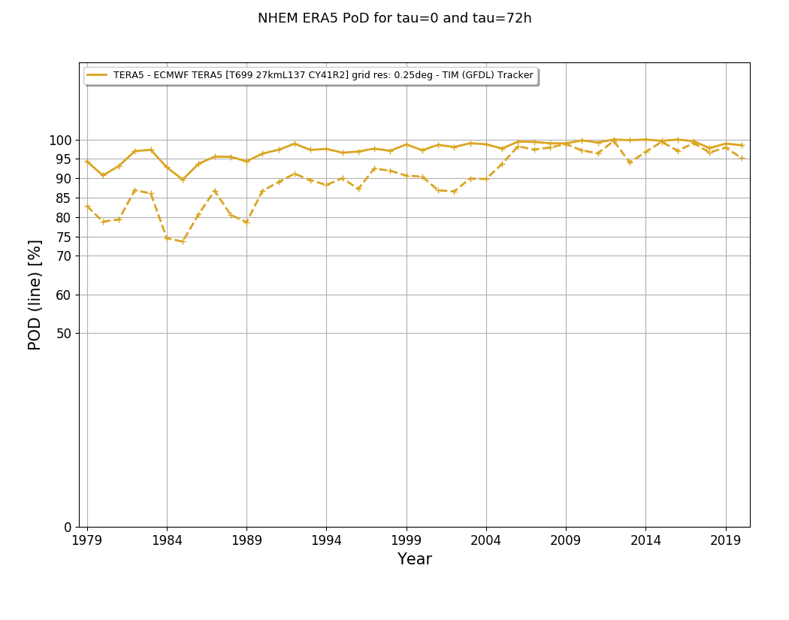
NHEM ERA5 PoD at tau=0 and 72 h
tau0 >= 90% and better than ERA40 1989-2021
tau72 much better

Slide 37
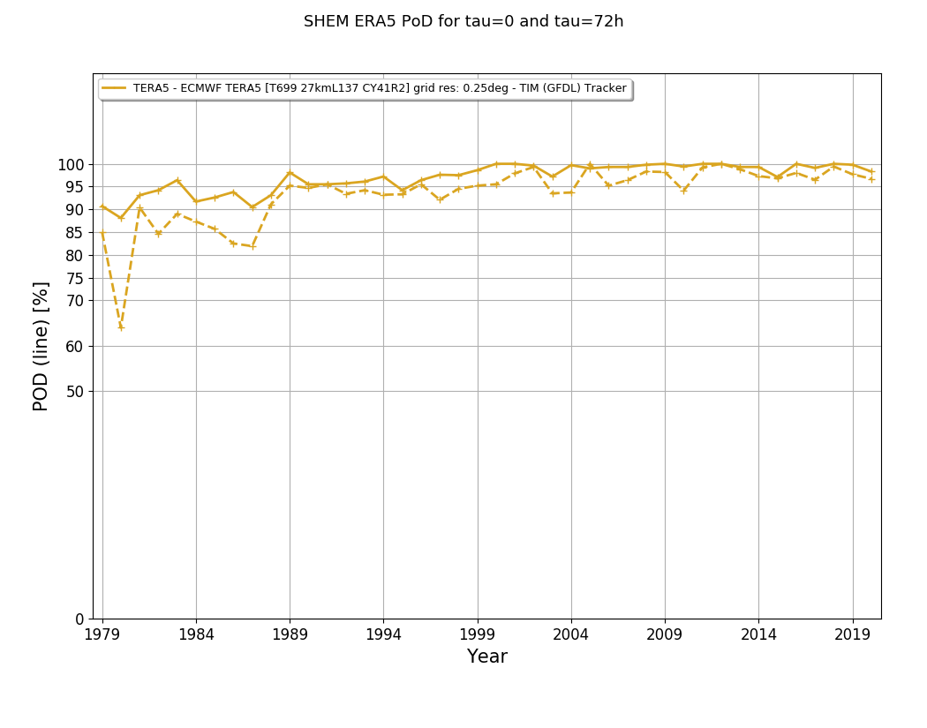
SHEM ERA5 PoD at tau=0 and 72 h
both tau0 and tau72 are way better than ERA40! and similar to NHEM

Slide 38
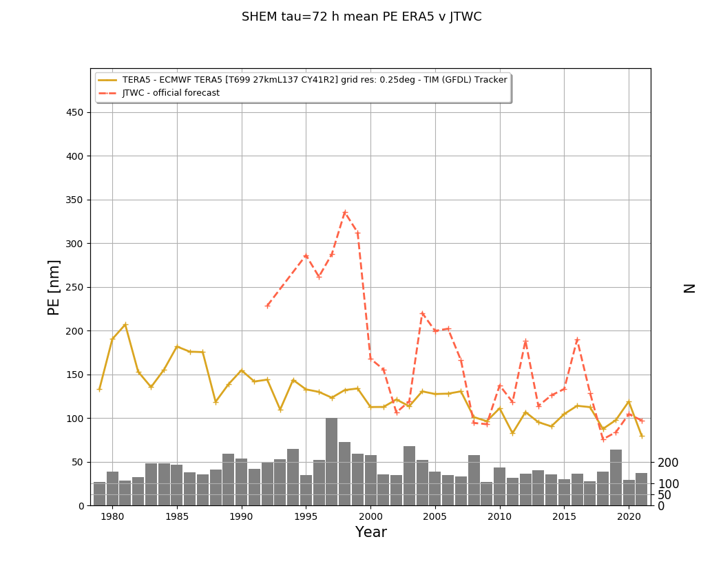
SHEM ERA5 v JTWC mean 72-h PE

Slide 39
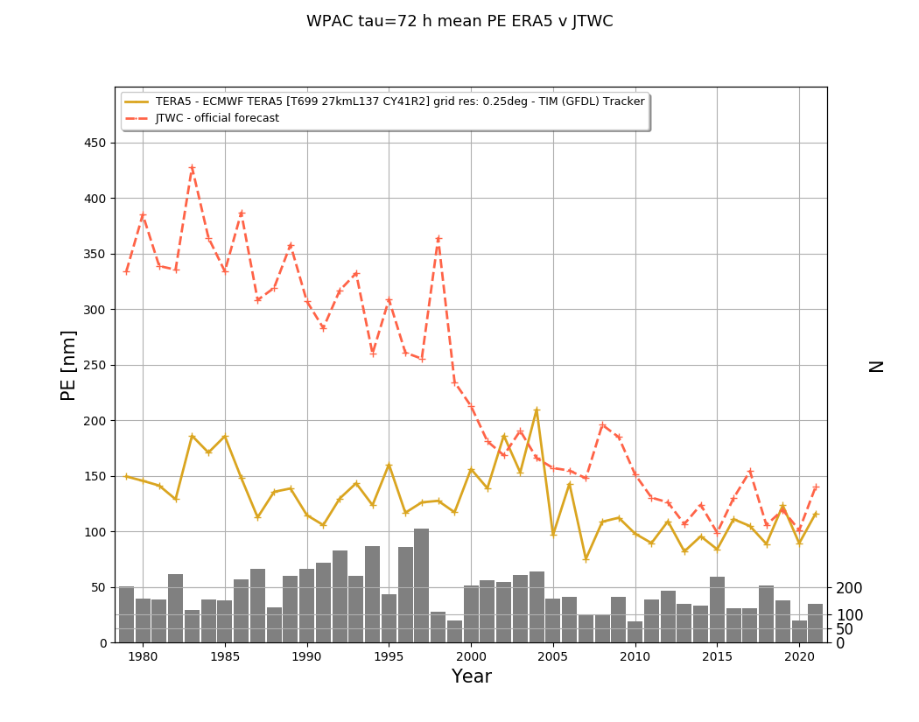
WPAC ERA5 v JTWC mean 72-h PE

Slide 40
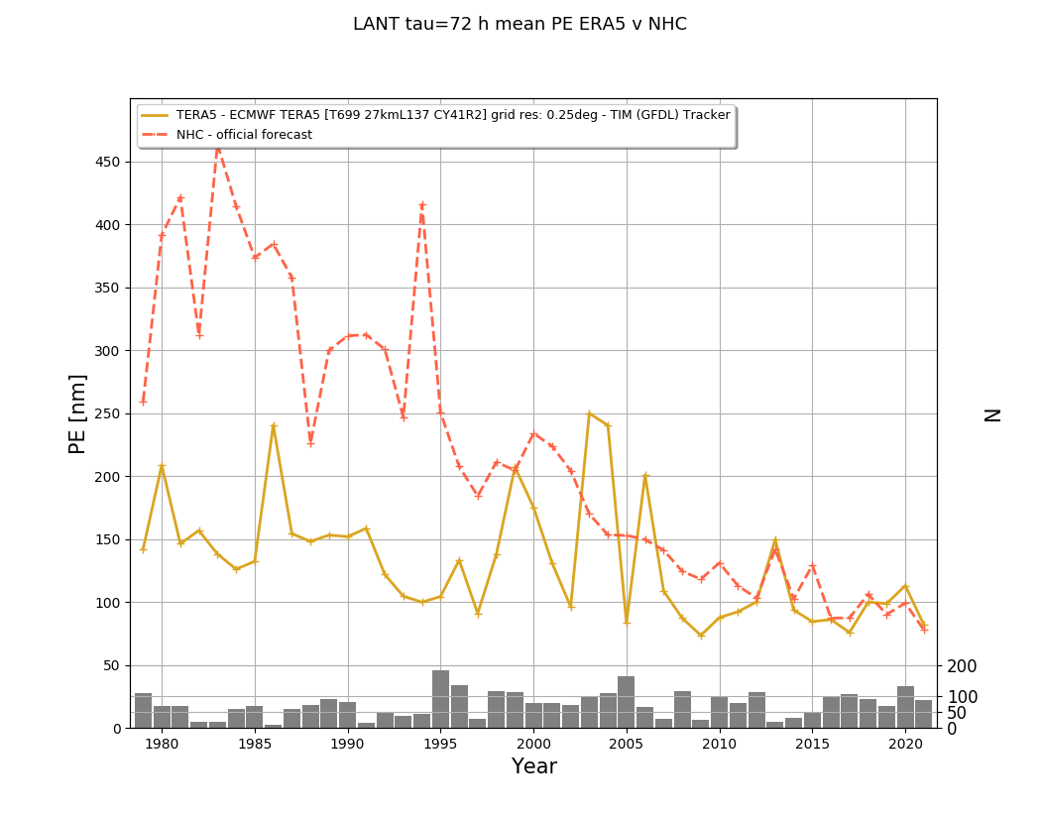
LANT ERA5 v NHC mean 72-h PE

Slide 41
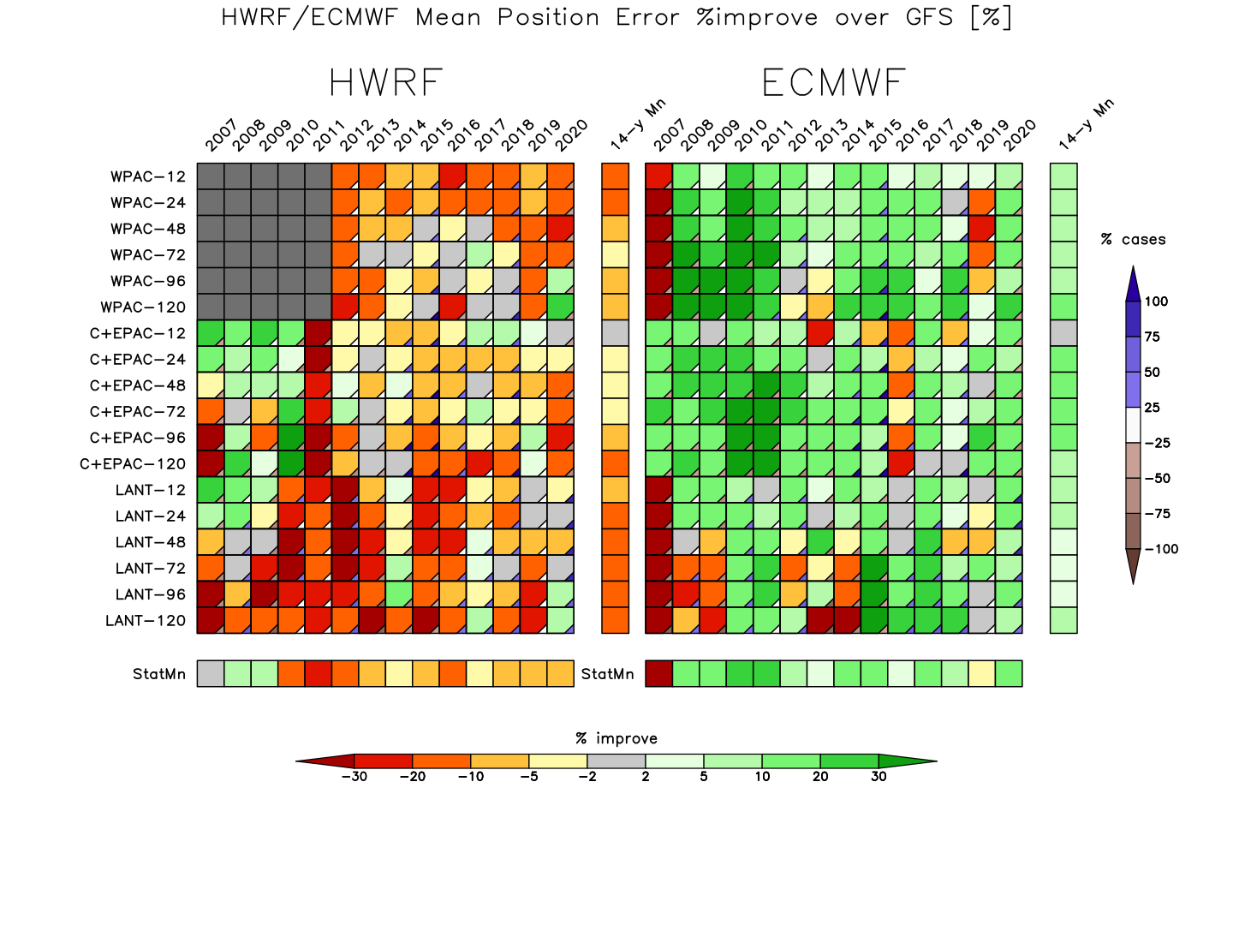
HWRF v ECMWF v GFS 2007-2020
% improve (lower) mean PE relative to GFS as a baseline

Slide 42
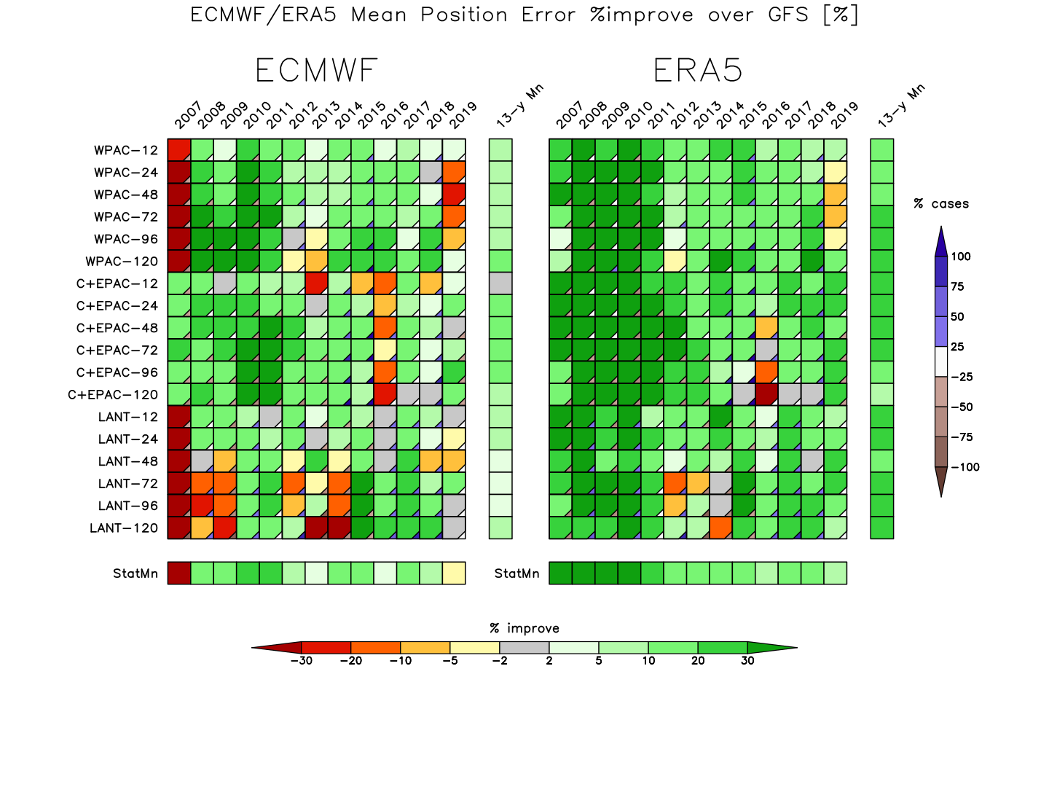
ECMWF v ERA5 v GFS 2007-2019
% improve (lower) mean PE relative to GFS as a baseline

Slide 43
concluding remarks…
the super Best Track brings all elements of my TC & NWP processing/diagnostics & data for TC NWP development – my magnus opus
ERA5 TC forecasts are outstanding ➔ useful for long-term TC variability studies especially 1990-2021…
JMA GSM had some good moments in the atLANTic
the entire set of s/w and data live on climateb.aori.u-tokyo.ac.jp

