Slide 1
if this is my last/penultimate TCC talk…
TC forecasting = 0.1*(TC meteorology)
wxmap2.com is my personal domain that contains 40+ years of TC & NWP data processing/analysis for both forecasting and meteorology – highly constrained by real JTWC/NHC operations
a big どうもありがとうございました (thanks) to JTWC (NHC) for helping make wxmap2.com a unique and powerful tool for my current science applications:
  WAF paper on TC forecast metrics
  super Best Track to be built at 東京大学 (U of Tokyo)…

Slide 2
wxmap2.com – TC/NWP data interface
TC Forecast Metrics & BT++
Mike Fiorino
Commander, United States Navy (retired)
B.S. (’75 PSU), M.S. (’78 PSU), Ph.D. (’87 NPS) all in Meteorology mfiorino@gmu.edu
George Mason University, Fairfax VA
Atmosphere Ocean Research Institute, 東京大学 Chiba Japan
University of Colorado Boulder CO
Earth System Research Laboratory, Boulder CO
National Hurricane Center, Miami FL
Joint Typhoon Warning Center, Pearl Harbor HI
Lawrence Livermore National Laboratory, Livermore CA
European Centre for Medium-Range Weather Forecasts, Shinfield Park, Berskshire, UK
Meteorological Research Institute – Japan Meteorological Agency, Tsukuba JAPAN
Space and Naval Warfare Systems Command, Arlington VA
NASA Goddard Space Flight Center, Greenbelt MD
National Centers for Environmental Prediction, Camp Springs MD
Naval Postgraduate School, Monterey CA
Fleet Numerical Meteorology and Oceanography Center, Monterey CA
Naval Research Laboratory, Monterey CA
Atlantic Oceanographic and Meteorological Laboratory, Miami FL
Pennsylvania State University, University Park PA

Slide 3
a famous Bill Grayism…
“This is all well and good Mike…
but why are you doing this?”

Slide 4
that’s a good question Bill…
not for $ (I’m pro bono at GMU)…a geek’s idea of a good time
I’ve been a JTWC fanboy since 1981(NRL/FNMOC/USN(RC))
operational experience at both JTWC (qualified as a TDO) and NHC (I was in Charlie Neumann’s billet) deeply informs my science, modeling and TC data interfaces (WxMAP)
prove Bob Falvey wrong (he’s been trying to kill WxMAP since at least 2015) – it’s not going anywhere…
the sum of my 40+ years is encapsulated in wxmap2.com both the backend (all the TC/NWP processing) and the public-facing web
wxmap2.com will be the basis of the super Best Track (BT++) that will be built at 東京大学 starting in 202109?

Slide 5
BLUF and there will be some homework for JTWC/NRL
wxmap2.com – original JTWC WxMAP (2001-) and FNMOC (1997-present)
  the data interface was built for forecasting –
  prime objective – get the best and most important NWP in front of the TDO to view the critical meteorology in less than 5 minutes
  contains all the processing/models used in my research/meteorology
TC forecast metrics – application of wxmap2.com
  Charlie Neumann was 90% correct that Forecast Error ≈ Position Error
  2007-2020 NHEM comparison of HWRF v GFS v ECMWF HRES & ERA5
super Best Track or BT++
  BIG purpose QUERY e.g., ‘mean shear 24-h before formation in LANT’

Slide 6
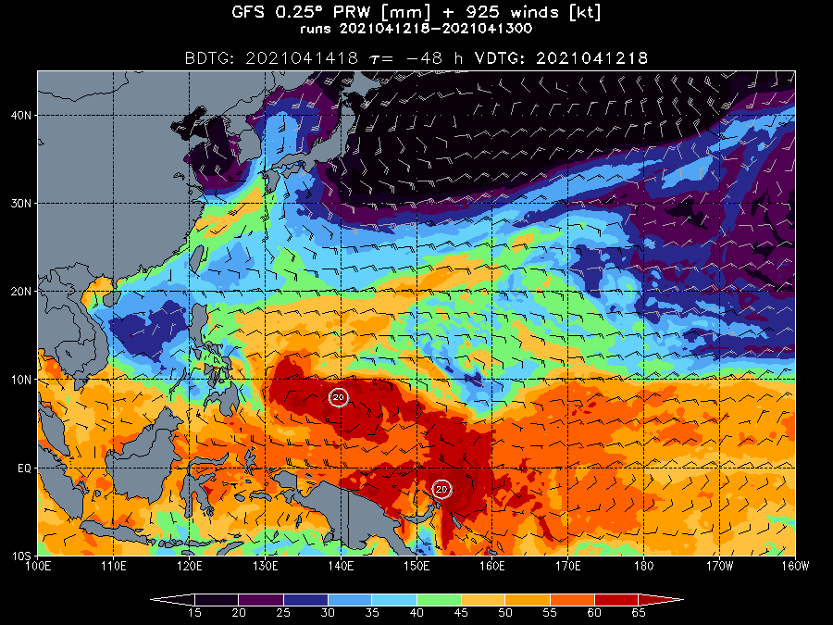
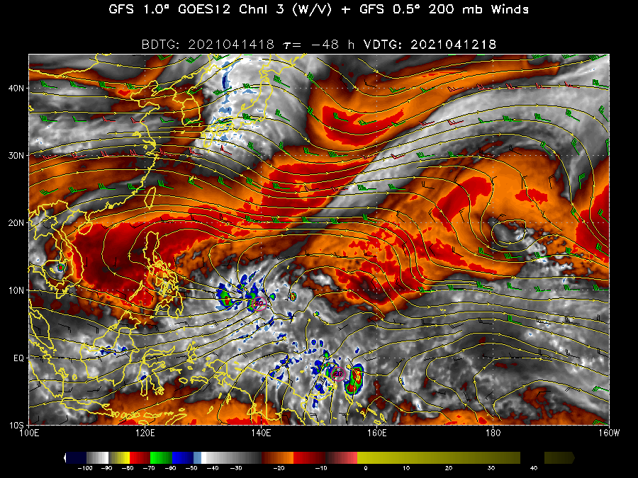
need a graphics break…how I do daily SA
2021041418 precip H2O

Slide 7
need a graphics break…how I do daily SA channel 3 (w/v) 0.25 deg GOES GFS imagery (CIRA color bar)

Slide 8
wxmap2.com
models
  JMA GSM since 202007 (1.25 deg grids)
  ECMWF HRES since 202001 (0.25 and 0.10 deg grids)
  GFS ~ 0.25 deg; CGD.ca ~ 0.15 deg; NAVGEM ~ 0.5 deg
wxmap2.com – webs
  http://jtdiag.wxmap2.com – ‘diagnostic file’ tables/plots of forecast-critical vars sync’d to JTWC/NHC operations
  http://maps.wxmap2.com – JTWC wxmap2 + 0.25deg GFS GOES
  http://tcgen.wxmap2.com – TC genesis
  http://tceps.wxmap2.com – process trackers from UKMO/ECMWF/NCEP/CGD ensembles
  http://tctrkveri.wxmap2.com – new one with model/ops tracks and verification

Slide 9
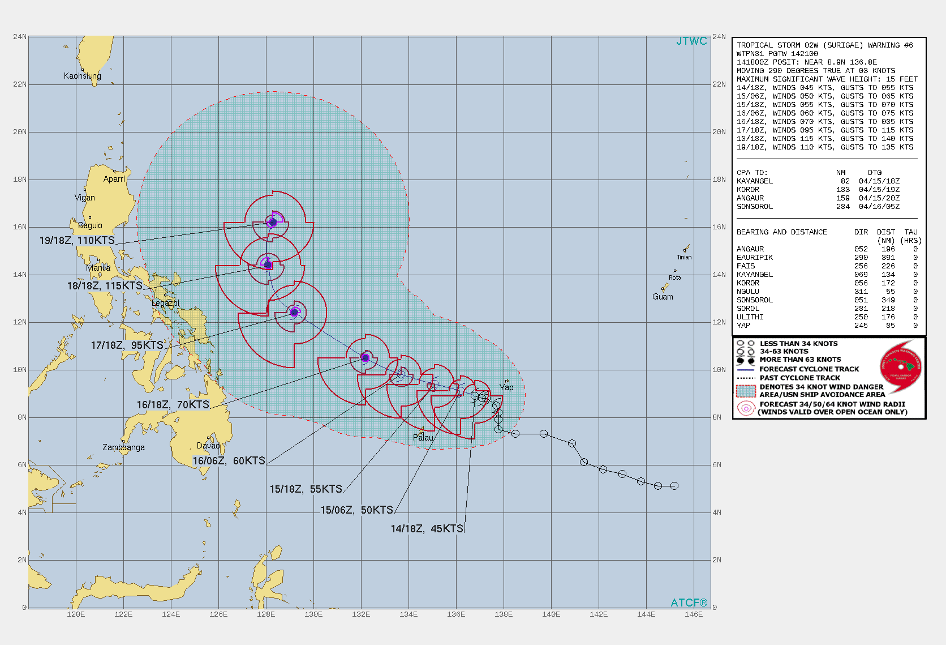
http://jtdiag.wxmap2.com
02W JTWC 2021041418 warning

Slide 10
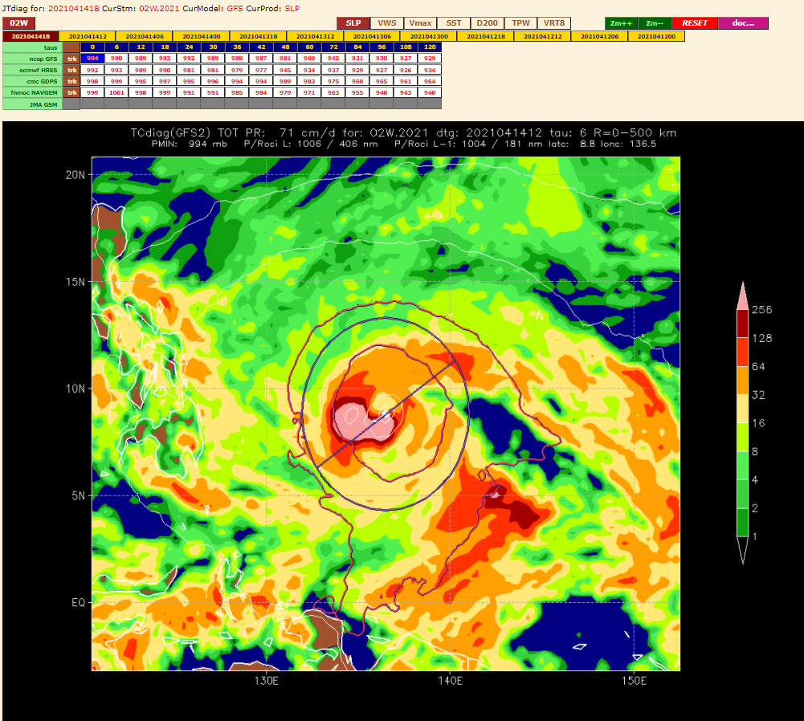
http://jtdiag.wxmap2.com
02W JTWC 2021041418 warning

Slide 11
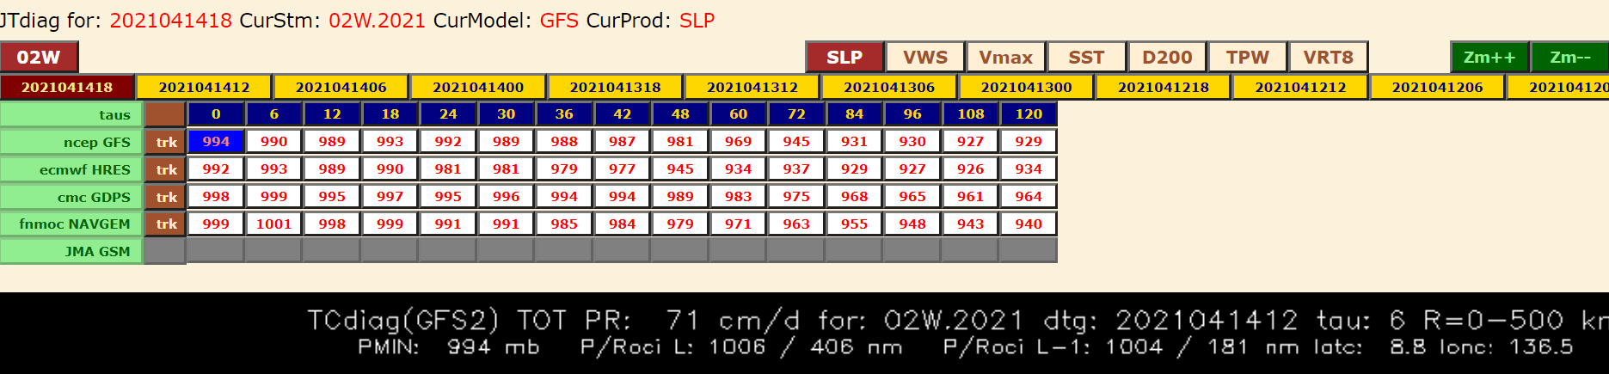
http://jtdiag.wxmap2.com
ROCI/POCI calculated using the lat,lon of the contours (GrADS trick)
ROCI/POCI 1006mb/406 nmi
ROCI/POCI L-1 1004mb/181 nmi

Slide 12
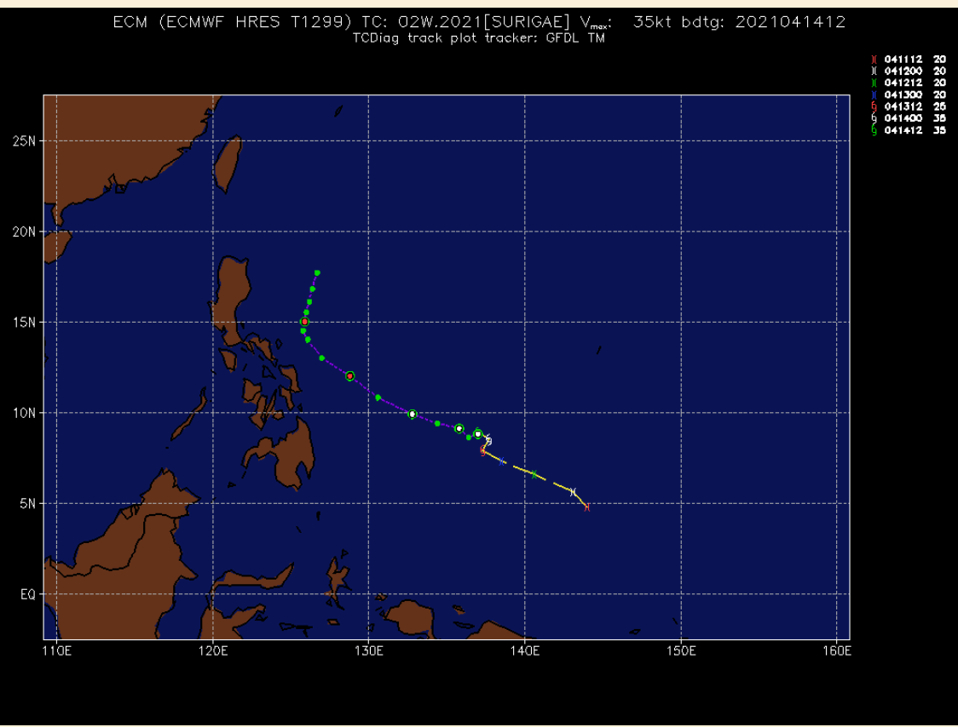
http://jtdiag.wxmap2.com
02W JTWC 2021041418 warning
trk
button

Slide 13
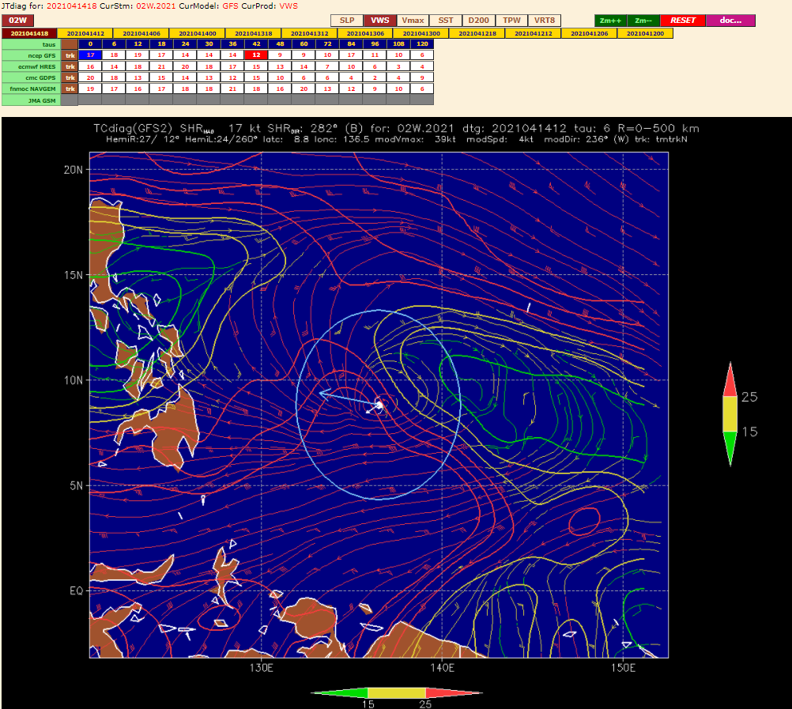
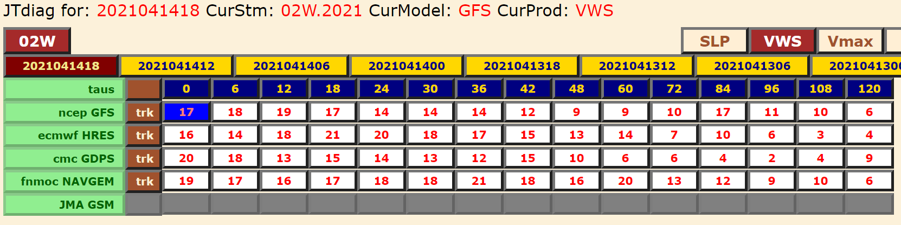
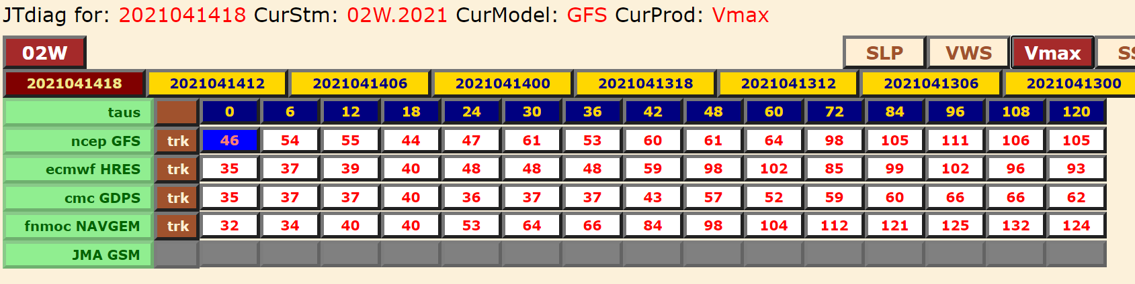
http://jtdiag.wxmap2.com – VWS & VMAX
02W JTWC 2021041418 warning
VWS < 15 kts ~ tau36
HRES Vmax → 98 kt at tau 48

Slide 14
http://jtdiag.wxmap2.com – VWS
02W JTWC 2021041418 warning
no vortex removal
wind barbs and contours colorized as CIMSS (good <= 15 kts)
blue circle shows how the mean calculated (500 km)

Slide 15
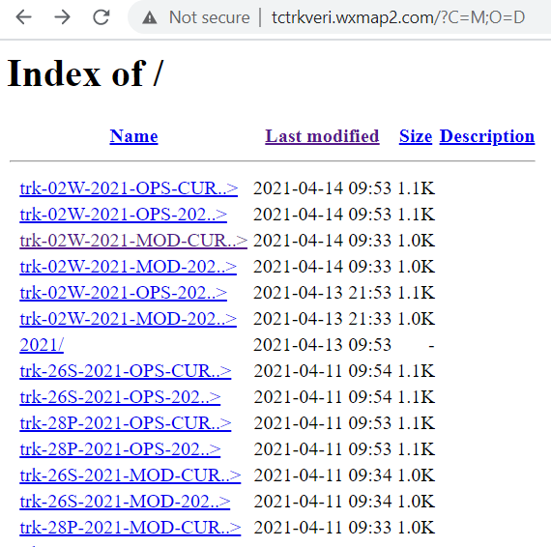
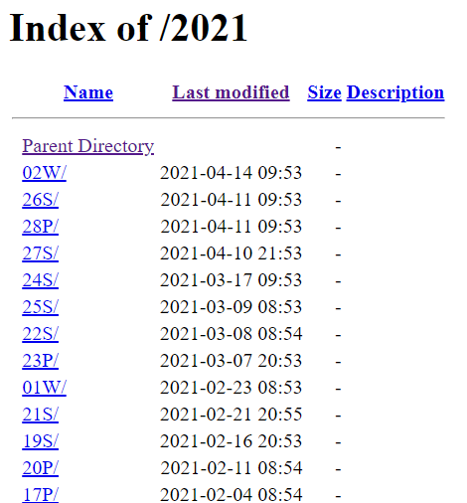
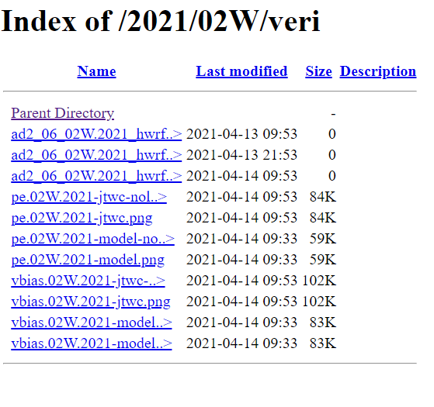
http://tctrkveri.wxmap2.com interface incomplete…but…mostly for SA
http://tctrkveri.wxmap2.com/trk-NNB-YYYY-MOD-CUR.htm
http://tctrkveri.wxmap2.com/trk-02W-2021-MOD-CUR.htm
http://tctrkveri.wxmap2.com/trk-02W-2021-OPS-CUR.htm

Slide 16
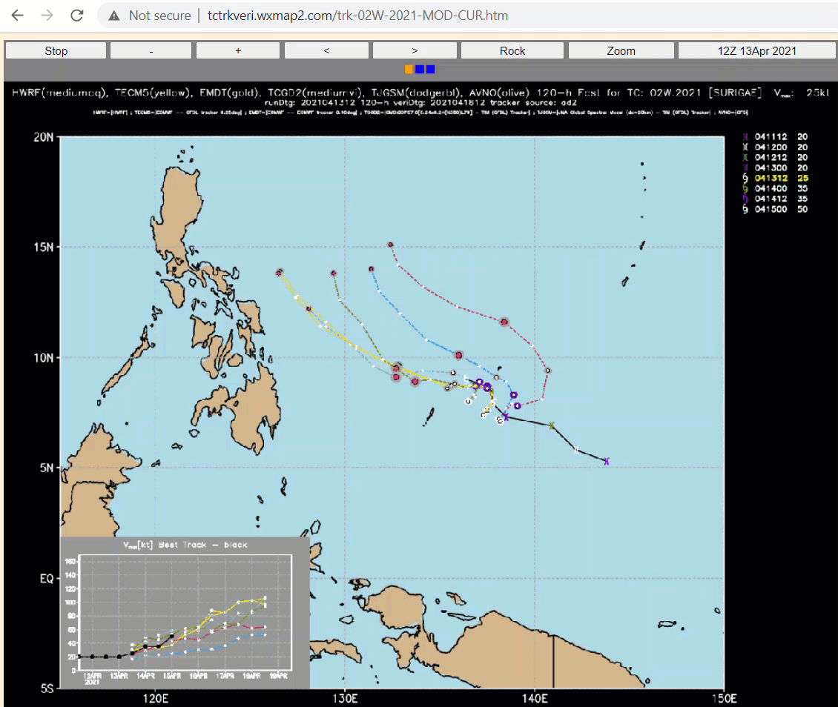
http://tctrkveri.wxmap2.com
MOD → raw tracker output
http://tctrkveri.wxmap2.com/trk-02W-2021-MOD-CUR.htm

Slide 17
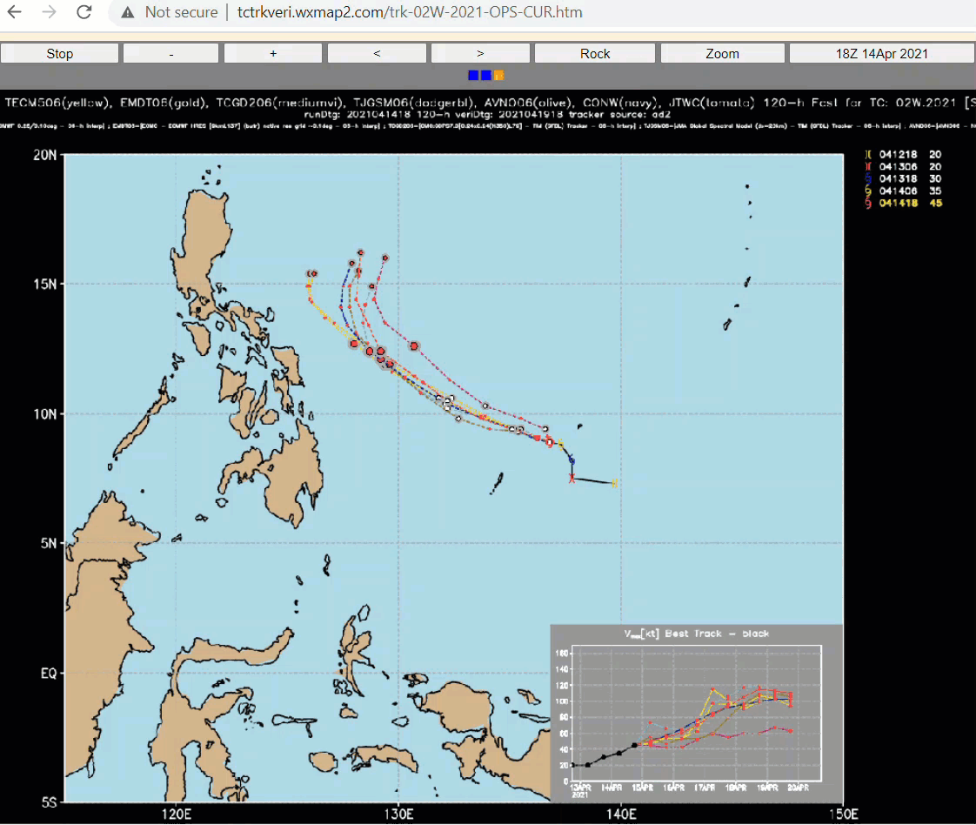
http://tctrkveri.wxmap2.com
OPS → 6-h interp of models + JTWC + CONW
http://tctrkveri.wxmap2.com/trk-02W-2021-OPS-CUR.htm

Slide 18
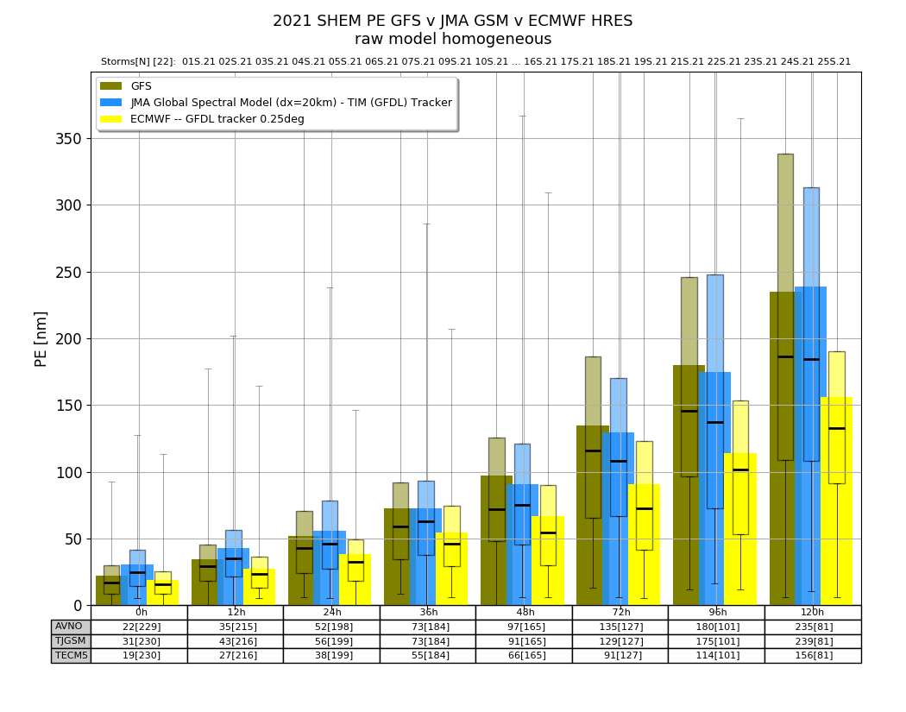
JMA GSM 2021 SHEM PE

Slide 19
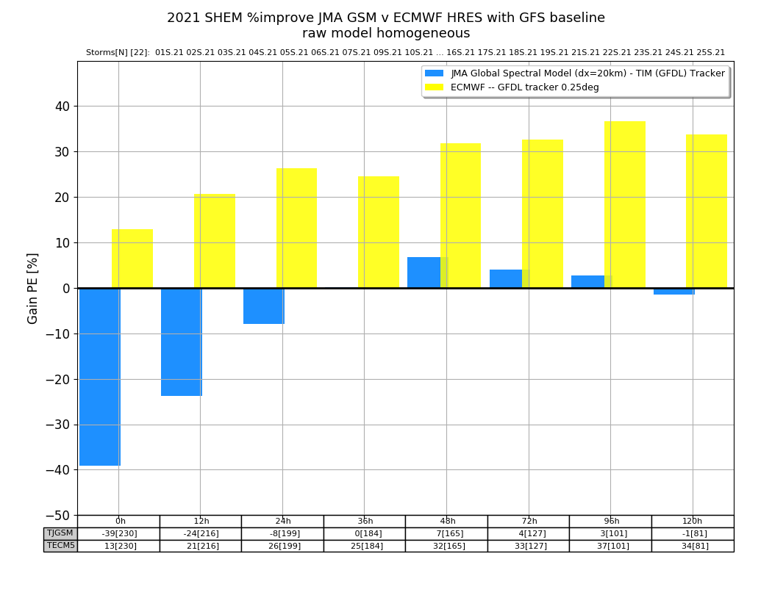
JMA GSM v ECMWF 2021 SHEM
%improve (lower PE) with GFS baseline

Slide 20
STY ABBY 1983 when I personally experienced the direction stuff flows…to the lowest person…
Most consequential typhoon since Halsey’s encounter in 1944 (cobra) and ’45 (viper)?
  COMNAVFORJAPAN was highly PO’d at the1984 annual typhoon conference (New Sanno) – quite a sight to see O6s being chewed out big time by a Flag officer…
  TCM 90 and big push by ONR for improved modeling…
  my PhD thesis on beta gyre dynamics…
was the failure of the dynamical models of the day (OTCM/NTCM) ‘lack of obs’ or modeling?
my opinion: 99% modeling … data assimilation is a model development process whose byproduct is an analysis for forecasting

Slide 21
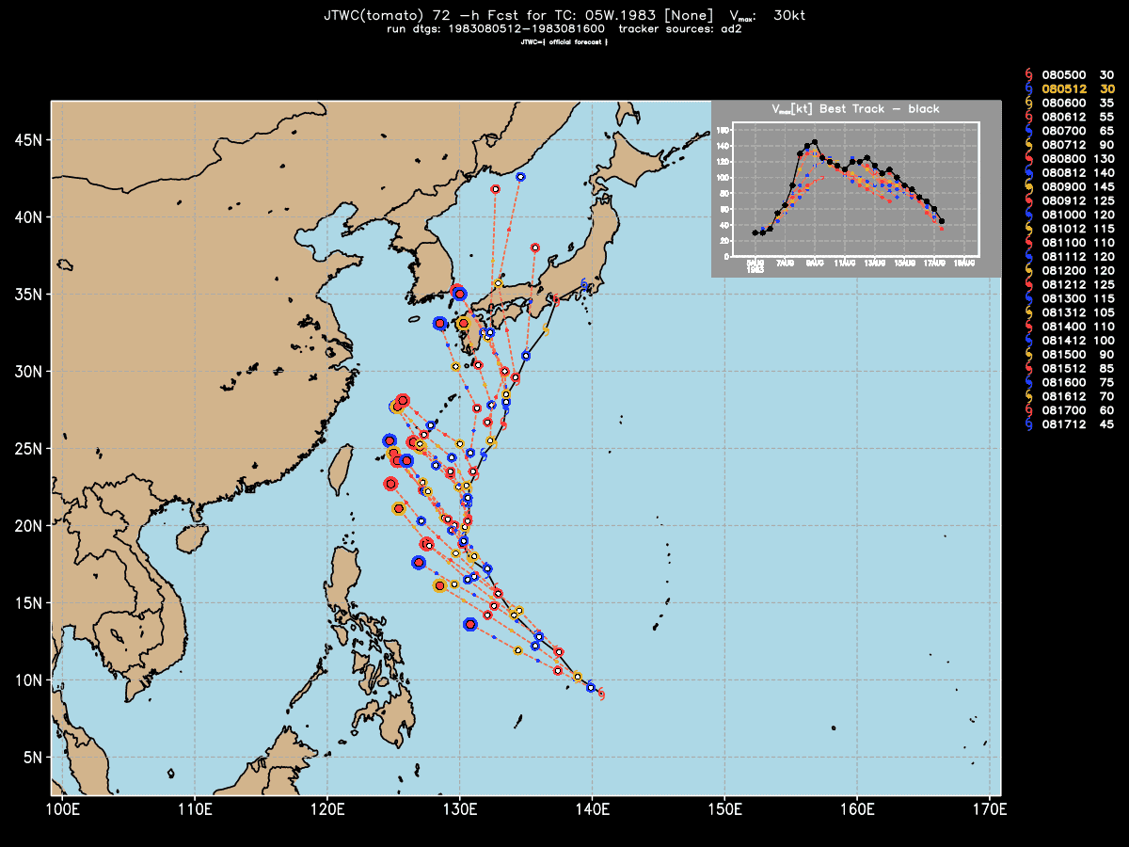
05W.1983 JTWC forecasts
080712- 081512 > 65 kts
CNFJ lost ½ summer aviation training days…unhappy camper

Slide 22
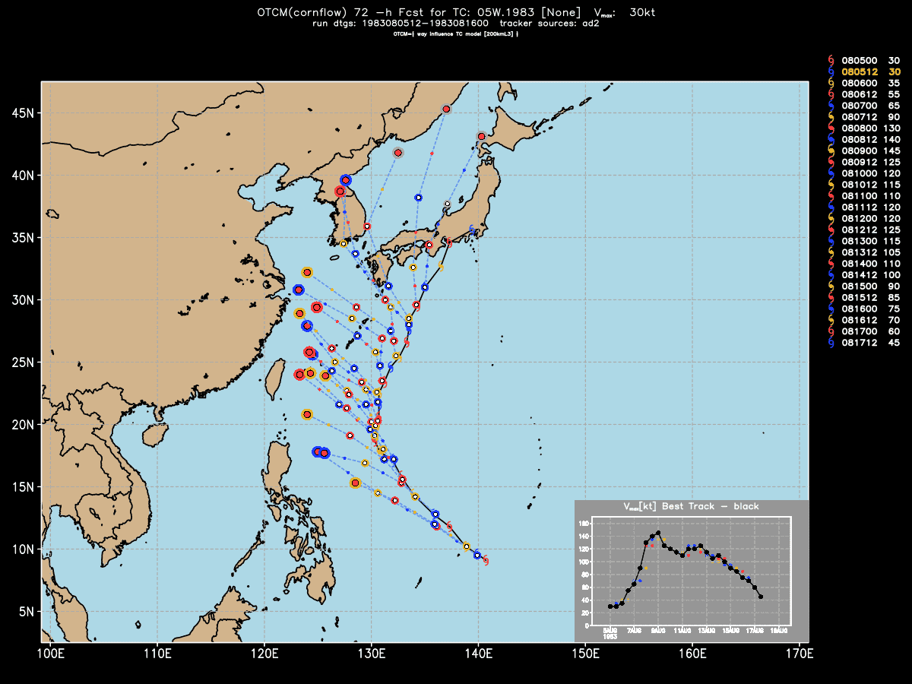
05W.1983 OTCM forecasts

Slide 23

05W.1983 NTCM forecasts

Slide 24
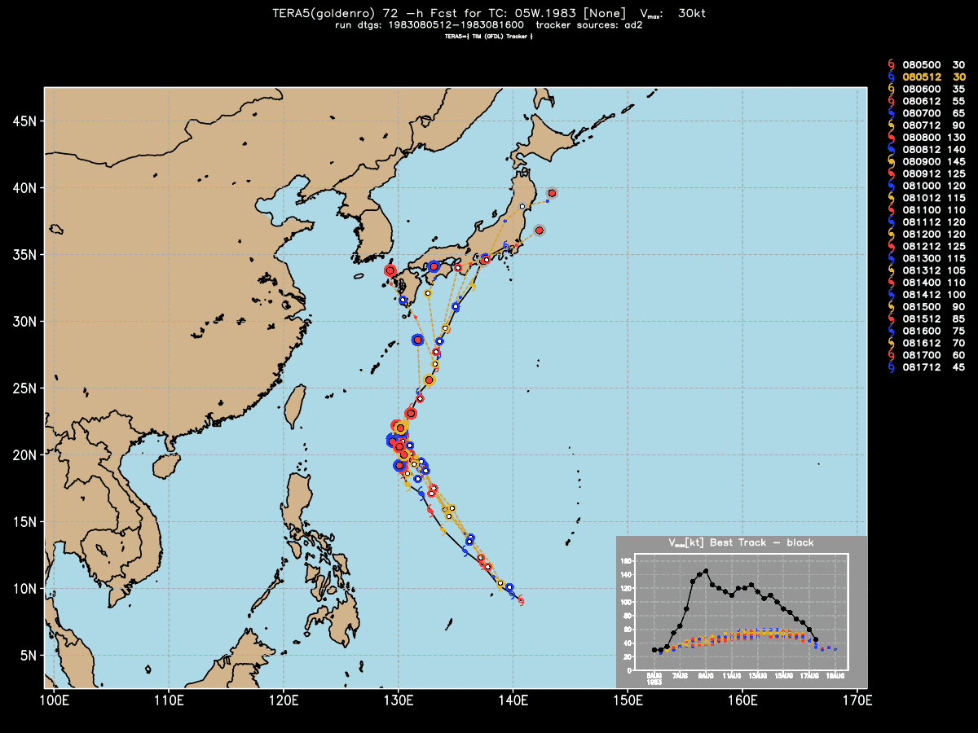
05W.1983 ERA5 forecasts
track – great
intensity – rubbish

Slide 25
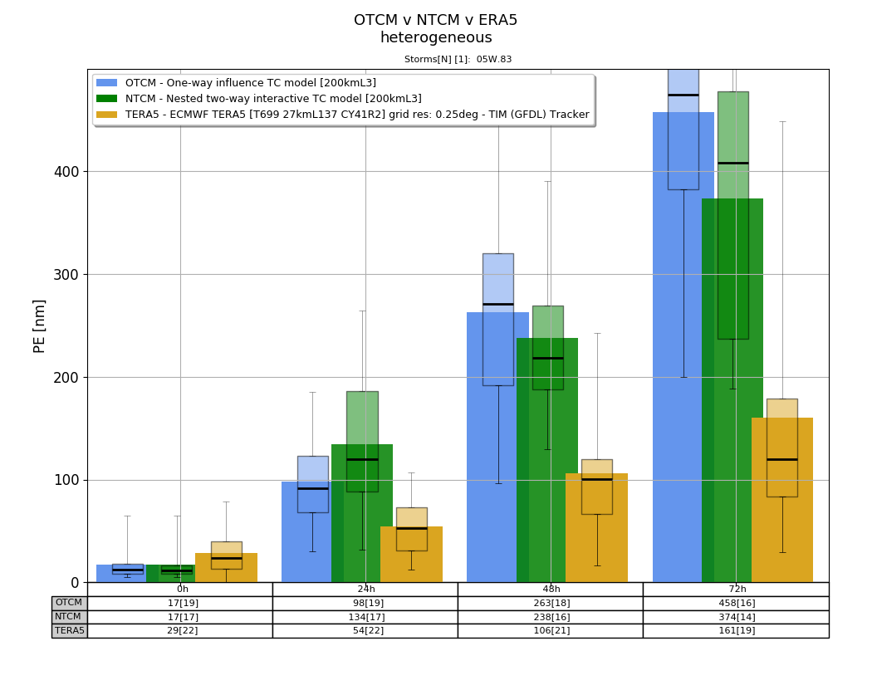
05W.1983 PE verification
72-h mean PE
ERA5 – 160 nmi
OTCM – 460 nmi
NTCM – 374 nmi

Slide 26
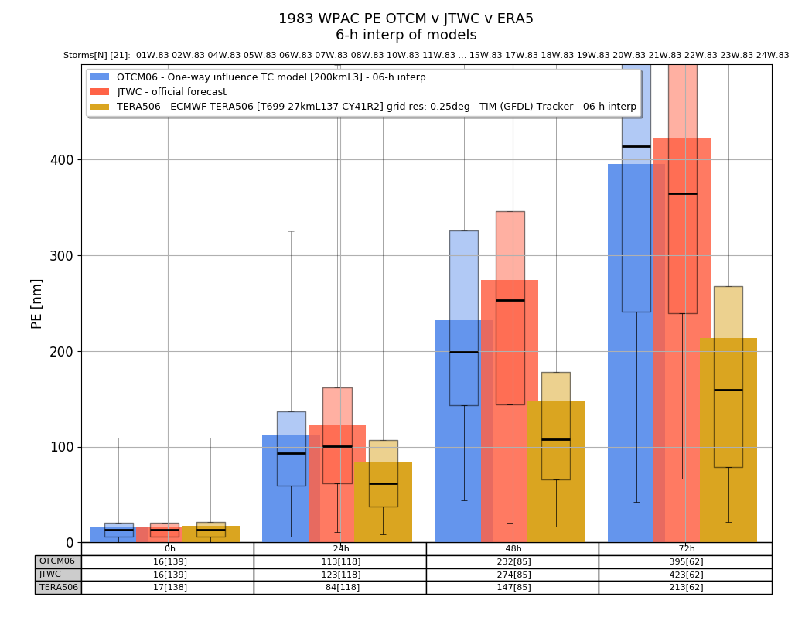
WPAC 1983 PE
6-h bias corr of models -- homogeneous
72-h mean PE
ERA5 – 213 nmi
OTCM – 423 nmi
JTWC – 395 nmi

Slide 27
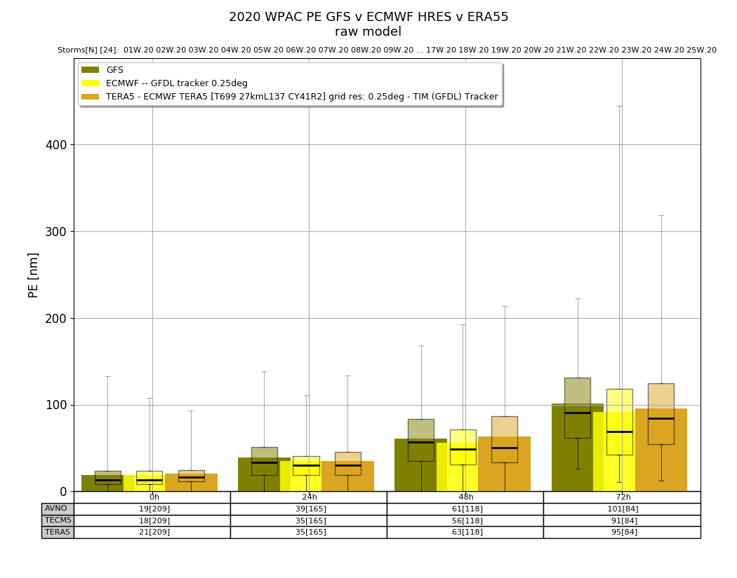
WPAC 2020 PE homogeneous
72-h mean PE
GFS – 101 nmi
HRES – 91 nmi
ERA5 – 95 nmi

Slide 28
A TC forecast is … TC forecast error (FE) is …
02W JTWC 2021041418 warning
TC forecast is the sfc wind field
PE = Position Error
IE = Intensity Error
current PE/IE metrics not directly related to wind field…

Slide 29
A TC forecast is … TC forecast error (FE) is…
02W JTWC 2021041418 warning
TC forecast is the sfc wind field
PE = Position Error
IE = Intensity Error
current metrics not directly related to wind field
Charlie Neuman:
FE = PE
NWS – HU/TS warnings/watches based on onset of 34 kt winds
INDOPACOM – no-sail zone based on R34 + 5-y mean JTWC PE(tau)
JTWC lowers PE → more space to fight (real operations)
FE should be related to the wind field forecast

Slide 30
a proposed TC FE defined as error in Integrated Kinetic Energy (IKE) of the sfc wind field >= 34 kts
suppose the forecast (FC) and best track (BT) R34 is symmetric and identical…
what happens when PE = 2*R34?
  no intersection of the FC & BT wind fields with V >= 34kts
  the onset of 34 kt winds is completely wrong, but more significantly the wrongness does not depend on intensity or IE…
  FE = 2*IKE in the BT

Slide 31
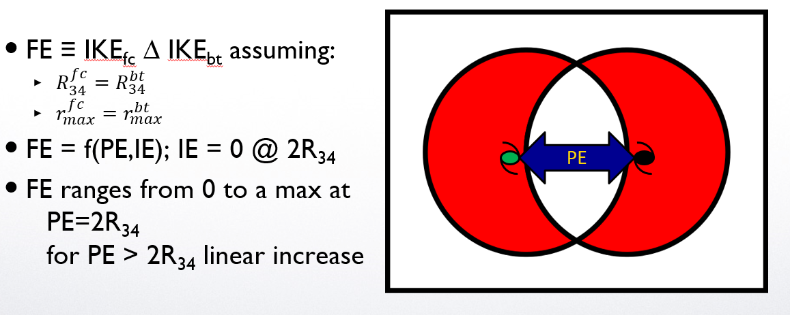
a proposed TC FE defined as error in Integrated Kinetic Energy (IKE) of the sfc wind field >= 34 kts
assumptions – lower limit in FE
  R34 is symmetric and is the same for both the FC and BT
  Rmax is the same for both FC and BT
  use Fiorino & Elsberry 1989 for symmetric wind profile – depends on a pair of (v,r) or (Vmax,Rmax) and (V34,R34)
FE=f(PE,IE)

Slide 32
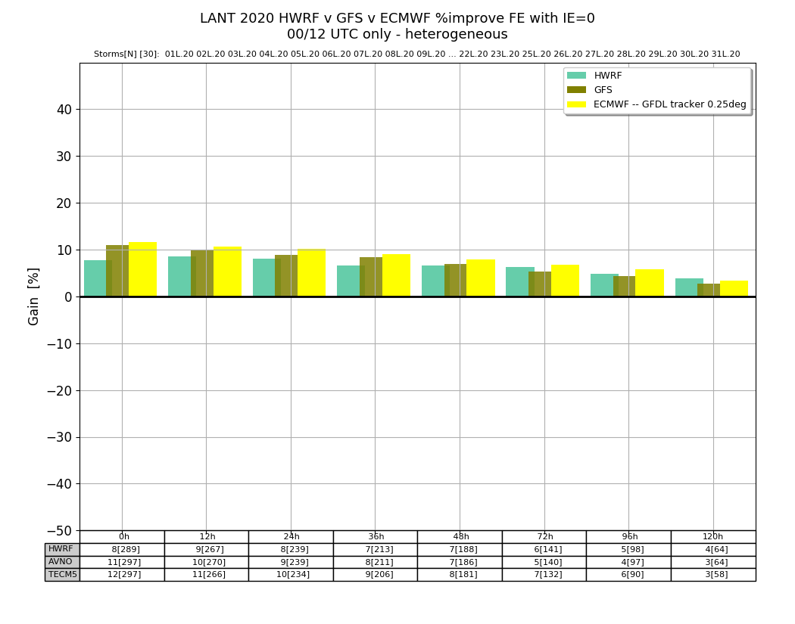
how does IE contribute to FE?
2020 LANT (31 storms)
HWRF v GFS v ECMWF (HRES)
% improvement in FE for a perfect intensity forecast (set IE=0 in the FE calculation)
~10% or Charlie Neumann was 90% correct that
FE=PE

Slide 33
a super Best Track or BT++
two reasons:
  query capability to answer question like “what is the mean shear 24-h before formation in WPAC in August?”
  my project at UofTokyo – build BT++ and add Japanese precip data
TC data – global pTC or 9X – 2007-2021+
  TC genesis studies require best track data before a storm develops or not…
  archive of all 9X a/bdecks from both JTWC/NHC since 2007 when I was TECHDEV @ NHC…
  when a new/different a/bdeck comes in…add to a .zip file…every state of a storm 9X and NN a/bdeck in operations…
ERA5 for NWP component of BT++ for shear etc…
CMORPH V1.0 1998-2020 – CPC hi-res 30 min precip analyses

Slide 34
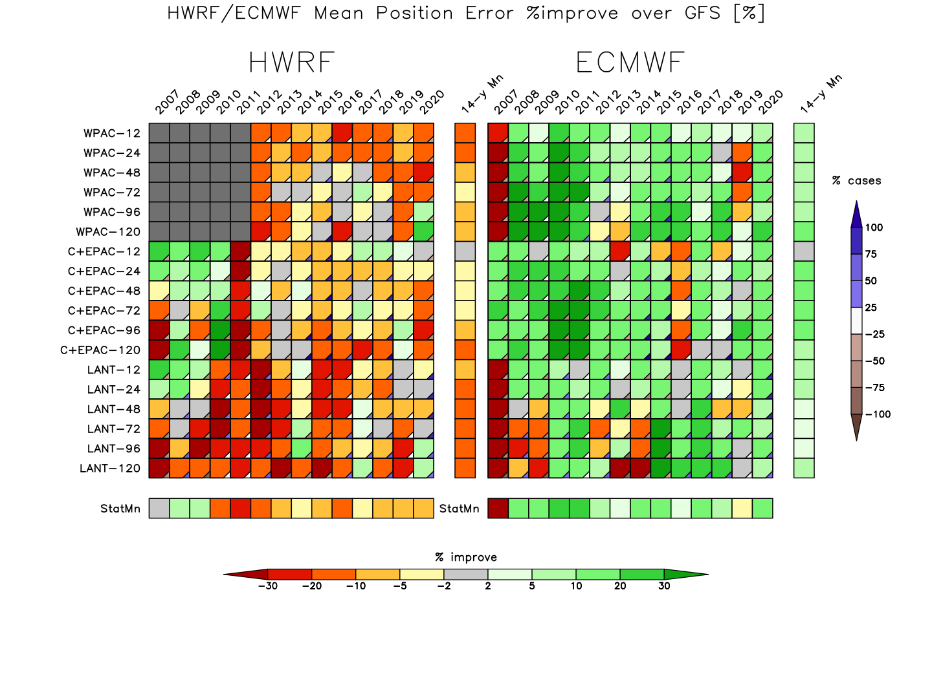
a super Best Track or BT++
ERA5 results that demonstrate it is LAG
Green→better than GFS
Red→worse than GFS
GFS baseline; 2007-2020; NHEM basins and taus
%improve over GFS PE: HWRF v ECMWF (HRES)

Slide 35
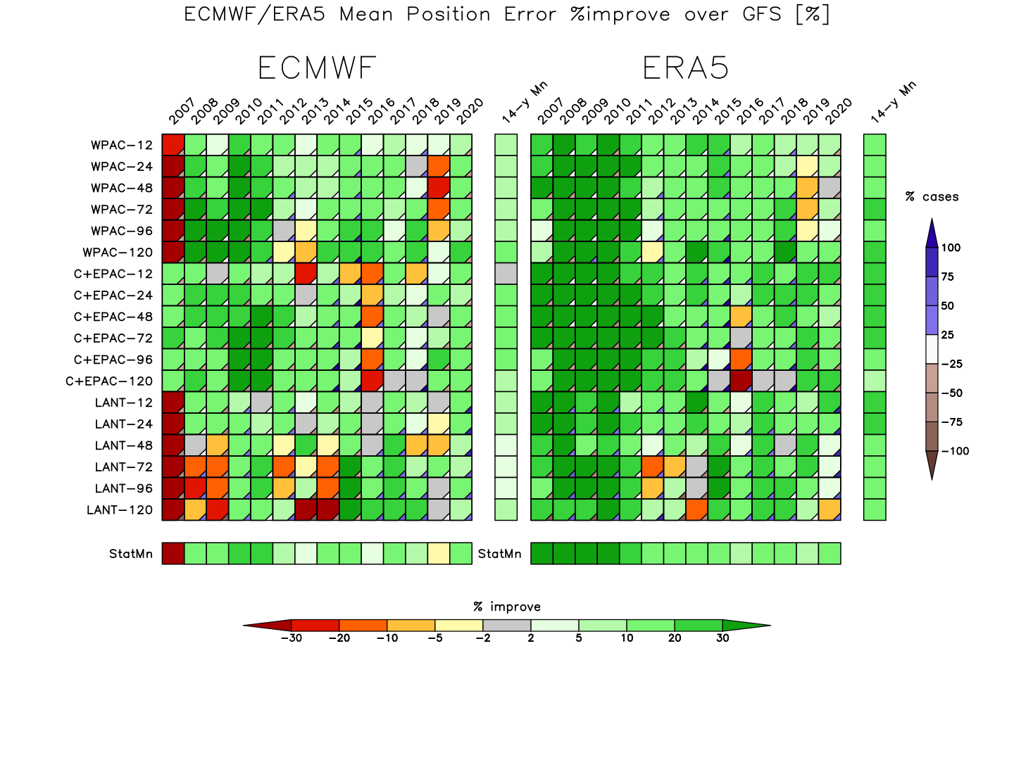
a super Best Track or BT++
ERA5 results that demonstrate it is LAG & 一番
Green→better than GFS
Red→worse than GFS
GFS baseline; 2007-2020; NHEM basins and taus
%improve over GFS PE: ECMWF (HRES) v ERA5

Slide 36
three wise quotes… everything I needed to know I learned at…USN/NWP
You’re only as good as what you measure
CAPT Vic Addison USN (ret)
CO FNMOC 200605
Forecast error = “Track Error”
Charlie Neumann (LT USNR and the father of US digital TC data)
NHC 1979
forecasting is the acid test of an analysis
Bob Kistler NCEP (father of US reanalysis)

Slide 37
takeaways…
interactive meteorology cannot be done in TC forecasting
  the forecasting time vise – NWP is always ready and 6 h behind, but to do the TC analysis…need to collect the most obs past the analysis time…pushes close to the +2:30 h to get the warning out…
  30 min to do science and if more than one storm…
  WxMAP type data interfaces will not go away – why FNMOC is still running my WxMAP the last 25 years (astounding to me) and why JTWC still using wxmap2.com since 2001…because it puts the modeling that should be used for forecasting front and center (the role of the modeler)
  wxmap2.com TC/NWP data interface is unique only because it was developed under real operational conditions
two applications
  analysis of TC forecast error
  super BT – a merge of all TC-related data from JTWC/NHC best tracks

Slide 38
homework for JTWC & NRL
can http://jtdiag.wxmap2.com be transitioned to MapRoom?
there are many instances of wxmap2.com
  stand-alone VM under VMware…
  https://sourceforge.net/projects/wxmap2/ (GPL license – open source)
  running on several of my PCs
  aorc.orc.gmu.edu
  ecmwf.int
  aori.u-tokyo.ac.jp
which diagnostics for BT++ and format?
  initial plan is to follow a/bdeck txt format except for many more columns

