Slide 1

A ‘superBT’ for TC Forecasting & Research Mike Fiorino Commander, United States Navy (retired) B.S. (’75 PSU), M.S. (’78 PSU), Ph.D. (’87 NPS) all in Meteorology mfiorino@gmu.edu George Mason University VA AORI University of Tokyo, 柏のは University of Colorado Boulder CO Earth System Research Laboratory, Boulder CO National Hurricane Center, Miami FL Joint Typhoon Warning Center, Pearl Harbor HI Lawrence Livermore National Laboratory, Livermore CA European Centre for Medium-Range Weather Forecasts Meteorological Research Institute – Japan Meteorological Agency, Tsukuba JAPAN Space and Naval Warfare Systems Command, Arlington VA NASA Goddard Space Flight Center, Greenbelt MD National Centers for Environmental Prediction, Camp Springs MD Naval Postgraduate School, Monterey CA Fleet Numerical Meteorology and Oceanography Center, Monterey CA Naval Research Laboratory, Monterey CA Atlantic Oceanographic and Meteorological Laboratory, Miami FL Pennsylvania State University, University Park PA

Slide 2

The Bill Gray Standard Seminar Question 20140401 AMS Hurr Conf San Diego
This is all well and good Mike…

Slide 3
The Bill Gray Standard Seminar Question 20140401 AMS Hurr Conf San Diego
This is all well and good Mike…
but why are you doing this?

Slide 4
The Bill Gray Standard Seminar Question 20140401 AMS Hurr Conf San Diego
This work is unfunded…
the real reason…

Slide 5
The Bill Gray Standard Seminar Question 20140401 AMS Hurr Conf San Diego
This work is unfunded…
the real reason…
Alzheimer’s avoidance😉
geeking -- TCs & NWP & computers
毎日日本語を勉強しています – I study Japanese every day to rewire my brain…

Slide 6
Acknowledgements
Yukari Takayabu-sensei
sponsoring my visiting professorship at U of Tokyo (“TouDai”)
Hans Hersbach, ECMWF
ECMWF computer account and access to ERA5 forecasts
Jim Kinter, COLA/GMU
sponsors my affiliated faculty position (essentially emeritus) at George Mason U since 2021

Slide 7
What’s a ‘superBT’? a partial theft from Krish’s ‘super ensemble’
superposition on to a TC best track data set of ancillary data from ERA5 (NWP – dynamics) and precipitation (thermodynamics)
three data set types:
genesis – add pre/potential TC positions – ‘pTCs’ or ‘seeds’ to the BT
2007-2024 for both developing and non-developing pTCs from operational files
formation rate and time to formation/dissipation
dynamical/thermodynamical differences between dev/non-dev pTCs
dynamics – ECMWF ERA5 reanalysis 00/12 UTC 10-d forecasts
thermodynamics – two hi-res satellite global precipitation analyses
GsMAP (Japan JAXA)
IMERG (NASA)
implementation – github project – V04 (1st beta)
2007-2022

Slide 8
some words of wisdom…
“Forecasting is the acid test of an analysis”
Bob Kistler, NCEP
father of American Reanalysis
NCEP/NCAR R1
ERA5 quality metrics:
PoD – Probability of Detection of TCs by the tracker
PE – Position Error – model TC track forecasts compared to the BT

Slide 9
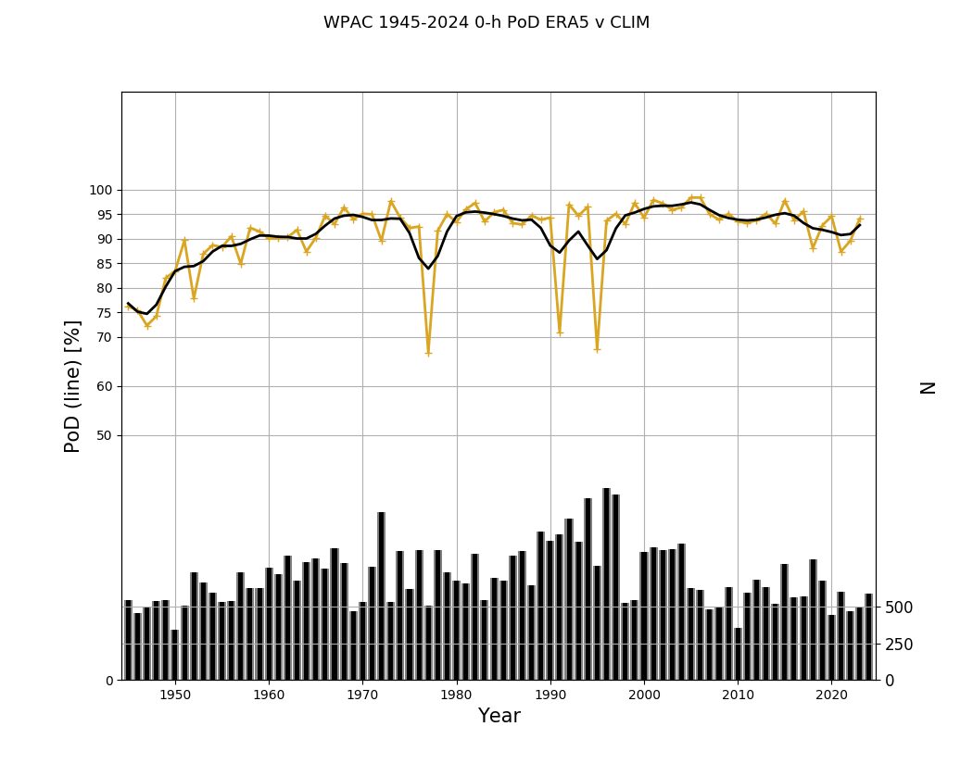
ERA5 TC forecasts – TCs in the analysis Probability of Detection (PoD) - WPAC 1945-2024 – TC central pressure assimilated 1945-1980
dropouts?
curious year-to-year variability

Slide 10
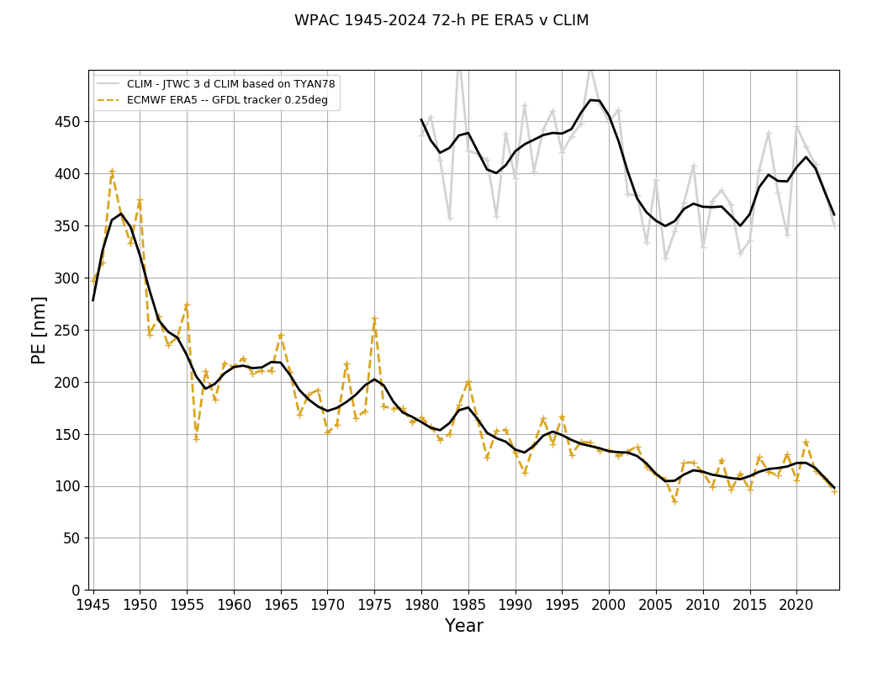
ERA5 TC forecasts – 72-h Position Error WPAC 1945-2024 – TC central pressure assimilated 1945-1980
ERA5 – steady reduction from ~ 190 nm in 1960s to ~ 110 nm in the 2000s
and much better than Climatology ~ 375 nm!

Slide 11
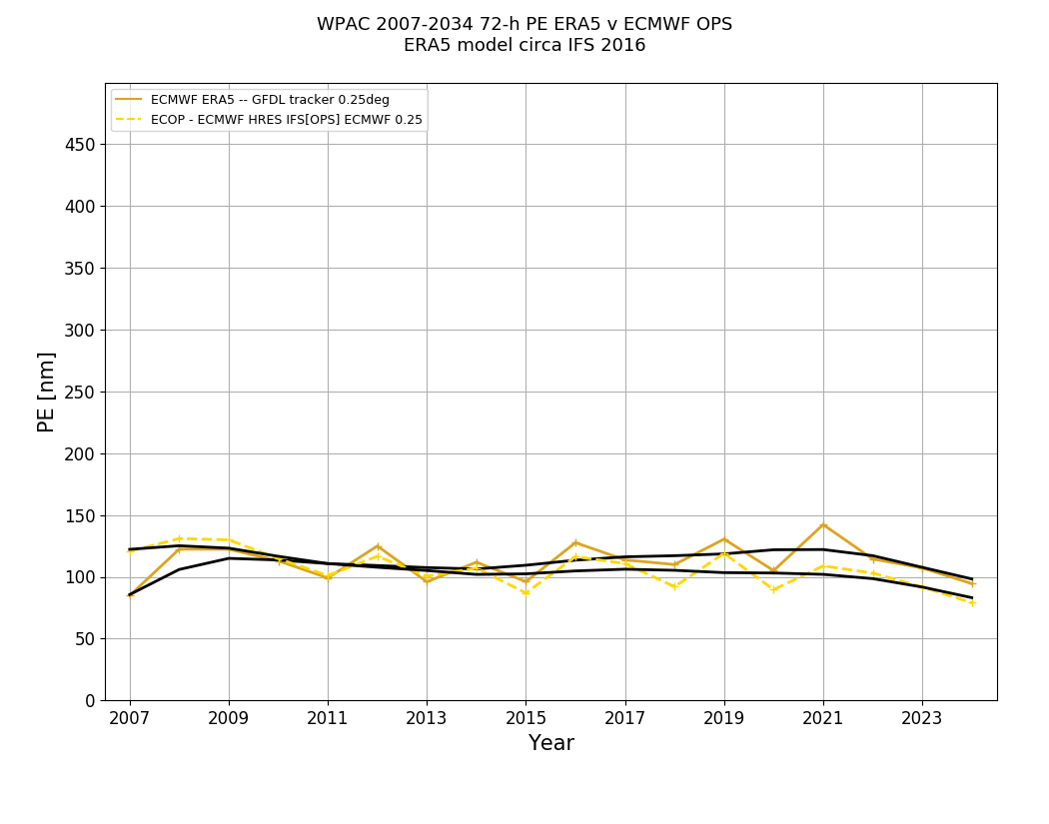
ERA5 v ECMWF OPS – TC forecasts – 72-h PE WPAC 2007-2024 – ERA5 model is the Ops model ~ 2016
ERA5 better OPS 2007-2015 (lower PE)
~ 110 nm and ~ 90 nm in 2024!

Slide 12
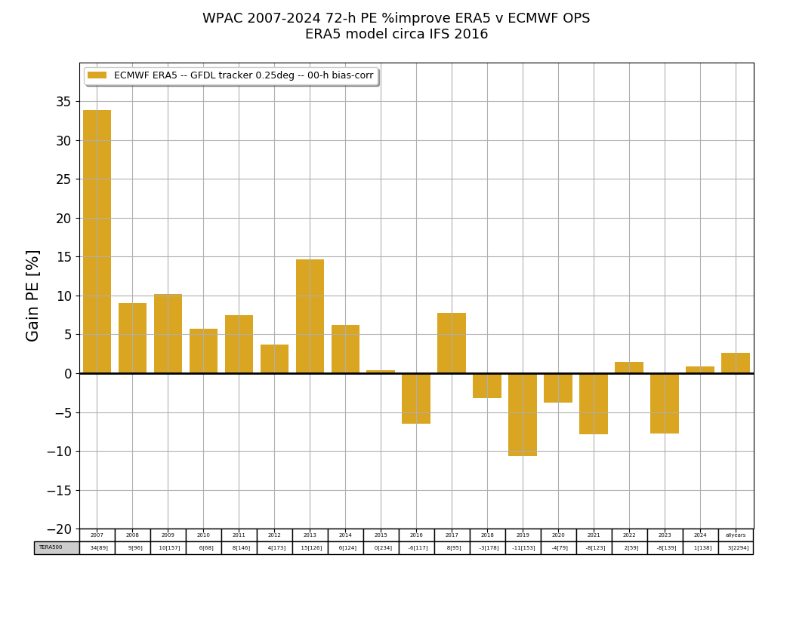
ERA5 %improve over OPS – TC forecasts – 72-h WPAC 2007-2024 – ERA5 model is the Ops model ~ 2016
ERA5 better OPS generally better 2018-2024 in WPAC

Slide 13
TC genesis
All TCs start as ‘pTCs’ or pre/potential TCs
TC genesis is defined as:
intensity >= 35 kts
time of first warning –
JTWC is required to issue warnings on ALL TCs regardless of intensity (max wind)
NHC now issues pTC warnings/advisories before a pTC becomes a TC
TC forecast problem = when to start warnings issued on an existing pTC (labeled 90-99 or ‘9X’) becomes a TC (numbered 01-50 or ‘NN’)
pTC tracks are only recently maintained at JTWC/NHC
the superBT has curated pTC data set is based on operational files 2007-2024 (and present)

Slide 14
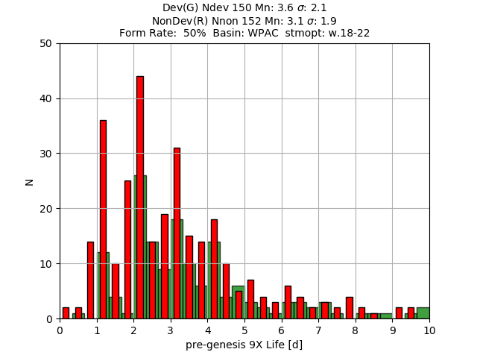
Formation Rate & Time to Genesis/Dissipation WPAC 2018-2022
Form Rate: 50%
(50% of all 9X become NN)
T-Gen: 3.6 d (9Xdev)
T-Diss: 3.1 d (9Xdev)

Slide 15
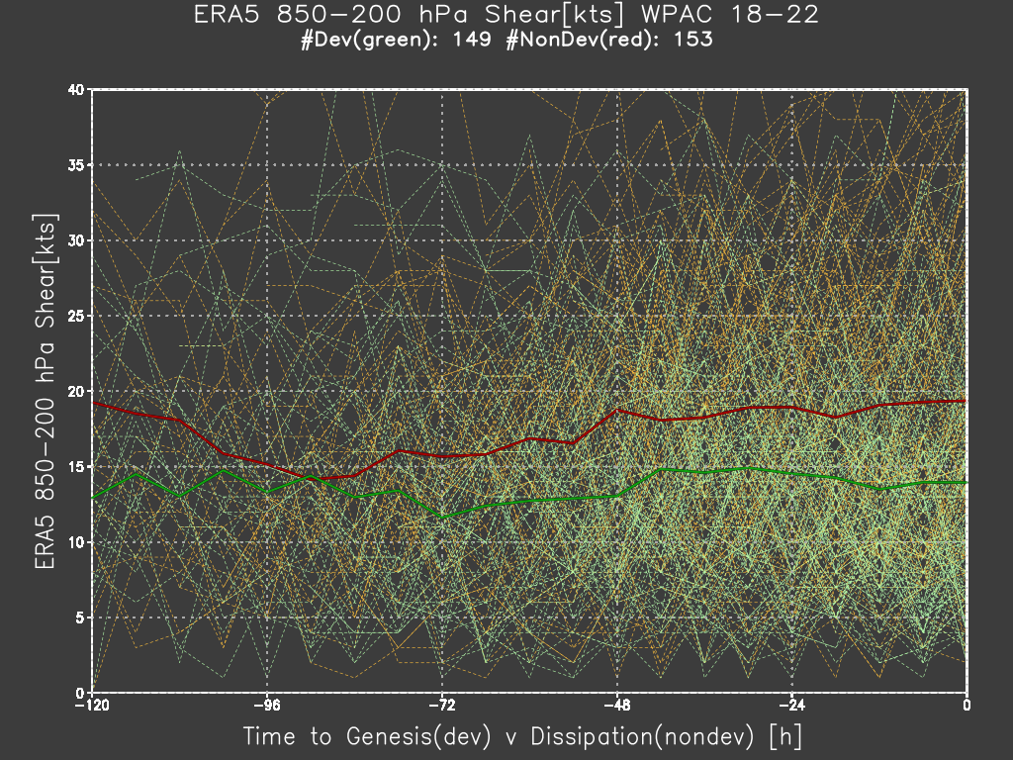
Dynamics – Vertical Wind Shear – diff between 9Xdev & 9Xnon WPAC 2018-2022

Slide 16
Dynamics – Vertical Wind Shear – diff between 9Xdev & 9Xnon WPAC 2018-2022
Red line – 9Xnon
Green line – 9Xdev
Xover ~ 84 h (3.4 d)
VWS ~ 15 kts

Slide 17
Dynamics – Vertical Wind Shear – diff between 9Xdev & 9Xnon WPAC 2018-2022
Red line – 9Xnon
Green line – 9Xdev
Xover ~ 84 h (3.4 d)
VWS ~ 15 kts
9Xnon ~ 19 kts
9Xdev ~ 15 kts

Slide 18
Vertical Wind Shear – diff between 9Xdev & 9Xnon summary for 5-y period 2018-2022
WPAC
9Xdev v 9Xnon begin to depart or Xover point ~ 3 d
VWS ~ 15 kts & lower than in the LANT
both 9Xdev & 9Xnon start at 15 kts but 9Xnon increases to 19 kts
LANT
9Xdev v 9Xnon begin to depart or Xover point ~ 2 d
VWS ~ 20 kts & higher than in WPAC

Slide 19
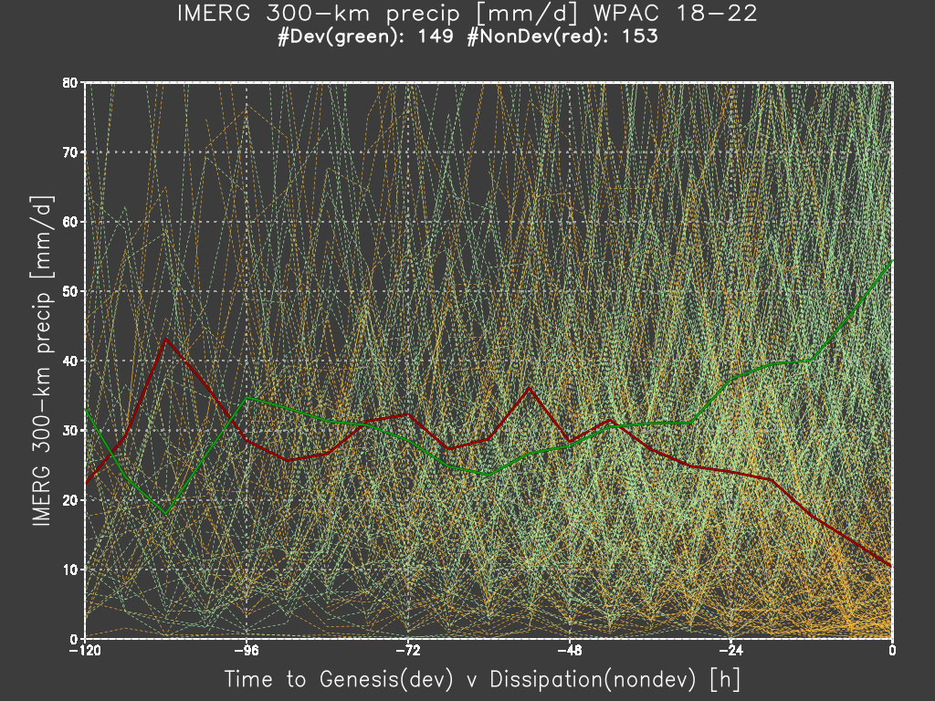
Thermo – IMERG 300 km rainrate [mm/d] – diff between 9Xdev & 9Xnon WPAC 2018-2022

Slide 20
Thermo – IMERG 300 km rainrate [mm/d] – diff between 9Xdev & 9Xnon WPAC 2018-2022
Red line – 9Xnon
Green line – 9Xdev
Xover ~ 48 h (2 d)
Rain ~ 30 mm/d

Slide 21
Thermo – IMERG 300 km rainrate [mm/d] – diff between 9Xdev & 9Xnon WPAC 2018-2022
Red line – 9Xnon
Green line – 9Xdev
Xover ~ 48 h (2 d)
Rain ~ 30 mm/d
9Xnon
30 - 10 mm/d

Slide 22
Thermo – IMERG 300 km rainrate [mm/d] – diff between 9Xdev & 9Xnon WPAC 2018-2022
Red line – 9Xnon
Green line – 9Xdev
Xover ~ 48 h (2 d)
Rain ~ 30 mm/d
9Xdev
30 – 50 mm/d
9Xnon
30 - 10 mm/d

Slide 23
IMERG 300 km rainrate [mm/d] – diff between 9Xdev & 9Xnon summary for 5 y period 2018-2022
WPAC
9Xdev v 9Xnon begin to depart or Xover point ~ 2 d
RR ~ 30 mm/d & higher than in the LANT
both 9Xdev & 9Xnon start at 30 mm/d but 9Xnon decreases to 15 mm/d
LANT
9Xdev v 9Xnon begin to depart or Xover point ~ 1.5 d
RR ~ 20 mm/d & lower than in WPAC
RR change ~ 10 mm/d vice 15-20 mm/d in WPAC

Slide 24
Summary
superBT = BT +
genesis – 2007-2024 of both
developing and non-developing pTC
dynamics – 1945-2024 twice-daily 10-d ERA5 forecasts
TC tracker
TC diagnostics file of environmental variables (e.g., vertical wind shear)
thermodynamics – 1998-2024 - satellite global precipitation analyses
GsMAP JAXA V8
IMERG NASA V6
V04 (beta - https://surperbt.blogspot.com/2023/12/intro-to-superbt.html )
2007-2022
V10 (available around 202512)
1945-2024
R34 (radius of 34 kt winds) – TC size

Slide 25



Contacts and Links
mfiorino@gmu.edu
https://surperbt.blogspot.com/2023/12/intro-to-superbt.html
https://github.com/tenkiman/superBT-V04/
https://maps.wxmap2.com

Slide 26
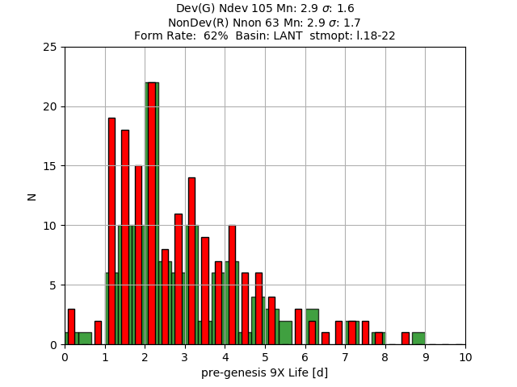
Formation Rate & Time to Genesis/Dissipation LANT 2018-2022
Form Rate: 62%
(62% of all 9X become NN)
T-Gen: 2.9 d (9Xdev)
T-Diss: 2.9 d (9Xdev)

Slide 27
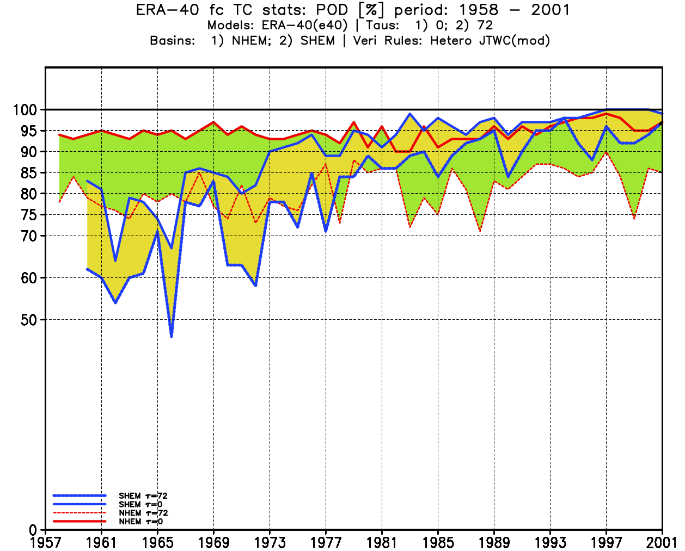
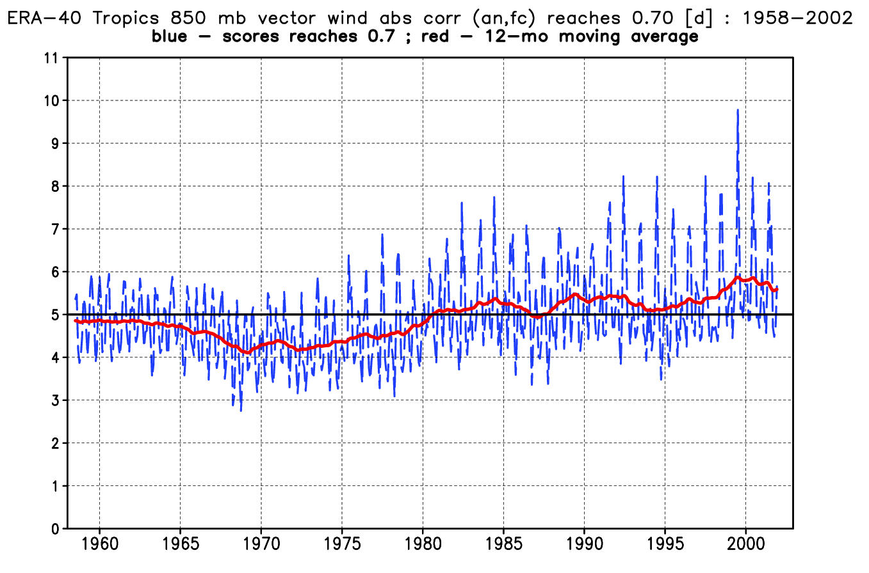
ERA-40 TC detection v tropical wind score SHEM v NHEM ; tau=0 v tau=72 h

Slide 28
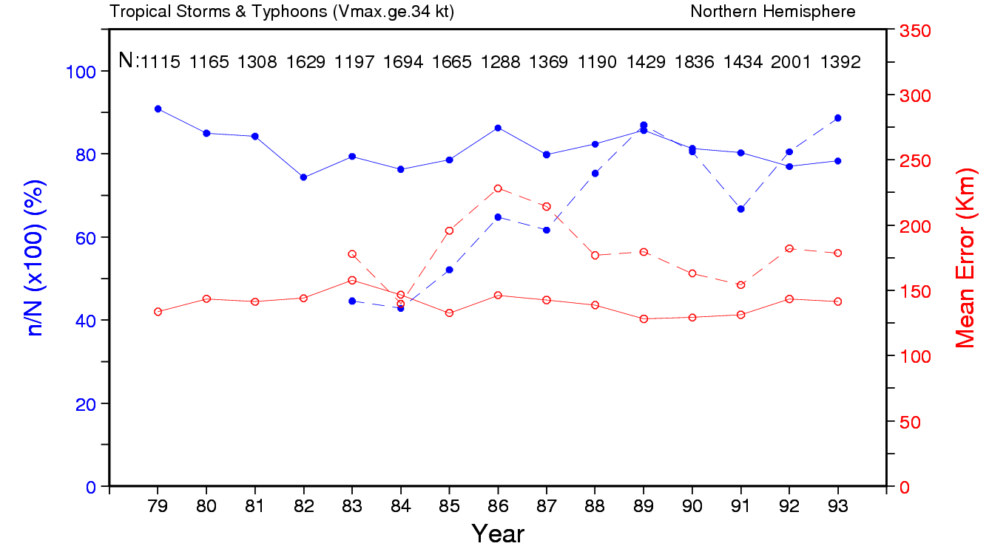
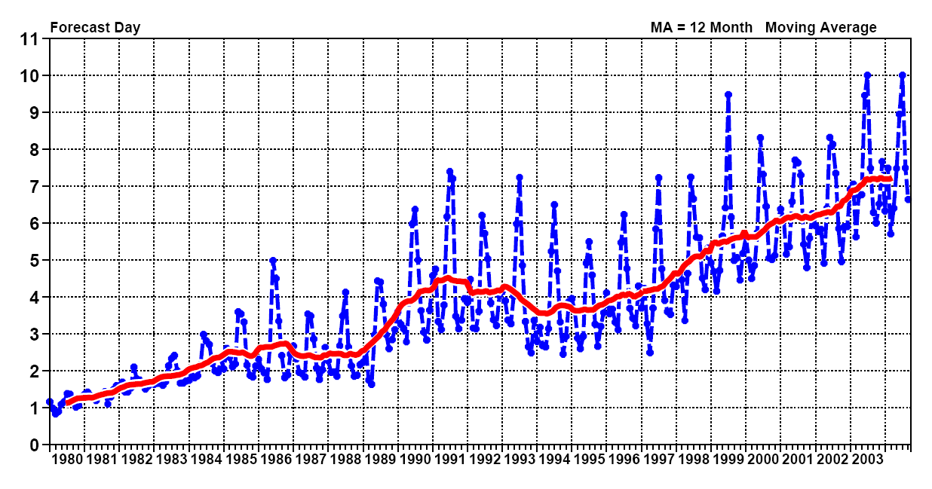
TC Detection in ERA-15 v ECMWF ops
ERA-15 ~85% 1979-93
tropical wind skill increases from 2.5 to 4 days ~1989
Ops detection increases to 80+% ~1989

Slide 29
Topics
Quality of ERA5 analyses and forecasts – how good are the dynamics like vertical wind shear?
run TC tracker for all TC 1945-2024
position error (PE) and probability of detection (PoD)
Formation or 9X → NN
rate or percentage of 9X that become NN
difference in dynamics (vertical wind shear) & thermo (3deg mean rain) between 9Xdev and 9Xnon
Version 0.4 (beta)
2007-2022
Version 1.0
add 1945-2006 & 2023-2024
add more R34 data from CIRA & ERA5

Slide 30
Mahalo どうも ありがとう ございました

