Slide 1
“You’re only as good as what you measure”
Answer & Question to/for John Knaff
CAPT Vic Addison USN
Commanding Officer FNMOC 2006

Slide 2




The Gary Atkinson 2x2 contingency table
Atkinson 1971 AWS TR 240 Forecasters Guide to Tropical Meteorology
OB
 | no typhoon | Typhoon
no typhoon
TYPHOON
FC

Slide 3
The Moral of the story is…
The forecaster (and modeler) can never win

Slide 4
What is a good forecast?
What is a good model?
or
What model/aid should a forecaster use?

Slide 5
a moral danger…
HFIP…improve forecast by 50%
which metrics define “improve”?
FE=f(PE,IE [R34])
allocate $ to reduce IE or PE or R34?
metrics matter

Slide 6
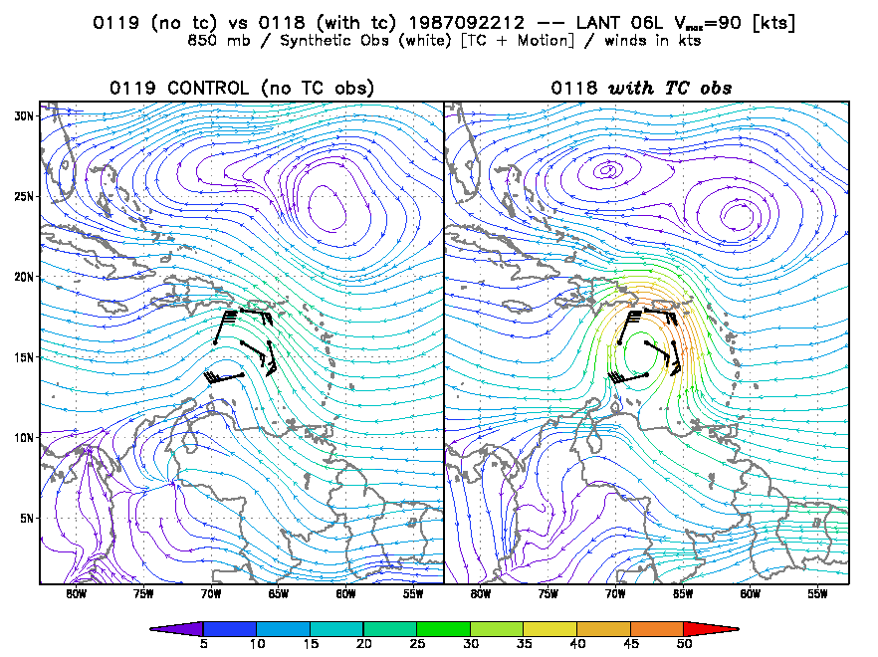
TC Wind Retrievals -- Hurricane Emily, 1987
open wave; V < 15 kts
closed circ; 50 kts

Slide 7
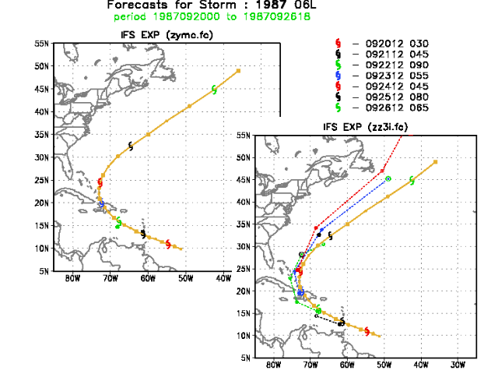
Impact on Emily detection & track forecasts
Excellent recurvature forecast with retrievals
Only one position detected in control

Slide 8
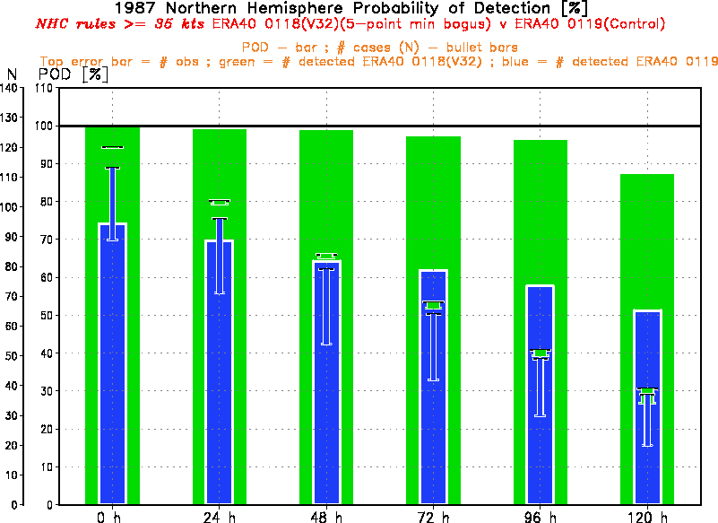
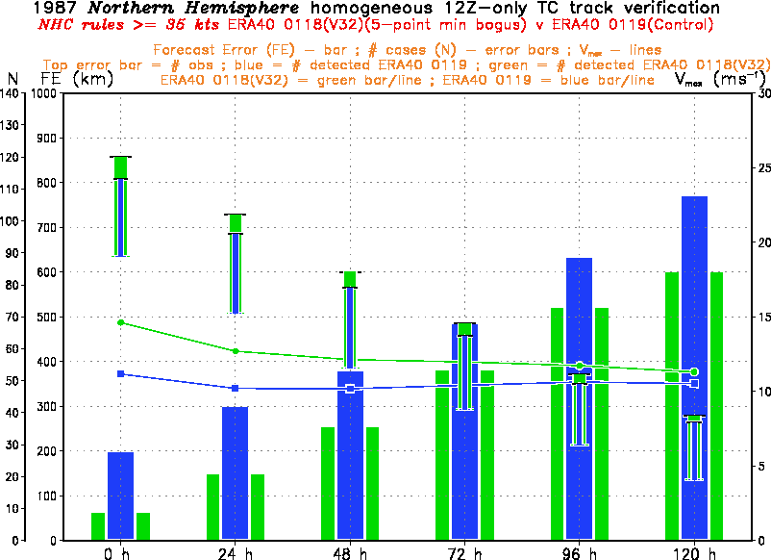
Impact on Detection/Track Forecast Statistics
90 v 50 % detection at 120h
72-h FE ~ 380 km
stronger vortex
lower initial position error

Slide 9

Tropical Cyclone Bogussing ?!+?#^&~!!
Mess up the d+5
NHEM 500 Z anomaly correlation Fiorino and you’re TOAST

Slide 10
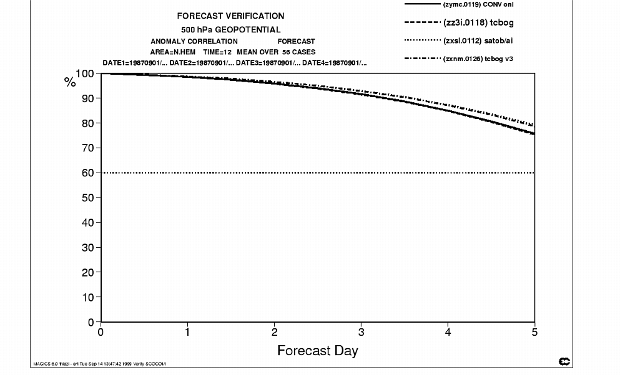
Z₅₀₀ Anom Corr Midlats
My downfall…
ACC w/TC
< 1% lower

Slide 11
another Moral of the story is…
all metrics are equal
it’s just that some metrics
are more equal than others
Orwell 1954: “Animal Farm”

Slide 12
TC NWP Progress 1985 – 2018 from IWTC I to IWTC IX
Mike Fiorino
Commander, United States Navy (retired)
B.S. (’75 PSU), M.S. (’78 PSU), Ph.D. (’87 NPS) all in Meteorology michael.fiorino@noaa.gov
University of Colorado Boulder CO
Earth System Research Laboratory, Boulder CO
National Hurricane Center, Miami FL
Joint Typhoon Warning Center, Pearl Harbor HI
Lawrence Livermore National Laboratory, Livermore CA
European Centre for Medium-Range Weather Forecasts, Shinfield Park, Berskshire, UK
Meteorological Research Institute – Japan Meteorological Agency, Tsukuba JAPAN
Space and Naval Warfare Systems Command, Arlington VA
NASA Goddard Space Flight Center, Greenbelt MD
National Centers for Environmental Prediction, Camp Springs MD
Naval Postgraduate School, Monterey CA
Fleet Numerical Meteorology and Oceanography Center, Monterey CA
Naval Research Laboratory, Monterey CA
Atlantic Oceanographic and Meteorological Laboratory, Miami FL
Pennsylvania State University, University Park PA

Slide 13
Outline of Talk
50+ year history of TC NWP – it’s not just intensity
Basic progress since IWTC I
  biggest NWP success story and an irony…
  models with no TCvitals make the best 12- & 24-h track forecasts
NWP v TC Forecasting – they are not the same
Update from NWP centers
  what’s new for the 2019 season (we’re already in the SHEM 2019 season)
  TCvitals – best real-time TC data from the forecast centers
  forecasters do not ‘bogus’ the model
Discussion points
  Recommendation:s detailed diagnosis of the model-analyzed TC vortex and verification against cyclone-scale observational analyses (IPE and IIE not enough!!)

Slide 14
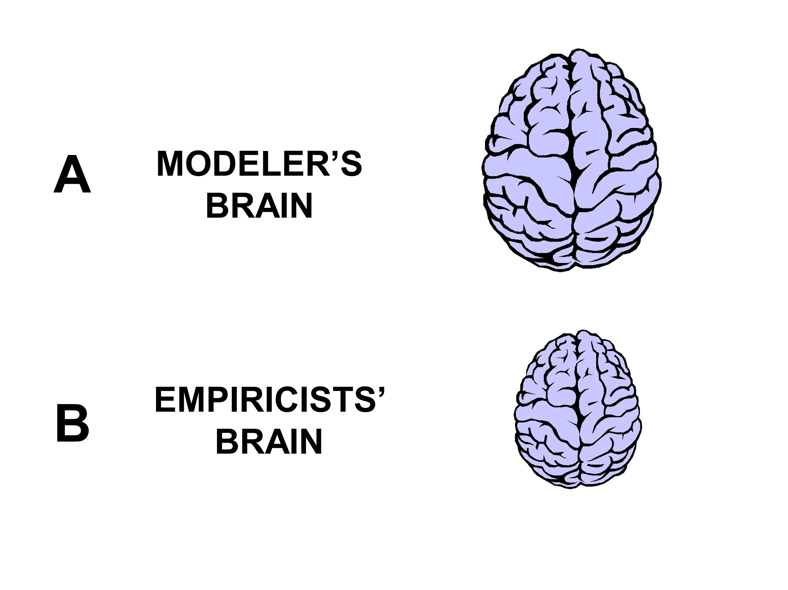
“NCEP never had a hurricane model until 2007”
Jason Sippel 20181204
…because a hurricane model predicts intensity…

Slide 15
NCEP has run TC models since 1968
JMA since 1963
US NAVY since 1978
Jason is off by 39 years…

Slide 16
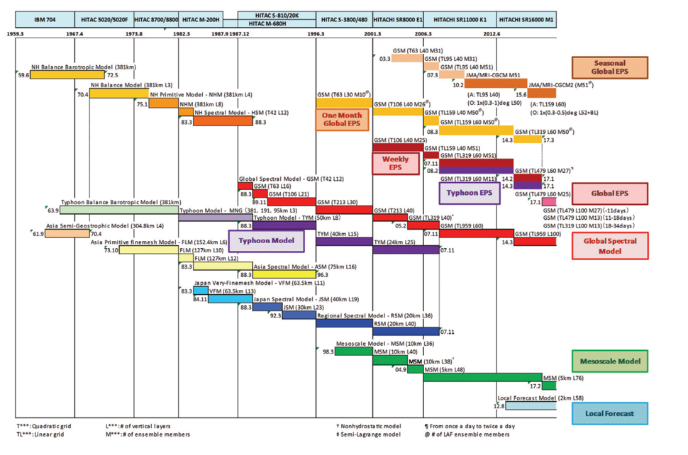
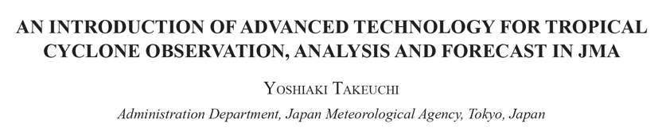
エンダベウピの日本
Japanese NWP

Slide 17
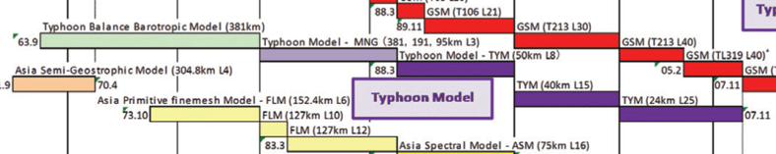
エンダベウピの日本 + NCEP
SANBAR 1968-1990
MFM 1976-1988
QLM 1988-1995
GFDL 1992-2017
HWRF 2007-
HMON 2017

Slide 18
エンダベウピの日本 + US NAVY
OTCM 1978-1998
NTCM 1981-1988
GFDN 1996-2017
COTC 2009-
“my” model
rm –f –r *.*

Slide 19

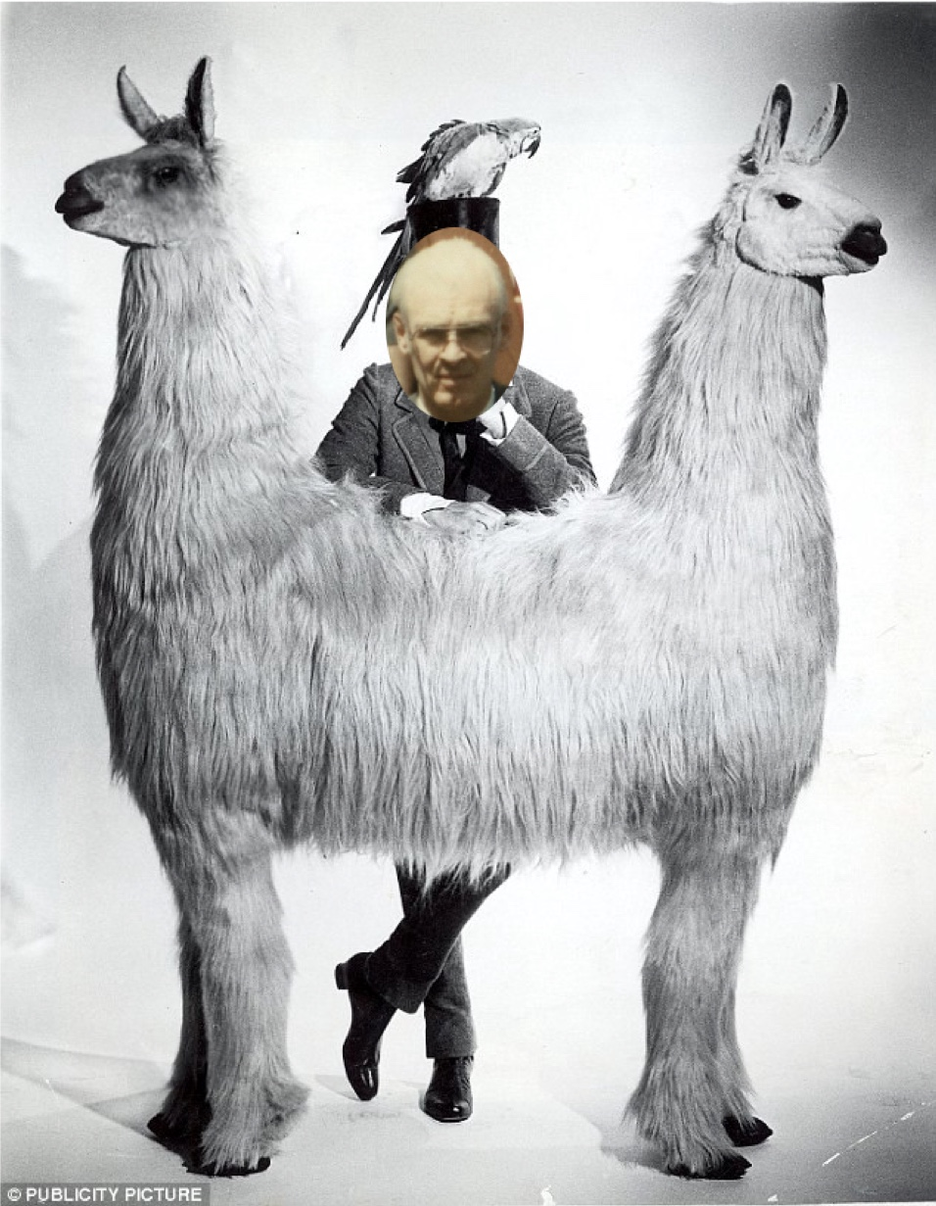
as an NWP modeler wearing two hats…it sometimes feels like...
Dr. Gray’s Push Me-Pull You
WOW Bill, my numerical model simulated the RI of Hurricane Michael and even the polygonal eyewall!!!
that’s all well and good Ms. Modeler, but when and where is the storm going to make landfall?
researcher
forecaster

Slide 20
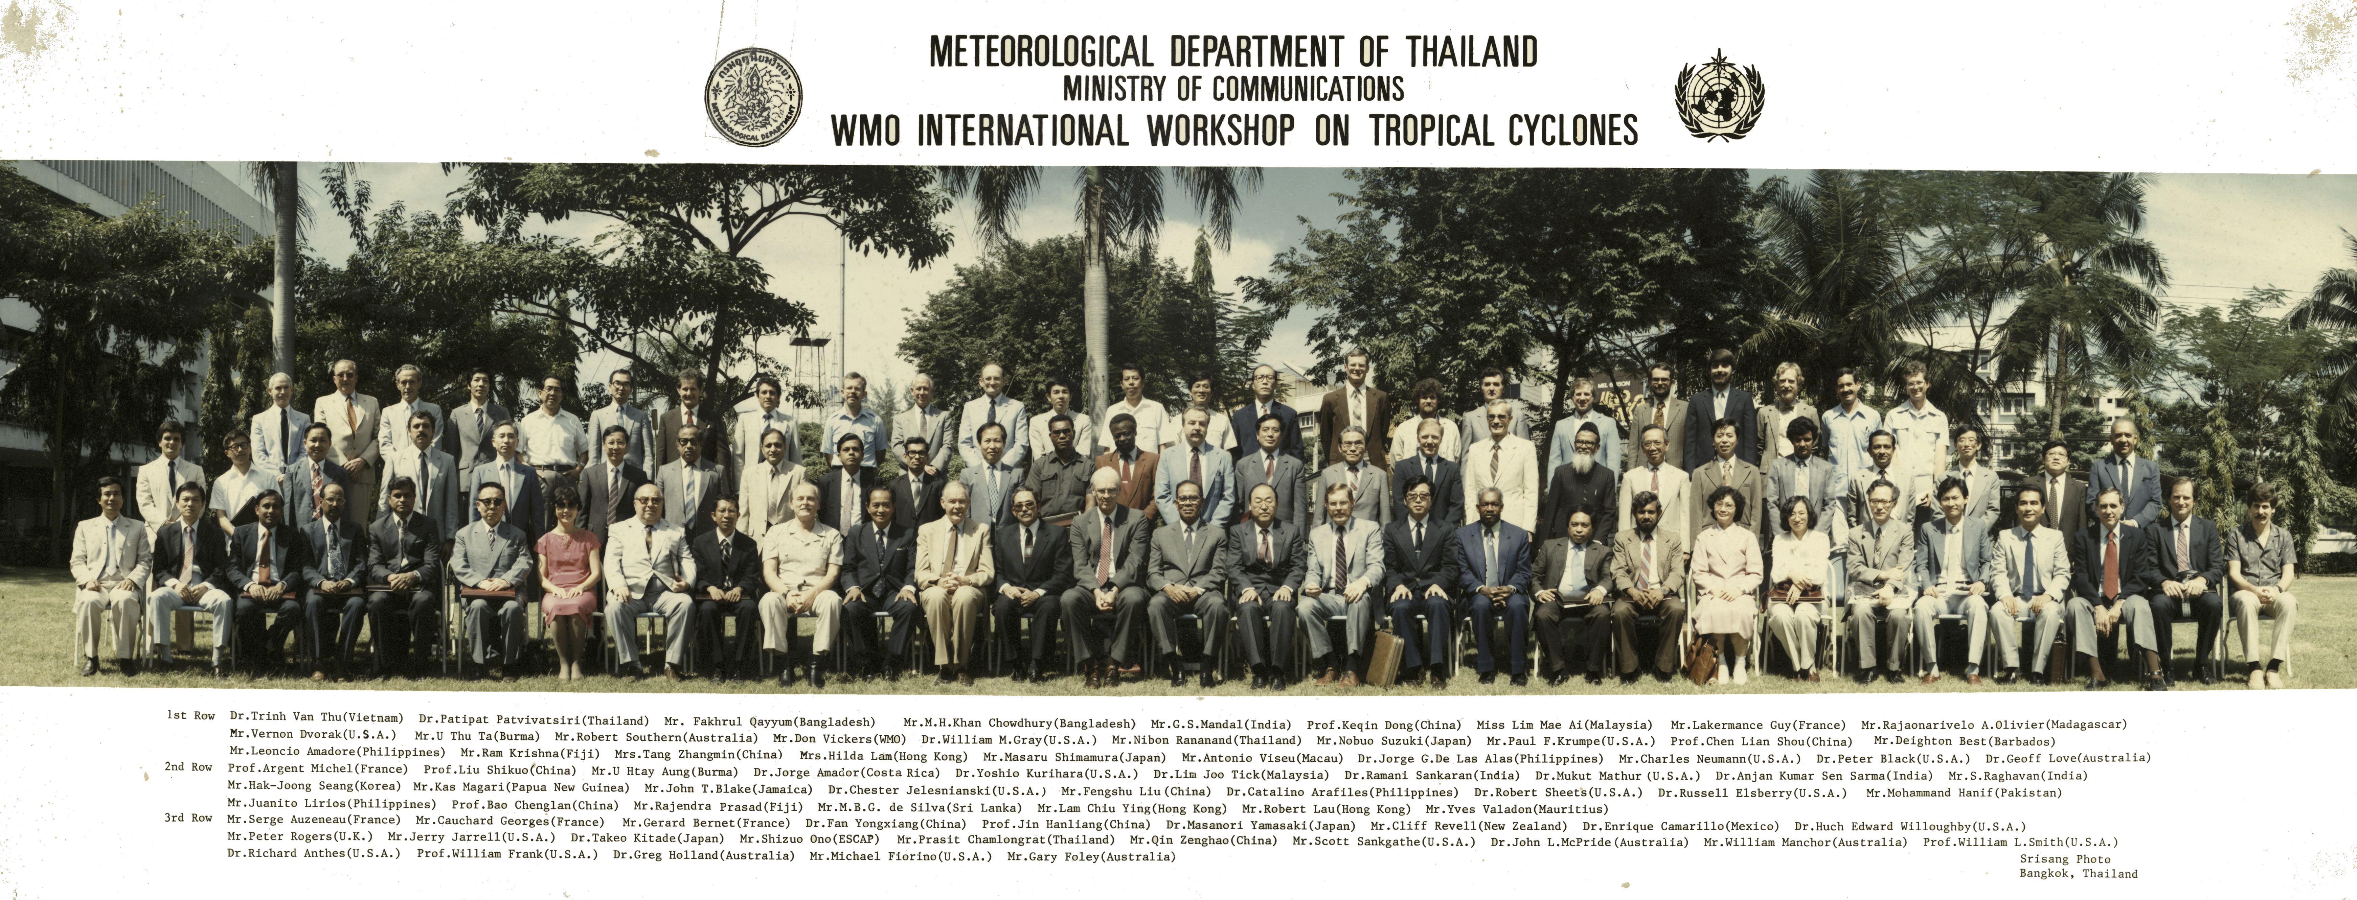
1st NWP Progress since IWTC I – Bangkok 1985
Rick Anthes’ lament:
the modelers were put in their own session…and not seen as another tool to understand and forecast TCs
dddd

Slide 21
1st Kepertian NWP Progress since IWTC 1
1 min v 10 min winds – potAAAto potaaato → progress because we aren’t talking about it in IWTC 9
ditto for modeling and NWP

Slide 22
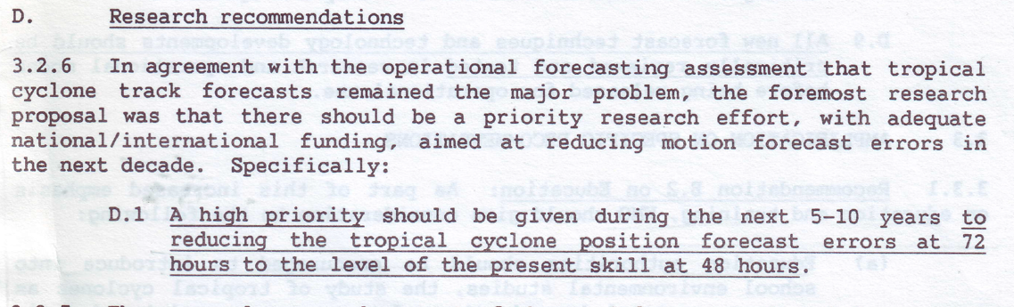
2nd NWP Progress since IWTC I – Rec D.1

Slide 23
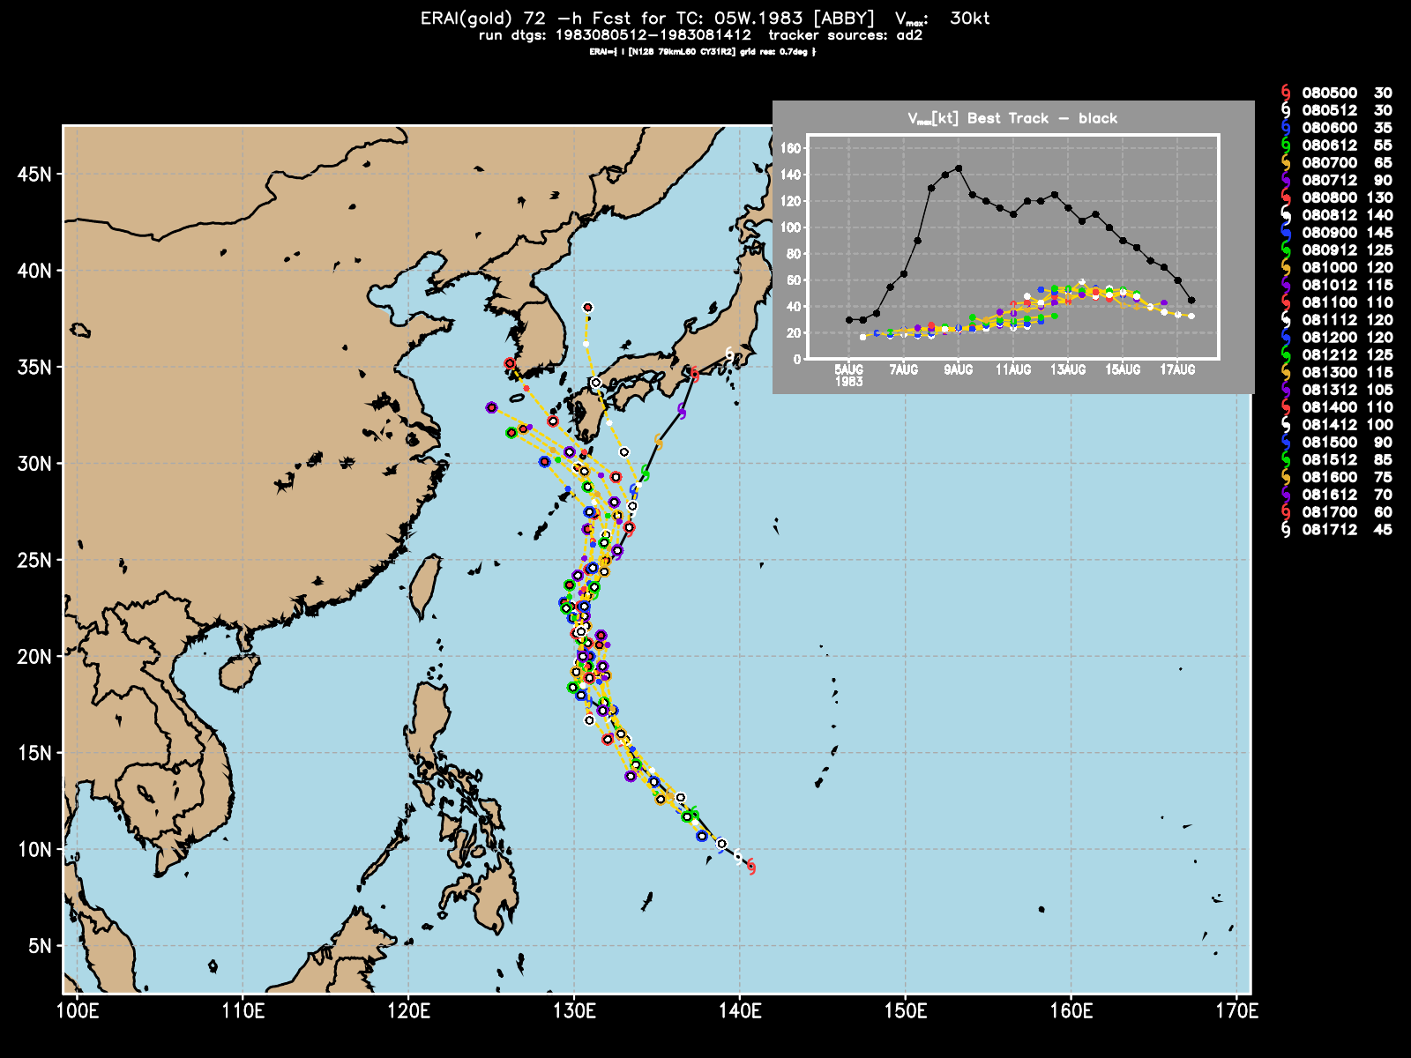
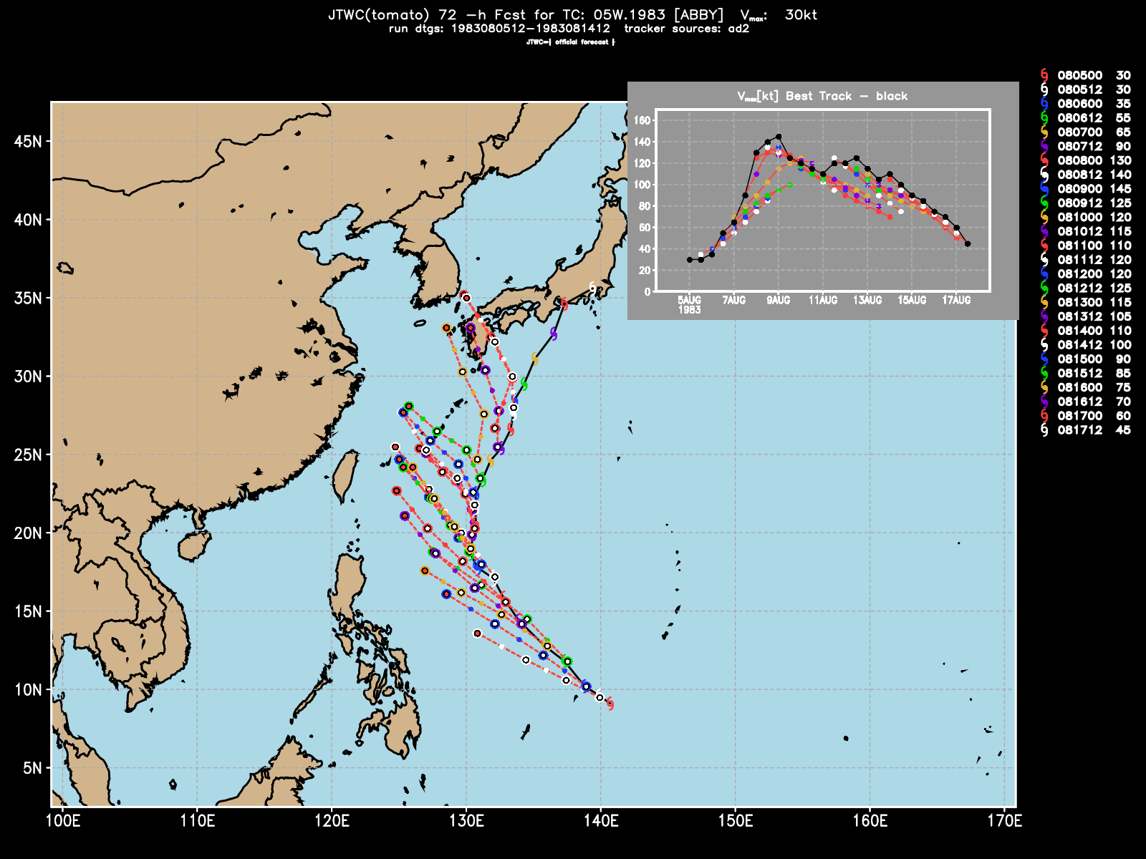
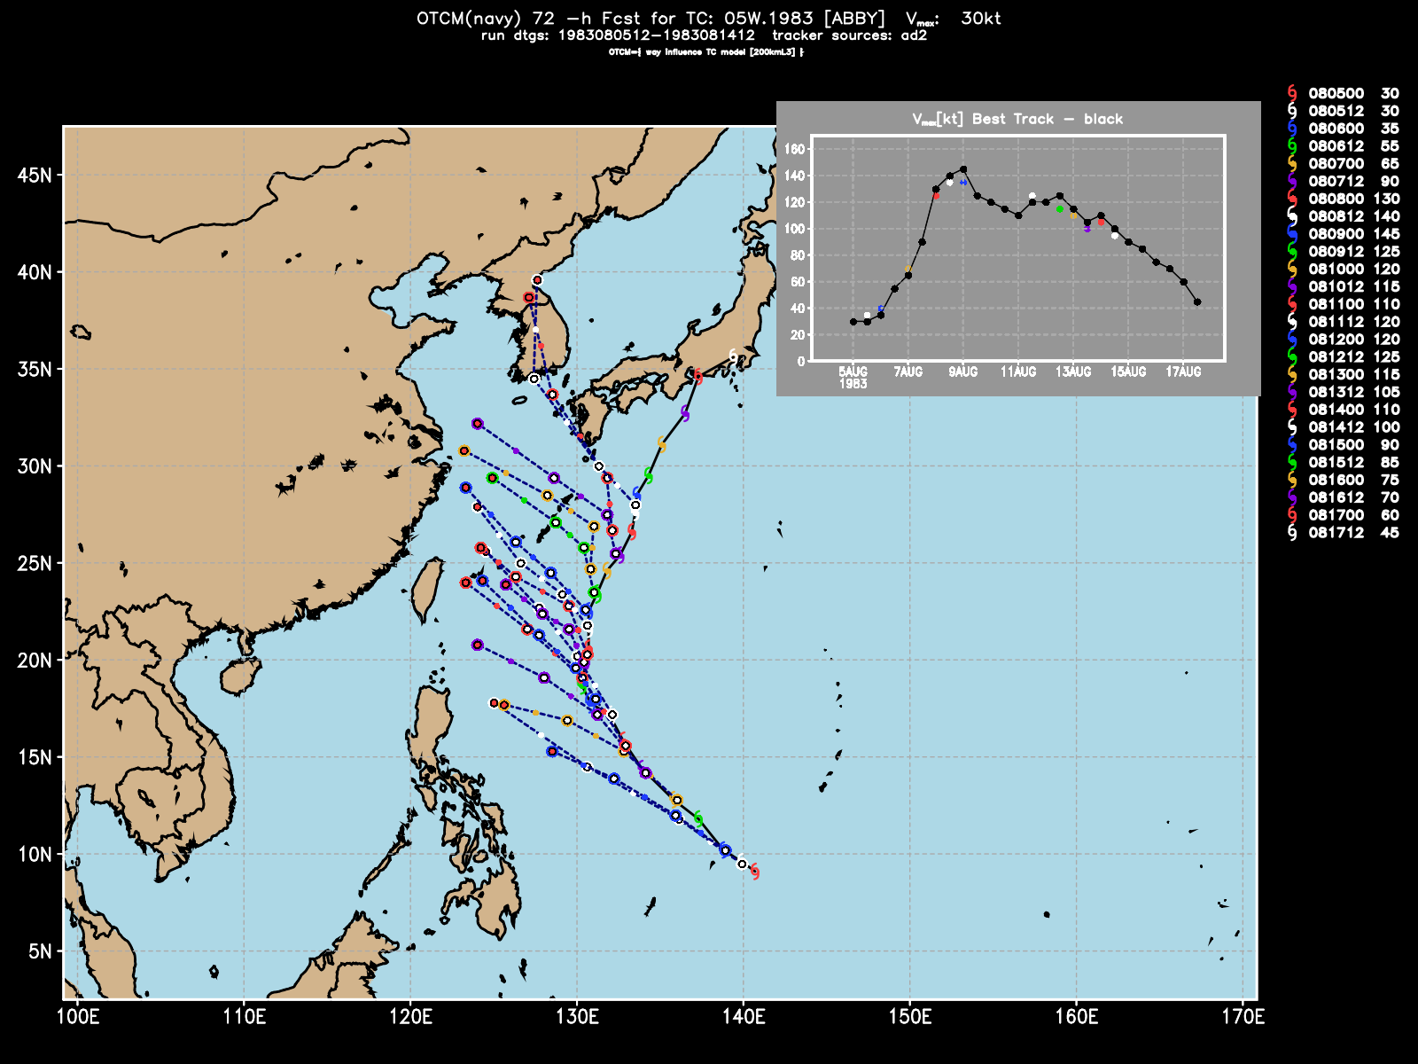
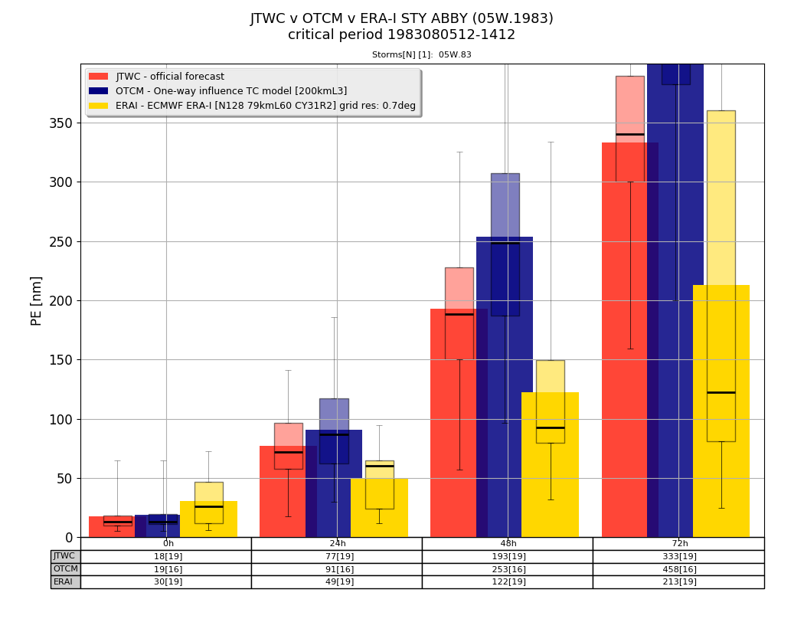
The Back Story – SuperTyphoon ABBY (05W.1983) the most consequential storm in the history of US Navy TC NWP
NWP 72-h mean PE ~ 350 nmi
…and I was personally blamed (for my bad model) by both JTWC and NOCC Pearl Harbor – stuff flows downhill…

Slide 24
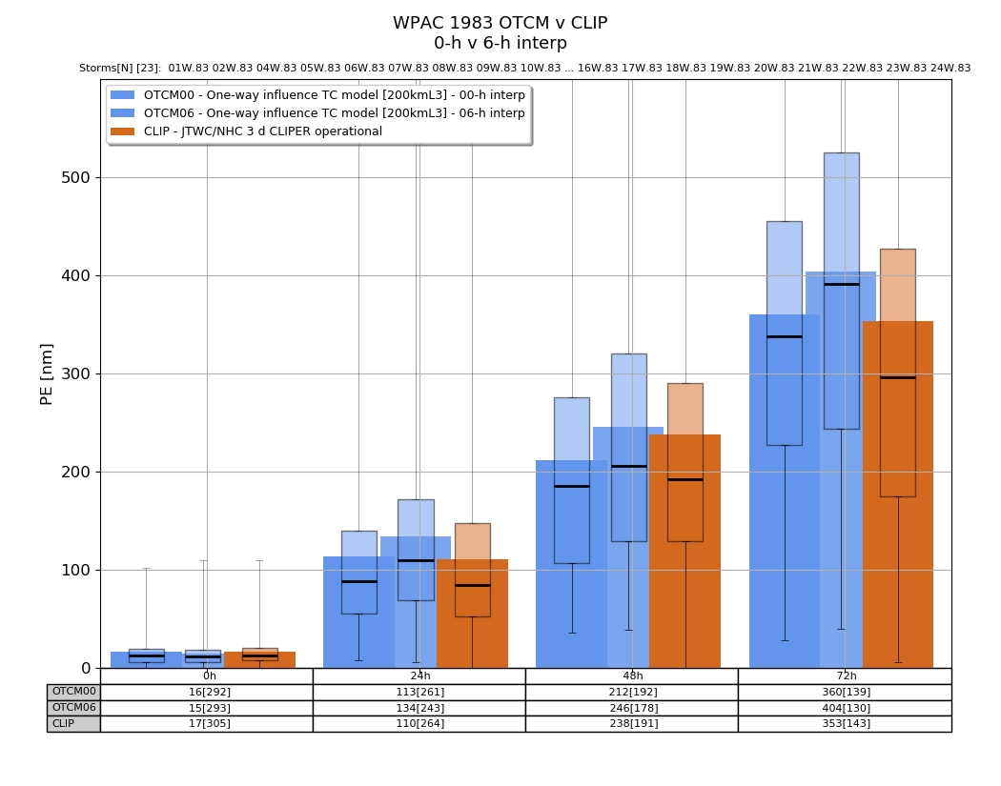
WPAC 1983 – NWP 72-h ~ 360 nmi

Slide 25
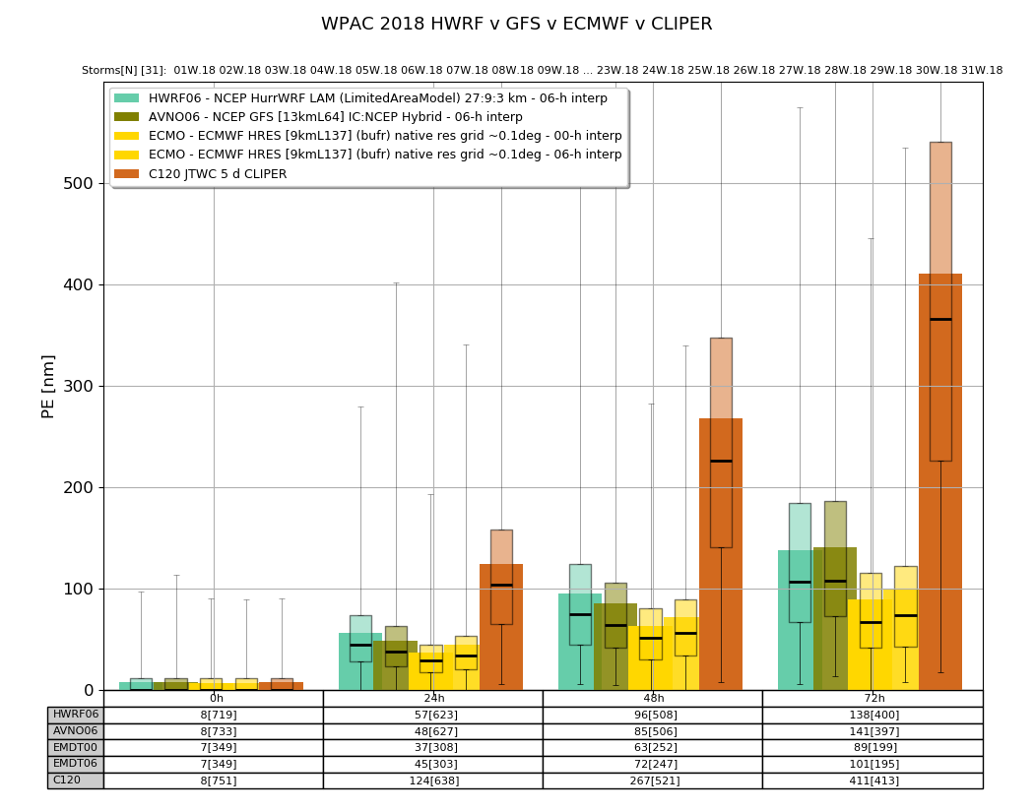
WPAC 2018 – NWP 72-h ~ 100 nmi

Slide 26
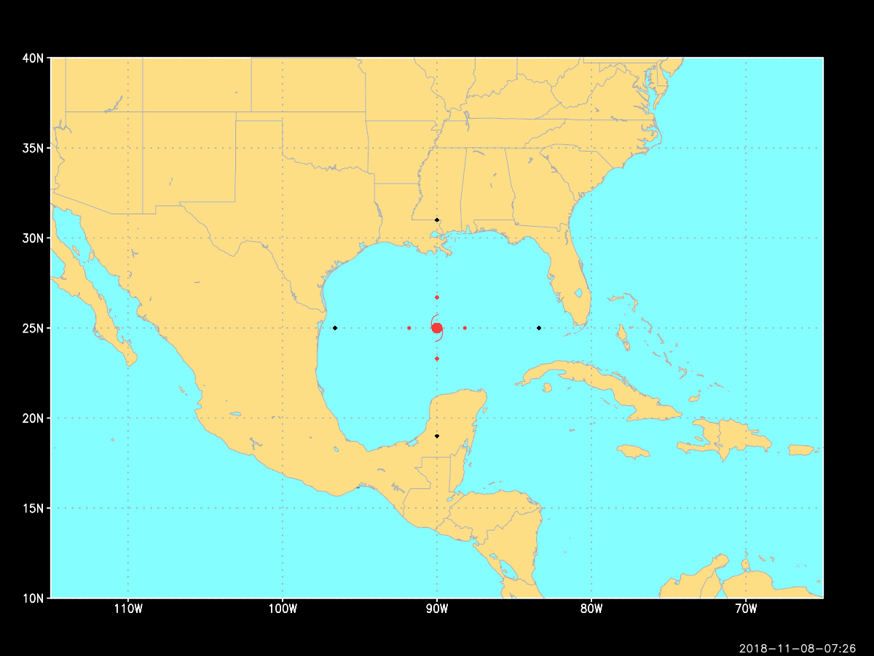
Circular area of mean 72-h PE
360 v 100 nm ➔ 92% reduction in area!

Slide 27
Summary of NWP progress
track forecast problem has been “solved”
  if mean 72-h PE is 100 nmi, then one 700 nmi 72-h PE requires (N*PE<100) 7 forecasts with PE = 0
  the big errors matter a lot!!!
  the one situation where the human forecaster has an advantage…models can do stupid stuff, like violating CFL, but humans don’t have to…
structure? not so much…
R34 drives the NWS W&W and PACOM TCOR because it’s associated with onset of gale force winds
but a track issue in the model remains…TCvitals

Slide 28
That was the good news…here is a concerning situation regarding TCvitals
TCvitals are the one unique data produced by the forecast centers = position, intensity, mean R34 & R50
ATCF form
AL, 06, 2018090700, 01, CARQ, 0, 250N, 495W, 60, 993, TS, 34, NEQ, 100, 50, 30, 90, 1014, 130, 15, 0, 0, L, 0, X, 290, 6, FLORENCE, D,
WMO form (from IWTC II)
M2TC 06L FLORENCE 20180907 0000 250N 0495W 290 031 0993 1014 0241 31 028 0185 0093 0056 0167 D

Slide 29
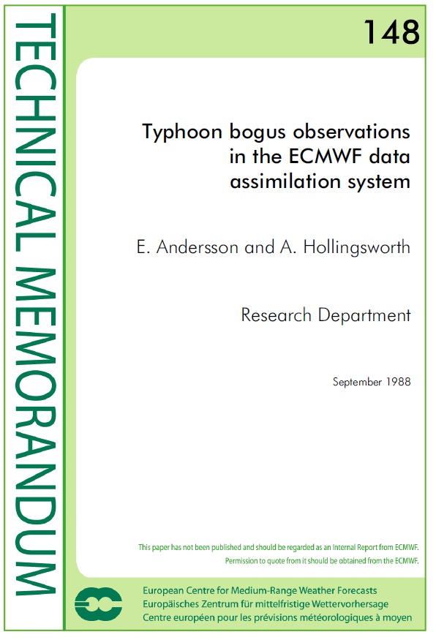
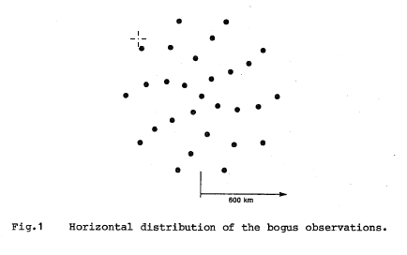
TCvitals DA – 1988
Invented at ECMWF but never used for many reasons:
  Quality and availability of TCvitals
  OB error?
  BG error the big one
  Started the use of ‘bogus’ – IT IS NOT!!
Two-fold purpose: 1) better vortex analysis; and 2) aid assimilation of other observations near storm
Implementations in global models:
  UKMO – 1989
  FNMOC – 1991
  NCEP – 1992

Slide 30
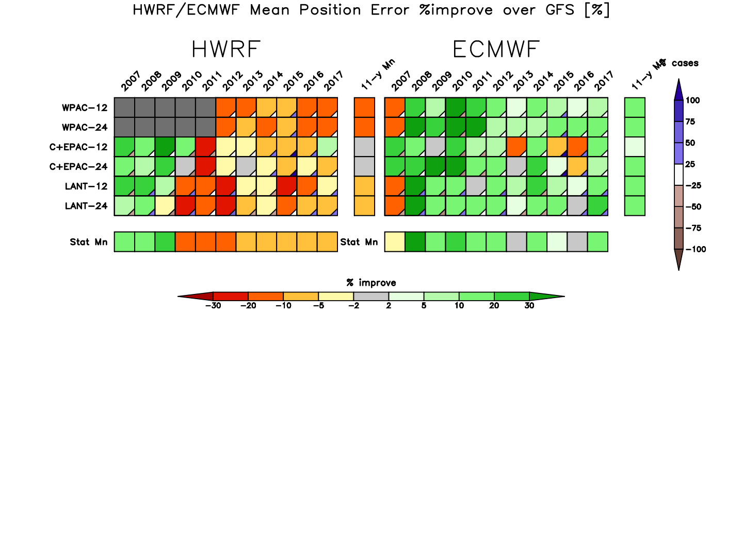
The TC NWP (profound?) irony
GFS & HWRF ‘assimilate’ TCvitals ECMWF does not…

Slide 31
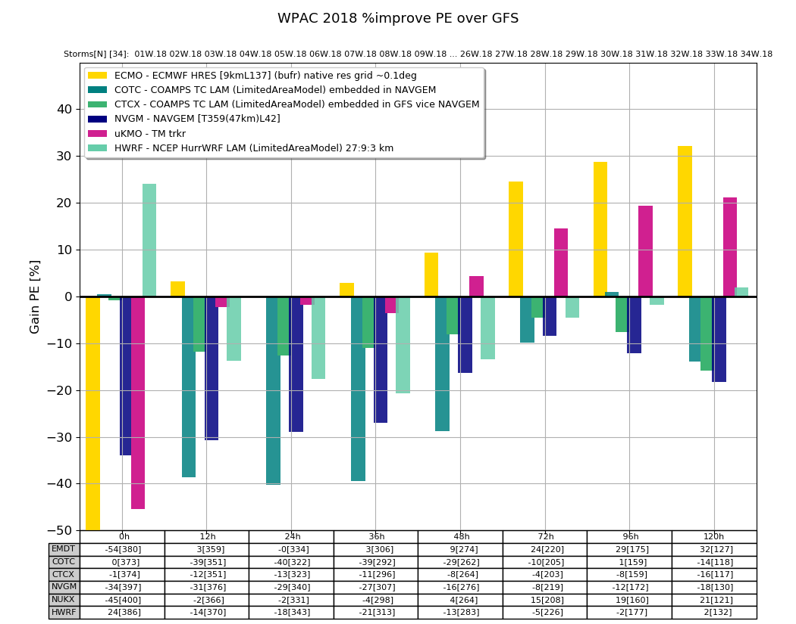
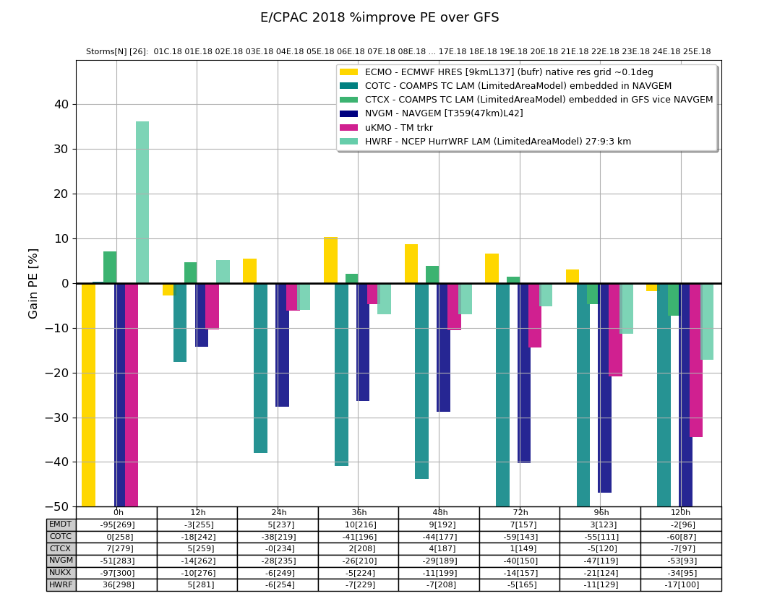
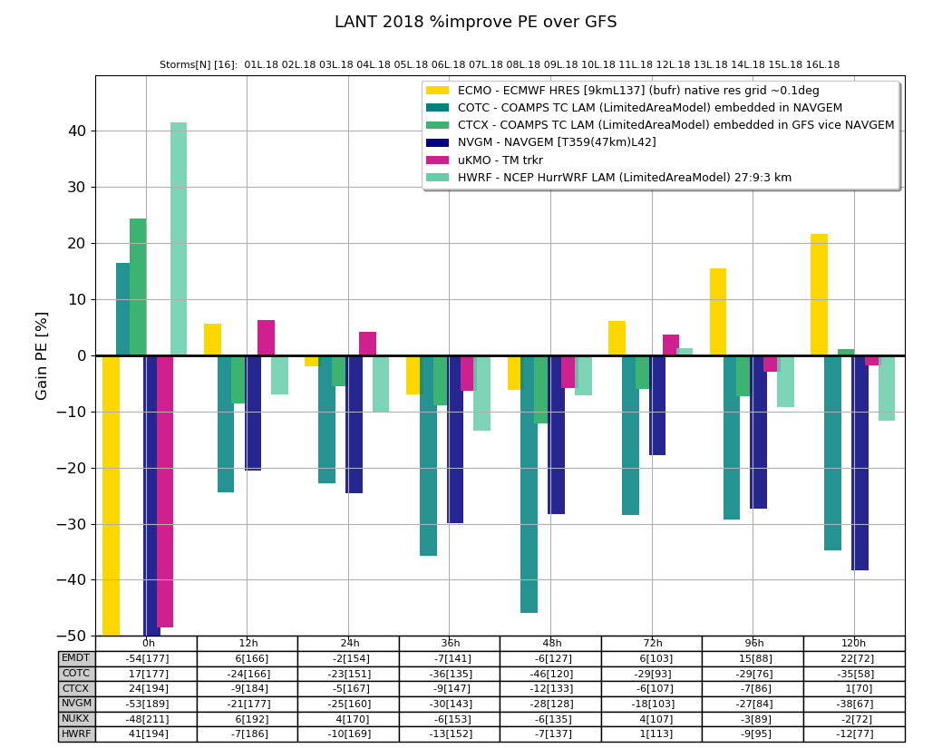
The TC NWP (profound?) irony – 2018

Slide 32
The TC NWP irony
ECMWF (and UKMO) have highest initial position errors…but lower 12- and 24-h PE!
Two possible explanations:
  accuracy of large-scale flow near vortex
  distortions in the ‘critical’ (~300-500 km) annulus by TCvitals assimilation, i.e., a poor vortex analysis
  others?
If the models don’t need this unique data from the forecast centers…why do we need the…
However, R34, intensity, SEP/ERC should be an initial value problem, but the model analyzed vortex should ‘do no harm’ to the motion…

Slide 33
Summary of NWP progress since IWTC I
The global models have more than met the goals of making 72 h position forecast <= 48 h… 72-h PE < 24-h PE of 1985!!!
analysis of the TC vortex in the models remains a big problem – the more the TCvitals are used, the worse the initial track forecasts – ‘less is more’ or ‘nothing is better than something’?

Slide 34
as an NWP modeler wearing two hats…it sometimes feels like...
Dr. Gray’s Push Me-Pull You
My job is to protect assets
NWP only does meteorology (if the model doesn’t blow up ☺)
researcher
forecaster

Slide 35
A Researcher - Forecaster conundrum
NWP models do not forecast TCs, they only do meteorology (solve equations)
An operational TC forecast is defined by humans, is made by humans for use by humans – meteorology is only a part of the TC forecast…

Slide 36
NWP is a misnomer
Models do not forecast TCs because models do not forecast
  10 m 1-min wind
  sea level pressure
  200-850 wind shear
tracker
post
processor
diagnostic
file →
SHIPS/LGEM
WxMAPs

Slide 37
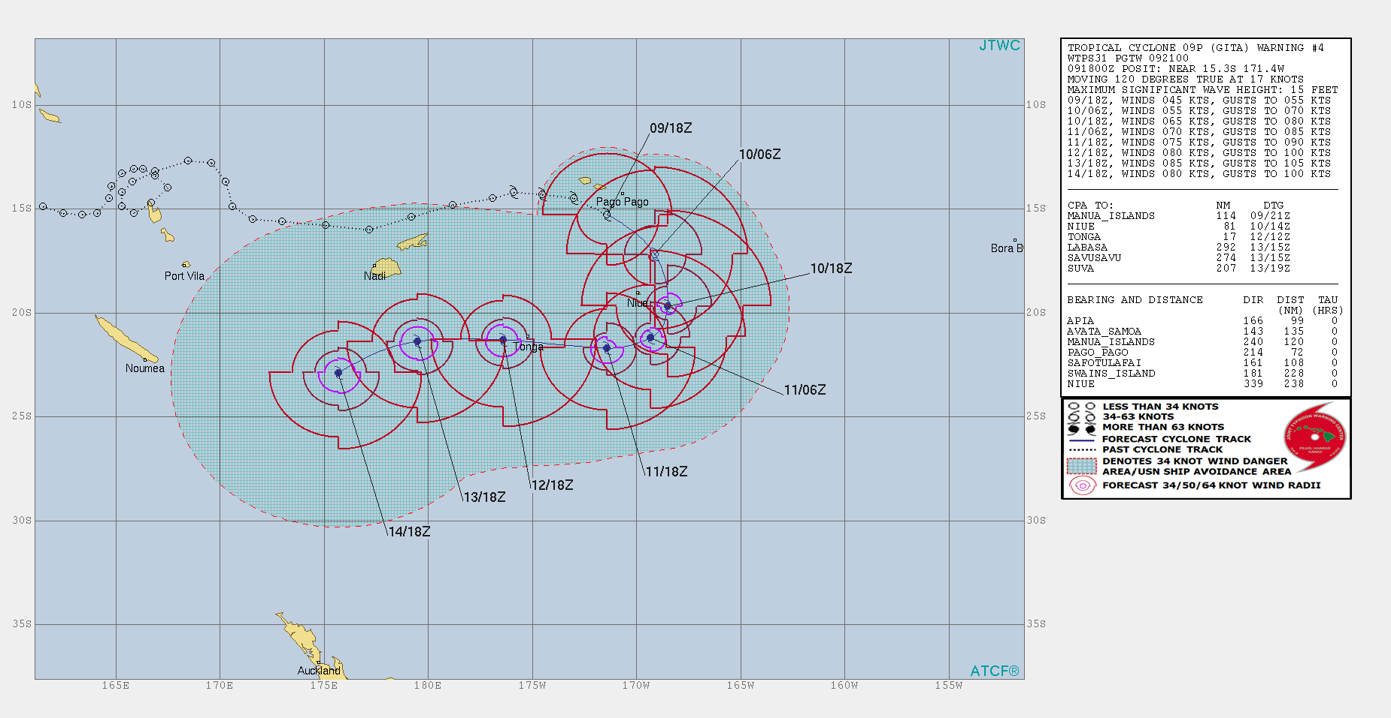
a TC forecast is …
09P.2018 (GITA) 2018020918 warning
10-m,1-min (sfc) wind field
key parameters: Position, Intensity (V_{max}), R34, mean PE (.mil)

Slide 38
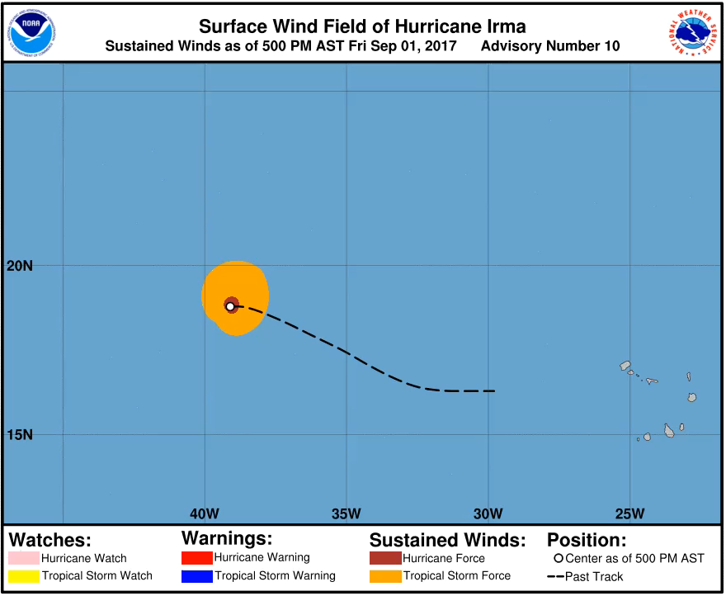
TC winds and NWS Watch/Warnings
Tropical Storm (winds ≥ 34kts)
Warning = TS Force winds expected
Watch = TS Force winds possible
Hurricane (winds ≥ 64 kts)
Warning = Hurricane Force winds expected
Watch = Hurricane Force winds possible
TS (gale) force winds within 36 h

Slide 39
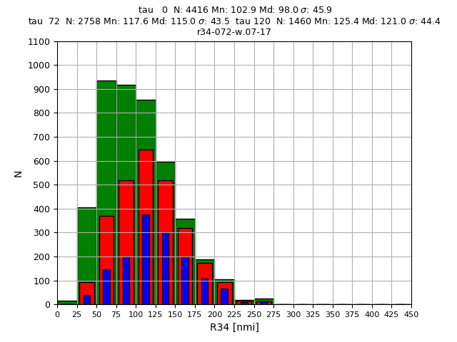
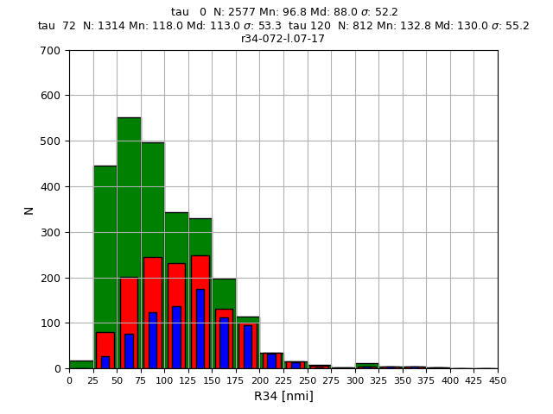
What is the difference between a 72-h mean PE and 120-h mean PE?
10-y R34 histograms (2008-2017) taus: 0 (G), 72 (R),120 (B)
only 1/2 the forecasts have a 72 h verifying position…
WPAC
100/62/33
98/118/121
LANT
100/50/31
88/113/130
only1/3 the forecasts have a 72 h verifying position…

Slide 40
What is the difference between a 72-h mean PE and 120-h mean PE? fundamentally different type of storms
LANT
  50% of the forecast TCs exist at d+3 days…
  d+5 TCs are larger than in WPAC
WPAC
  33% of the forecast TCs last d+5 days
  d+0 and d+3 TCs are larger than in LANT

Slide 41
Status of TCvitals Usage at the NWP Centers ~ 2019
Center | Model/Type/Comment
ECMWF (Reading) | None | Fully interactive ocean improves TC intensity
UKMO (Exeter) | AS88-- | Central pressure only
NCEP (Washington) | AS88++ in HWRF less in GFS-FV3 | Extensive use of all TCvital variables
FNMOC (Monterey) | AS88 in both NAVGEM/COAMPSTC
JMA (Tokyo) | AS88- | Reduce # of retrievals
KMA (Seoul) | ??
CMA (Beijing) | ??
Taiwan (Taipei) | AS88 in global model only
Others?
AS88 = Andersson & Hollingsworth 1988 = retrieve profiles based on TCvitals

Slide 42
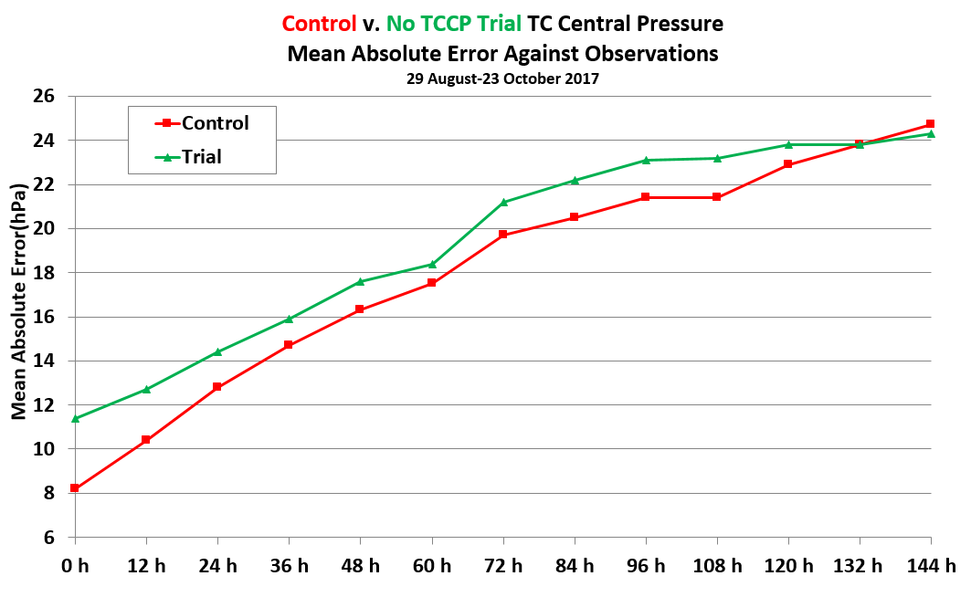
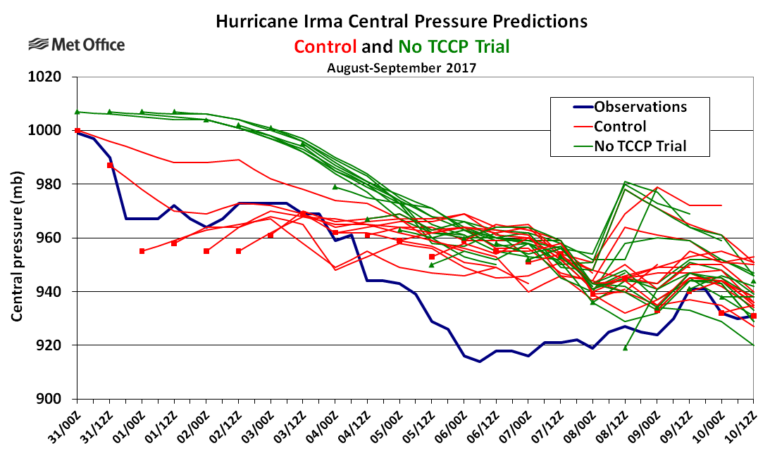
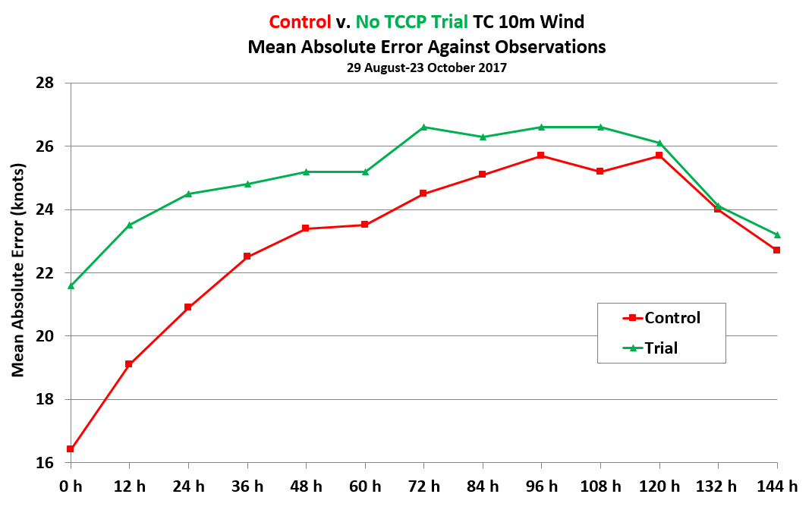
Central Pressure Data Assimilation
Operational since 2015
Recent trial shows positive impact on intensity, neutral for track.
Inconsistent usage of central pressure observations due to flagging by quality control in some cases of rapid deepening
Notes:
Julian Heming

Slide 43
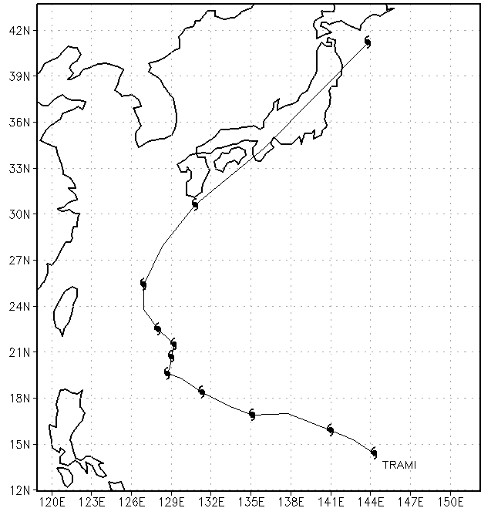
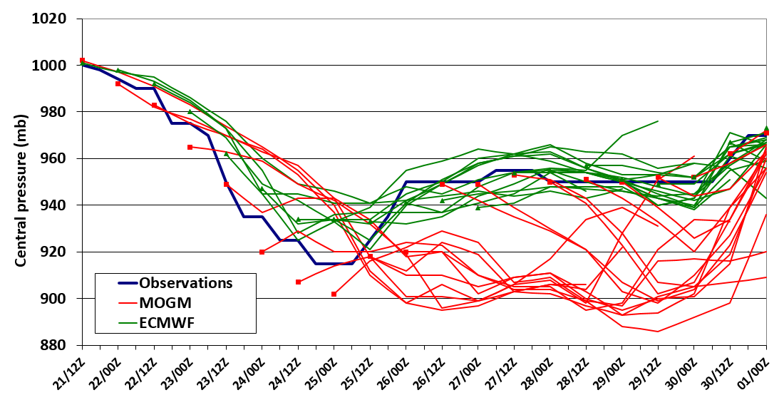
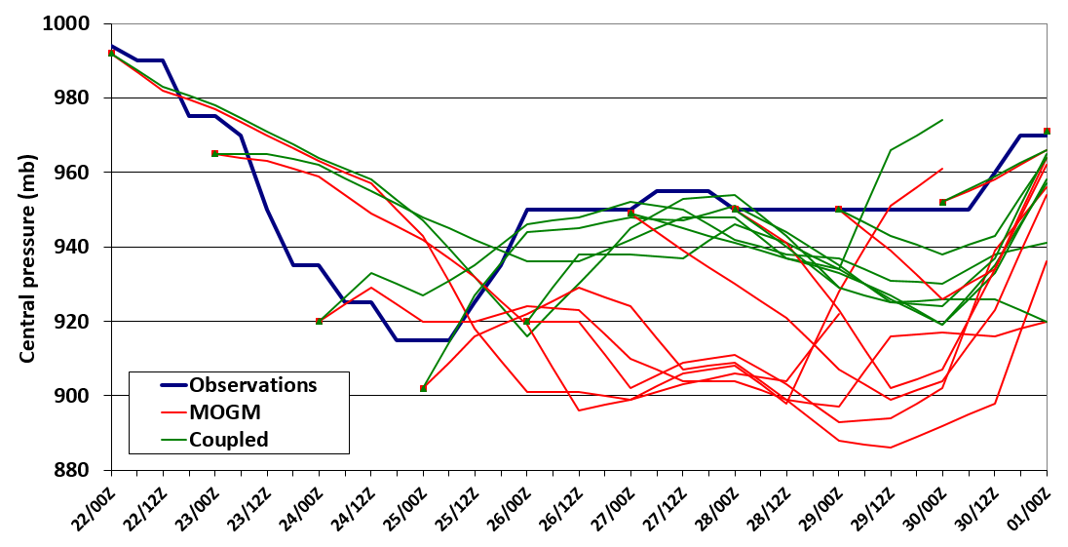
Atmosphere-Ocean Coupled MOGM: Typhoon Trami
Typhoon Trami slow movement then acceleration into subtropics
Operational MOGM too deep compared to ECMWF (now coupled)
Coupled MOGM reduces over-deepening
Tracks similar apart from one – coupled too slow.
Typhoon Trami
Observed track
Central pressure forecasts MOGM v ECMWF
Central pressure forecasts MOGM v coupled

Slide 44
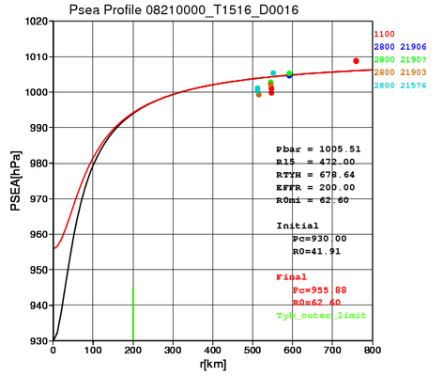
How to produce TYBGS profiles
Central pressure (P_{C})
30-kt wind speed radius
for each typhoon reported by forecasters
An example of axial symmetric profile of Psea
Using empirical formulas
Axial symmetric profiles of Psea
Steepness check of horizontal Psea gradients
P_{C}
Adjust P_{C} if needed
Calculate height and wind profiles
Too steep gradient !
Add axial asymmetric elements retrieved from first guess (FG)
－ : Initial profiles of Psea
－ : Adjusted profile of Psea
Assimilation of Pseas and upper winds as pseudo observations in the DA system (4D-ver)
Notes:
Using these empirical formula.
1. Radius of typhoon :
R_{B} = R₁₅*{1 + 2 * V₁₅ * 0.001/(f * R₁₅)}
2. Psea profiles :
P(r) = Pmax – ⊿P {1 + (r/R₀)**2}**(-1/2)
⊿P = Pmax – P_{C}
Pmax = P_{C} + (R_{B} - P_{C})/{ 1 - 1/(1-(R_{B}/R₀)**2)**1/2)}

Slide 45
2. Update of Typhoon Bogus (TYBGS) in Sep. 2016
2-1. Goal of the update
Mitigation of typhoon structure deformations.
  Too strong increment was found in very close area around typhoon centers in the old version.
  It caused deformation of warm cores, concentric circulation in height and wind field. Even ‘cold cores’ sometimes appeared.
  Deformation can lead ‘meandering’ during spin-up which causes increase positional forecasting errors.
Enhance the effects of typhoon center positional fixing.
  Not enough data points around typhoon centers in the old version.
2-2. Modifications of the observation errors
Observation errors for TYBGS data assimilation
Older ver. | Current ver. (Sep. 2016 – )
Psea : 0.8 hPa Wind : about 5 m/s | Psea : 2.0 hPa Wind : about 4 m/s
Notes:
Okabe-san

Slide 46
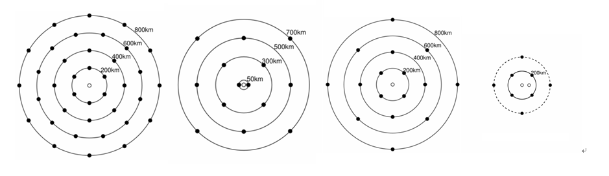
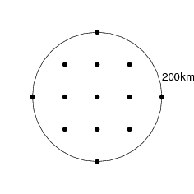
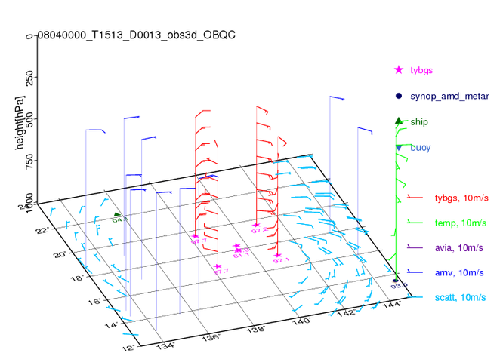
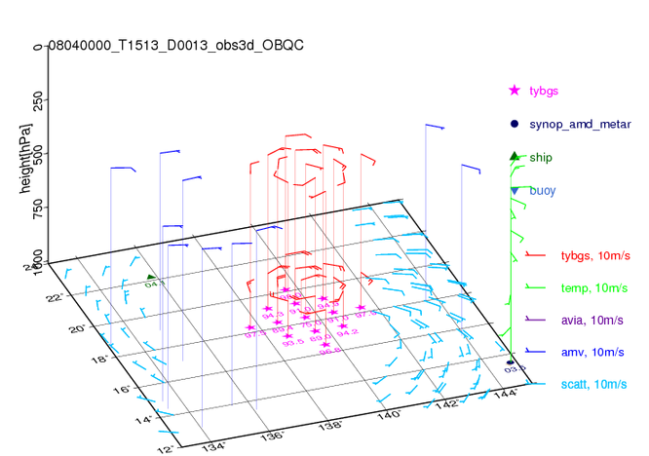
2-3. Changes of TYBGS data deployment location and height
TYBGS data deployment locations in the JMA global DA system
○: Psea only, ●: Psea and upper-air winds
– Mar. 2009
Apr. 2009 –
Oct. 2009 –
Apr. 2010 –
Sep. 2016 –
Current ver.
200 km from the center
An example of TYBGS and other observations in the DA system
★:TYBGS, Psea
Red arrows: TYBGS, upper-air winds
Current ver.
300 hPa→
850 hPa→
Notes:
Okabe-san

Slide 47
HWRF Vortex Initialization Overview
HWRF Vortex initialization is based on TcVital information, and includes three parts:
  storm relocation (data used: storm center position)
  storm size correction (data used: radius of maximum surface wind speed, radius of 34-kt winds, radius of the outermost closed isobar)
  storm intensity correction (data used: maximum surface wind speed, and minimum sea level pressure)
  Note: storm size correction is done before storm intensity correction, this is to avoid broad eyewall structure, or worse, two distinct eyewalls.
Notes:
Zhan Zhang

Slide 48
Notes:
Zhan Zhang

Slide 49
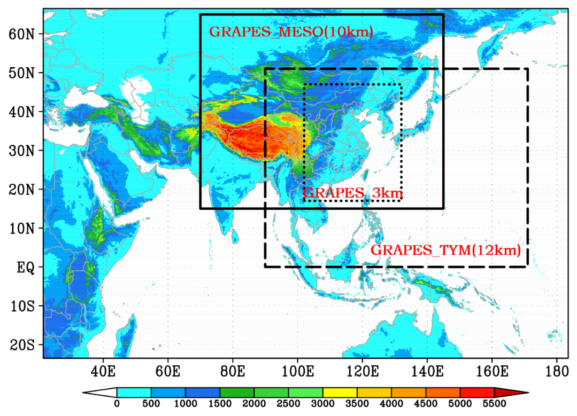
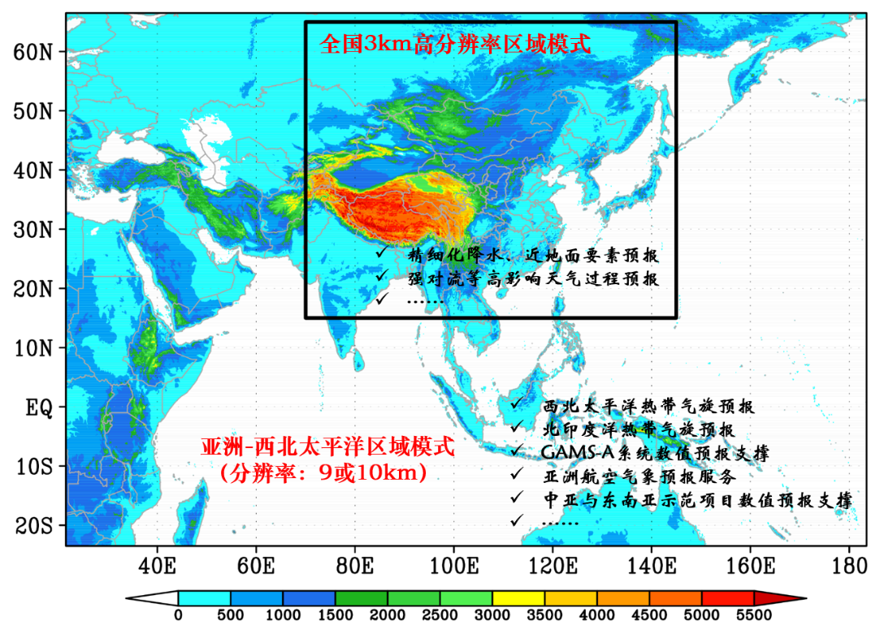
(2)“Asia–Northwest Pacific Ocean (A-NWP)” regional model system based on the GRAPES unified model
10km for China domain
10km for Typhoon forecast domain
3km for China domain
9km for A-NWP domain (Typhoon, Aviation, SWFDP )
2018
2019
Notes:
Jing Chen

Slide 50
Why IWTC important to me…
Operational experience at JTWC/NHC has been invaluable to my understanding of TC and has strongly informed my research and modeling
modelers and forecasters really have two distinct world views…but the intersection is the storms…communication is challenging but important

Slide 51
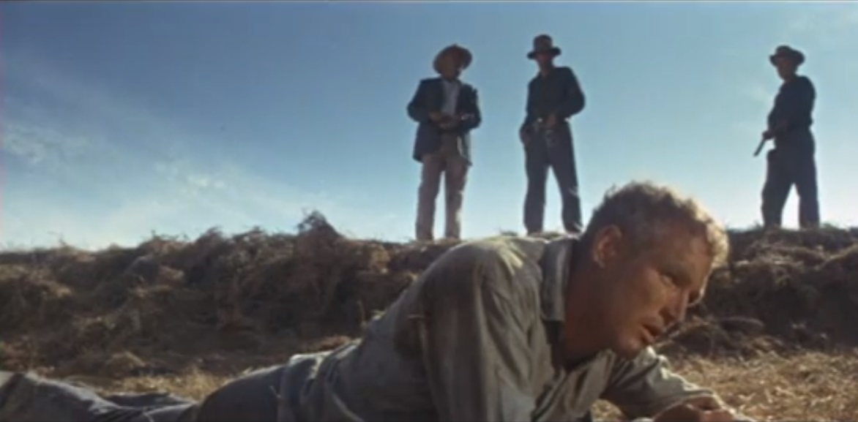
"What we've got here is failure to communicate”
Cool Hand Luke 1967
I told you FV3 had a problem with 5th v 6th order in the semi-lagrangian advection scheme
I really should have gone with ECMWF

Slide 52
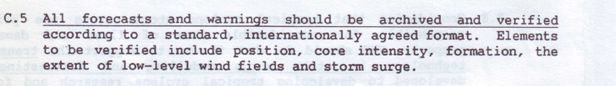


Recommendations
sort out the problem with TCvitals assimilation…otherwise there is no hope for accurate intensity/R34 forecasts as an initial value problem
revisit these IWTC I recs:

Slide 53
Web Sites and S/W
http://ruc.noaa.gov/wxmap2 Wxmaps & links
http://ruc.noaa.gov/hfip/tcdiag TC diagnostic file
http://ruc.noaa.gov/hfip/jtdiag JTWC version of TCDiag
http://ruc.noaa.gov/hfip/tcgen TC genesis
http://ruc.noaa.gov/hfip/tceps TC EPS
http://ruc.noaa.gov/hfip/tcact TC activity
https://sourceforge.net/projects/wxmap2/ All S/W

