Slide 1
50-year History of TC NWP - Progress & What's Next
Mike Fiorino
Commander, United States Navy (retired)
B.S. (’75 PSU), M.S. (’78 PSU), Ph.D. (’87 NPS) all in Meteorology mfiorino@gmu.edu
George Mason University VA
AORI University of Tokyo, 柏のは
University of Colorado Boulder CO
Earth System Research Laboratory, Boulder CO
National Hurricane Center, Miami FL
Joint Typhoon Warning Center, Pearl Harbor HI
Lawrence Livermore National Laboratory, Livermore CA
European Centre for Medium-Range Weather Forecasts, Shinfield Park, Berskshire, UK
Meteorological Research Institute – Japan Meteorological Agency, Tsukuba JAPAN
Space and Naval Warfare Systems Command, Arlington VA
NASA Goddard Space Flight Center, Greenbelt MD
National Centers for Environmental Prediction, Camp Springs MD
Naval Postgraduate School, Monterey CA
Fleet Numerical Meteorology and Oceanography Center, Monterey CA
Naval Research Laboratory, Monterey CA
Atlantic Oceanographic and Meteorological Laboratory, Miami FL
Pennsylvania State University, University Park PA

Slide 2
…in case you were wondering…
… what a retired old guy from SW Florida USA is doing in Kyushu…
My data legacy … as a computer nerd/geek
  4-CPU Linux cluster &150TB RAID5 filesystem
  spinning on my RAID5:
    1940-2024 (85 y) of twice daily 10-d forecasts from ERA5 (~25 TB)
    2007-2026 of ECMWF HRES (operational deterministic 10-d run every 6 h)
    2020-2026 operational NWP runs from NCEP, JMA, CMC, USN
    full archive of JTWC/NHC TC files
    1998-2025 CMORPH2, GsMAP, IMERG global precipitation 6-h on ERA5 25-km grid
  geeking is the 2nd part of my Alzheimer's avoidance strategy
  when I go … I’d prefer not to have my son’s just power down…
… what a retired old guy from SW Florida USA is doing in Kyushu…
1940-2024 (85 y) NWP data set
  ERA5 twice-daily, 10-d forecasts of a high-resolution global model (~25 km)
  ran TC tracker and ‘diagnostic file’ (e.g., wind shear) on every position in the JTWC best track archive (1945-2024 and NHC)
  a unique context to understand the history of TC NWP
… what a retired old guy from SW Florida USA is doing in Kyushu…
日本と日本人と日本語が大好きです
  I really like Japan, the people and the language, studying Japanese every day is part of my Alzheimer's avoidance strategy

Slide 3
3 WoWs – Words of Wisdom
  ”You’re only as good as what you measure”
  2006 – CAPT Vic Addison CO FNMOC
  ”Forecasting is the acid test of an (re)analysis”
  1994 – Bob Kistler, father of American reanalysis
  ”My most important forecast is 6 h”
  1997 – Sir Dave Burridge OBE, director ECMWF
Metrics Matter and define Good
Good Analyses make Good Forecasts
Good Models make Good Analyses
90% of DA is the model

Slide 4
State of TC NWP circa 2026 after 50 years doing TCs…
  TC NWP → TC forecasting
  TC NWP != TC modeling
  TC NWP = NWP
  NWP = Global Modeling
  Global Modeling = ECMWF
  at the end of the day…
  All NWP roads lead to Reading…
The secret to ECMWF success:
rigorous tracking of key metrics (5-d NHEM ACC)
model development using the DA ‘feedback’ or the BG-OB innovations. HI of turn # into lines of code. Why Dave Burridge said his most important forecast is 6-h, i.e., minimize BG-OB by making the model ‘look’ like the observations

Slide 5
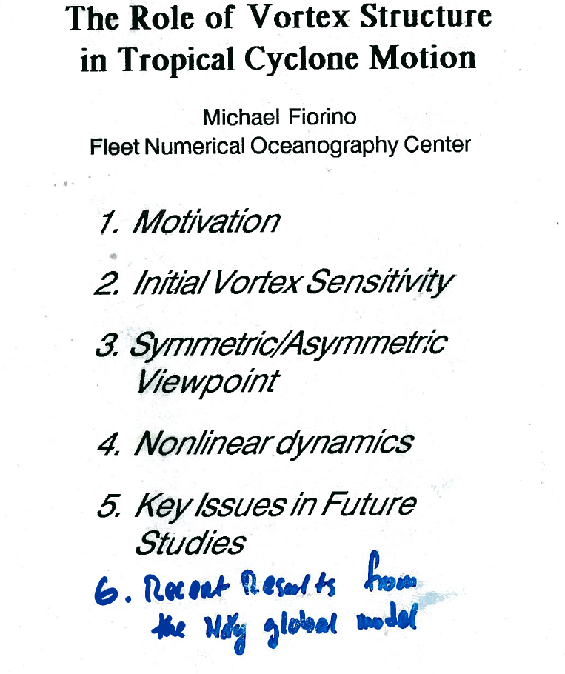
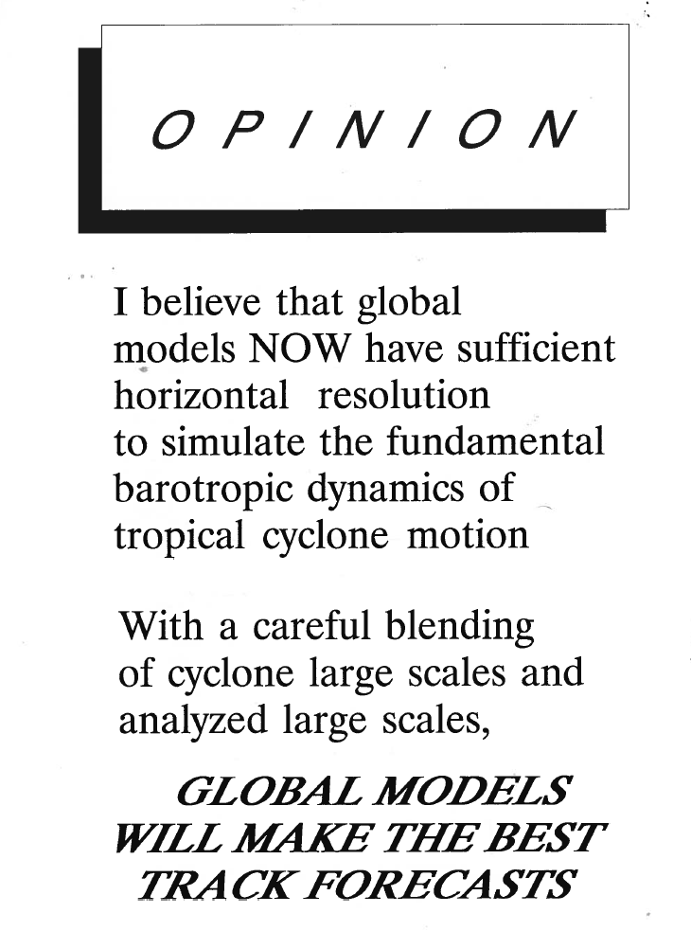
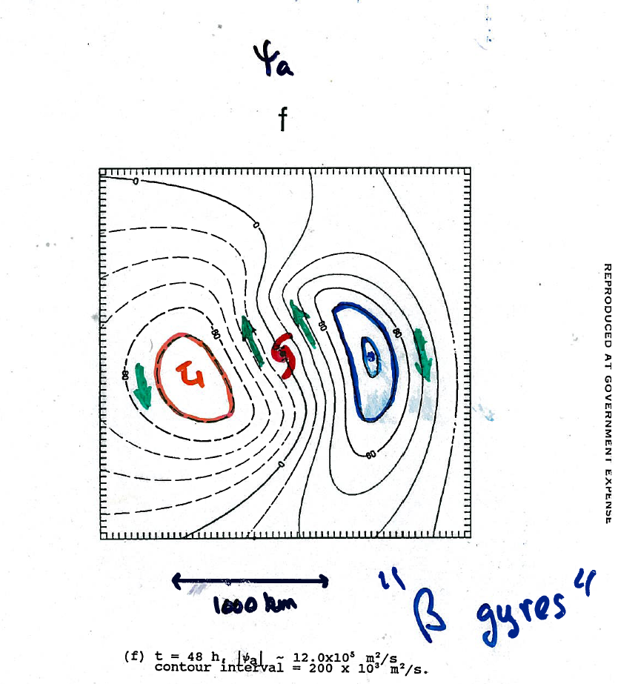
A 50-Year personal TC NWP Timeline
LAM – Limited Area Model
GcM – General Circ Model (Global Model)
TCvitals – position, intensity & sfc wind structure
TDO – Typhoon Duty Officer (forecaster)
Reanalyses
NCEP R1(NCAR) & R2 (DoE sponsored)
ERA15, ERA40, ERA5 (ECMWF) – dev TCvitals assimilation
JRA 25 & 55 (MRI-JMA) TCvitals
In 1987 @ NCEP Seminar…
1975
1985
1995
2005
2015
2025
TC LAM & Phd Modeling (PSU/NPS/NRL/ FNMOC)
1975–1987
Operational TC LAM NWP (NRL/FNMOC)
1982–1988
TC NWP GcM & Global Reanalysis
1990–2026
GrADS → NASA, NCEP, Japan→Asia
1994-2026
ECMWF – ERA40 TC NWP
1998–1999
JTWC – models officer / TDO
2001–2005
NHC – TechDev (NWP & metrics)
2006–2008
GcM dev and TCs (NOAA Boulder)
2009-2021
superBT project (U Tokyo)
2022–2026
Global Modeling & reanalysis
Operational TC NWP
TC LAM modeling
GrADS (Grid Analysis & Display System)

Slide 6
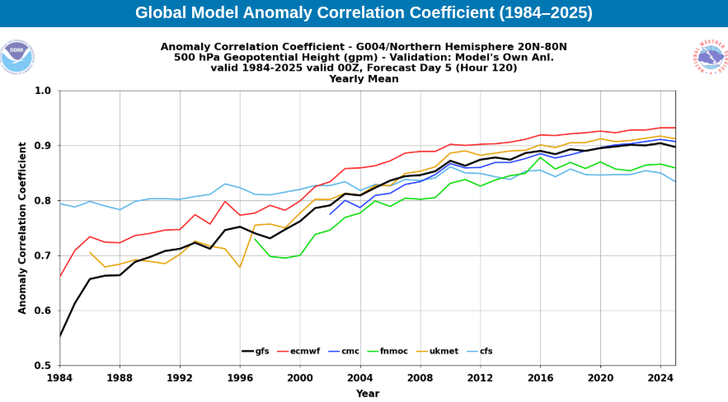
500 hPa 5-d NHEM ACC – the NWP ‘magic’ #
0.6→no skill; 0.8→good enough for … ; 0.9→high accuracy (almost ‘perfect’)
NWP League Table 202602 winter time |  | delta from ECMWF | %NWP cycles on LAM (estimated)
ECMWF.int | 0.948 | 0.000 | 0%
UKMO.uk | 0.933 | -0.012 | 20%
CMC.ca | 0.925 | -0.023 | 20%
NCEP.usnoaa | 0.922 | -0.022 | 50%
FNMOC.usnavy | 0.888 | -0.080 | 70%
ECMWF IFS → 0.9 ~ 2009
ERA5 → 0.9 ~ 2003
GFS → 0.9 ~2022?

Slide 7
summary for current NWP models
500 hPa 5-d NHEM ACC – the NWP ‘magic’ #
0.90 is a very good forecast; 0.80 useful; 0.60 no skill
the pecking order 2002-2026 yearly ACC ≥ 0.90
  2009 – ECMWF.int
  2016 – UKMO.uk
  2022 – CMC.ca
  2024 – NCEP.usa
  USN.usa.mil
the centers that spend the most cycles on LAM have the worse scores…
we will see ERA5 achieves this in 2003…

Slide 8
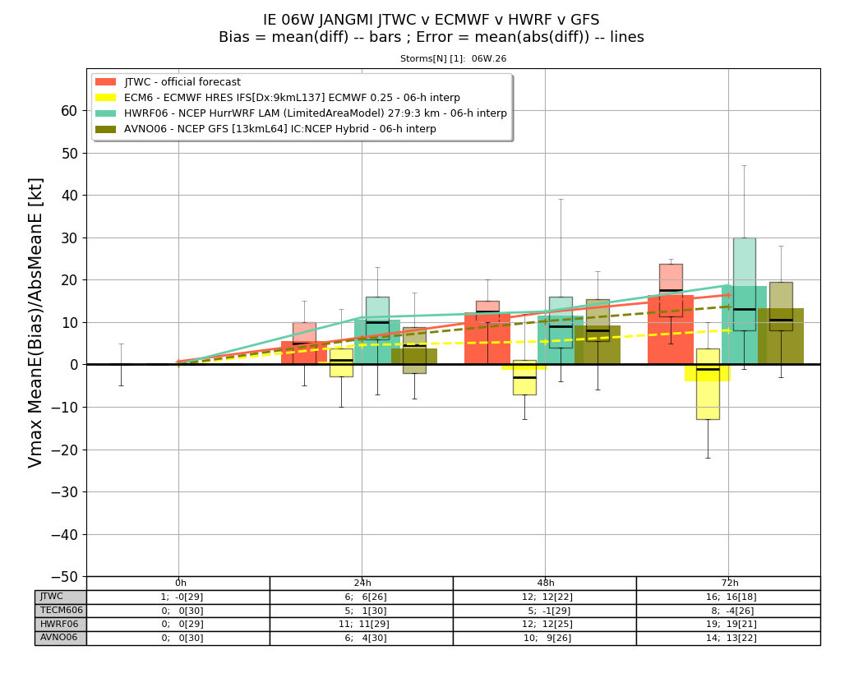
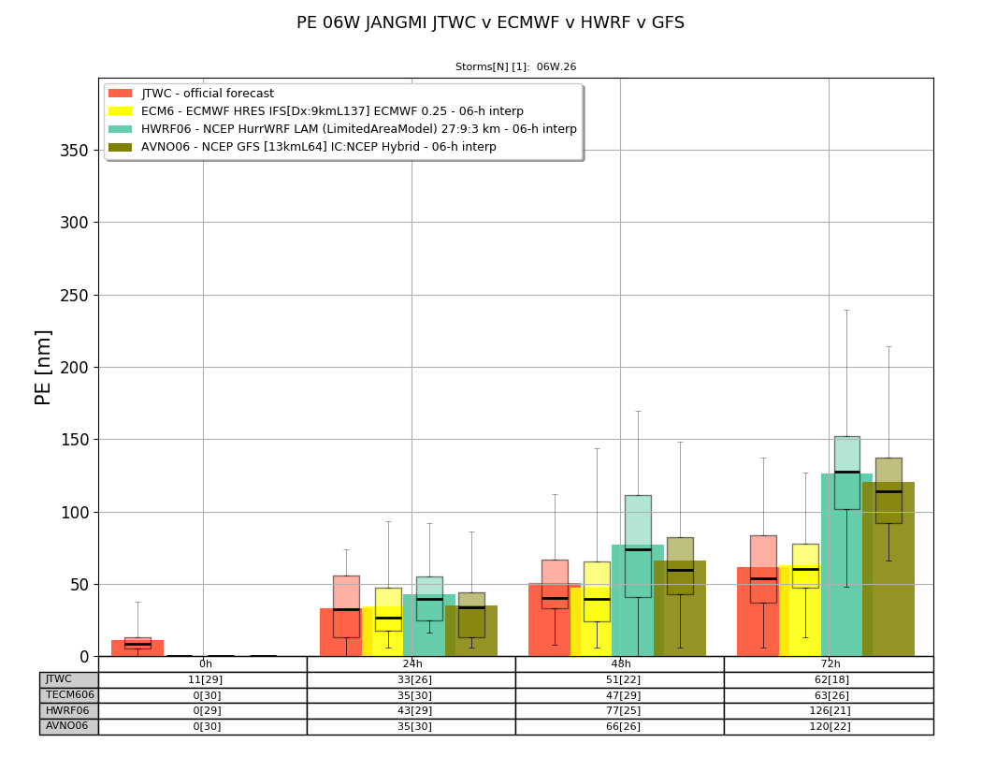
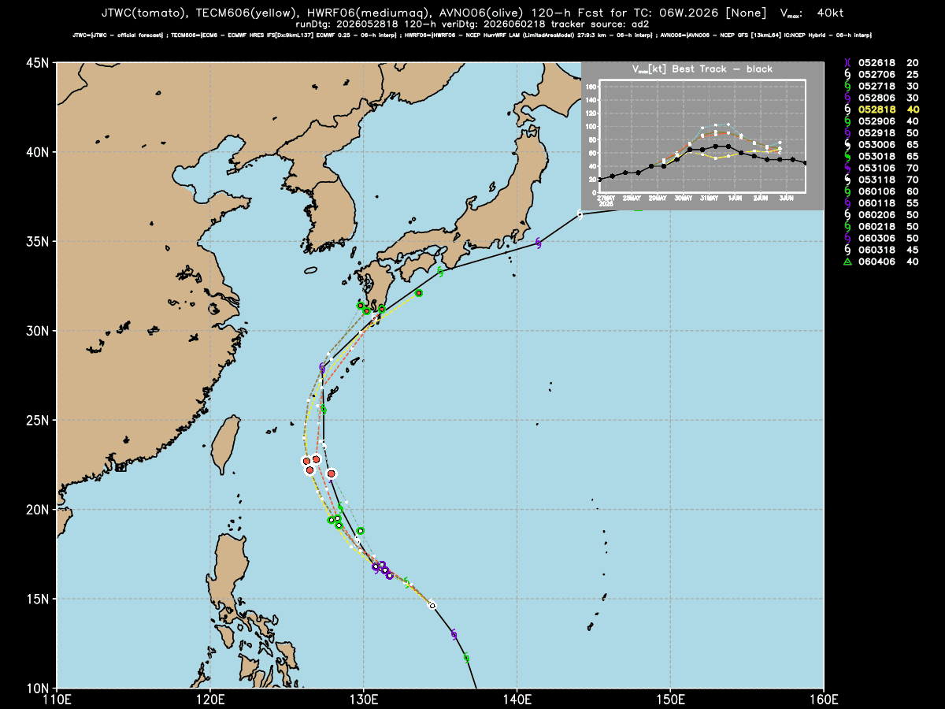
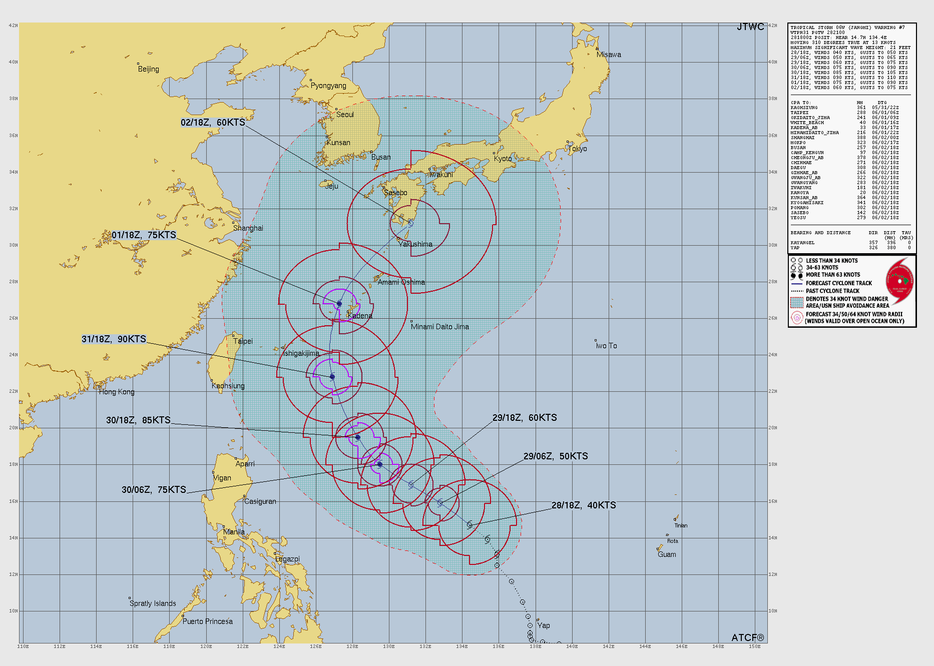
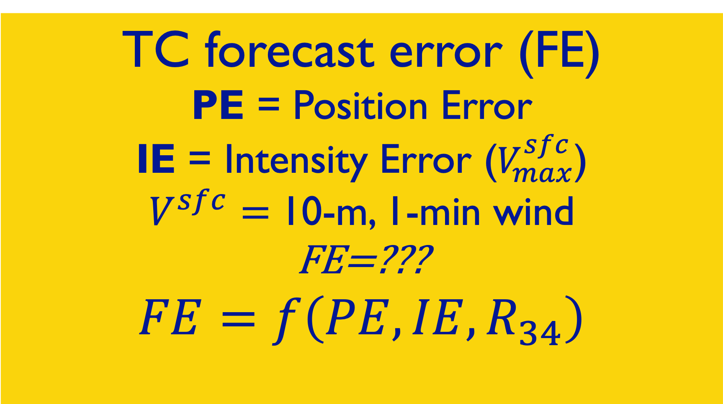
A TC forecast is…06W JANGMI 2026052818 both JTWC/NHC warnings ➔ onset/extent of 34 kt winds
Mean PE at 72 h
JTWC~ECMWF ~ 63 nmi
HWRF > GFS ~ 120 nmi
context:
CLPR ~ 350 nmi
TC forecast error (FE)
PE = Position Error
IE = Intensity Error ($V_{max}^{sfc}$)
$V^{sfc}=$10-m, 1-min wind
FE=???
$$FE=f\left(PE,IE,R_{34}\right)$$
TC forecast = surface wind field
10-m, 1-min wind
ECMWF
closest to BT Vmax
72 h verifiying position
      72 h
hatched blob:
R34 (145 nmi) + 72-h mean
JTWC PE (101 nmi) =
‘no sail zone’
Mean IE at 72 h
ECMWF ~ 0 bias! mean abs 8 kts is very low
HWRF highest IE at 19 kts
GFS, ECMWF, JTWC
all within 100 nmi
HWRF PE largest…

Slide 9
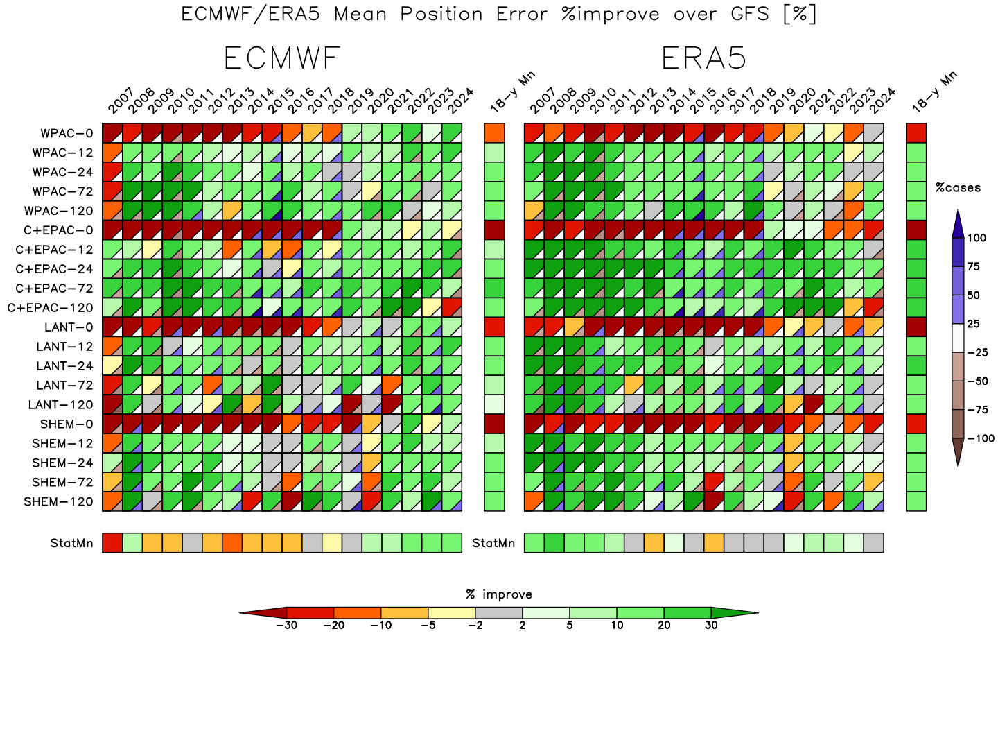
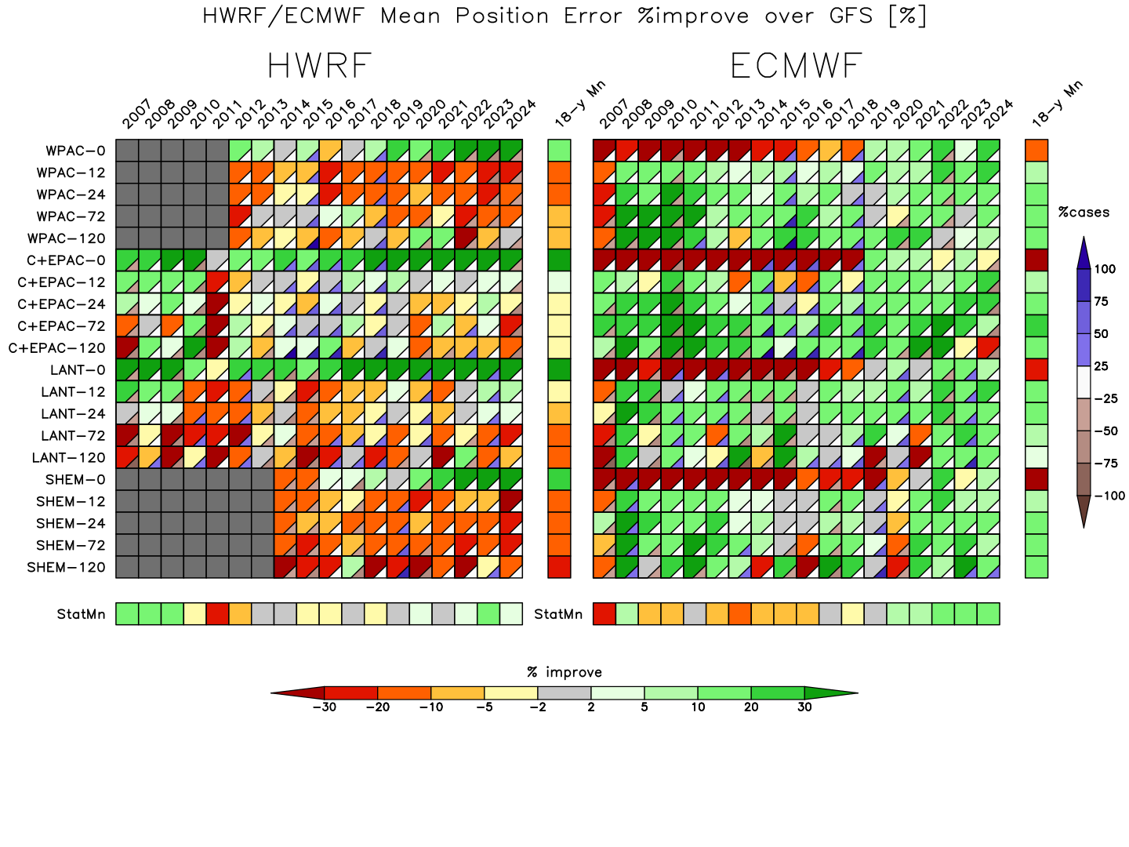
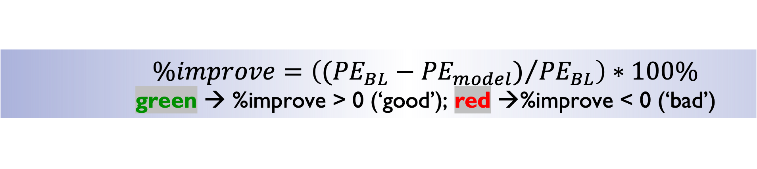
$$\%improve=\left(({{PE}_{BL}−{PE}_{model})}/{{PE}_{BL}}\right)∗100\%$$ green → %improve > 0 (‘good’); red →%improve < 0 (‘bad’)
HWRF-GFS best Initial Position Error
but degrades the GFS track forecast

Slide 10
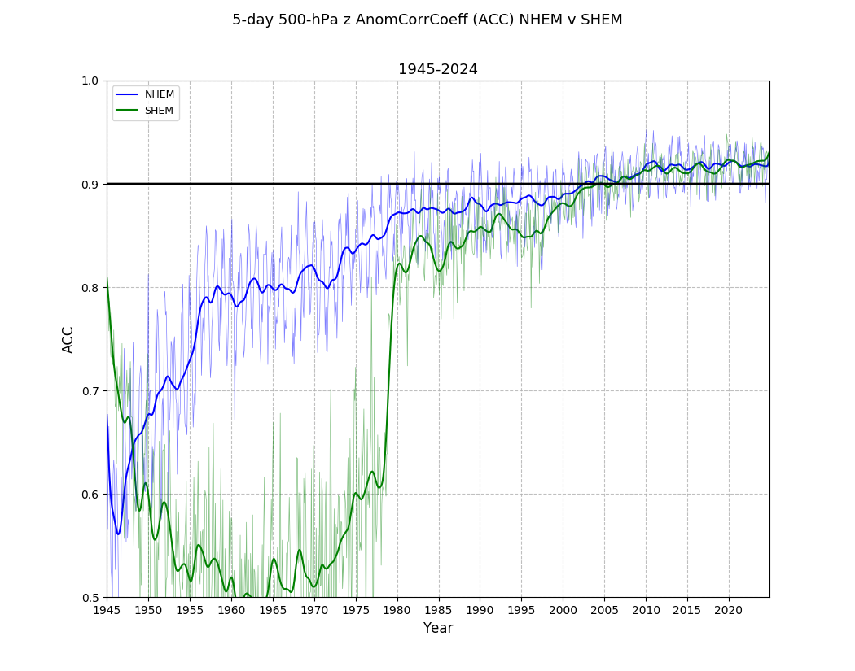

500 hPa 5-d ACC – the NWP ‘magic’ # 1945-2024 (80 y)
0.6→no skill; 0.8→good enough for … ; 0.9→high accuracy (‘perfect’)
Observing System Timeline Summary
ACC → 0.90 2003
SAT era 1979 →
Era | Primary Data Sources | Daily Obs Volume
1940–1958 | Surface stations, Ships, Radiosondes (Manual) | ~17k – 50k
1959–1978 | VTPR Satellites, PIREPS, Drifting Buoys | 100k – 500k
1979–2000 | TOVS Satellite Suite, early Scatterometers | 1M – 5M
2000–Present | Hyperspectral IR, GPS-RO, Ground Radar, Bufr | 25M+
IGY 1957 upper air

Slide 11
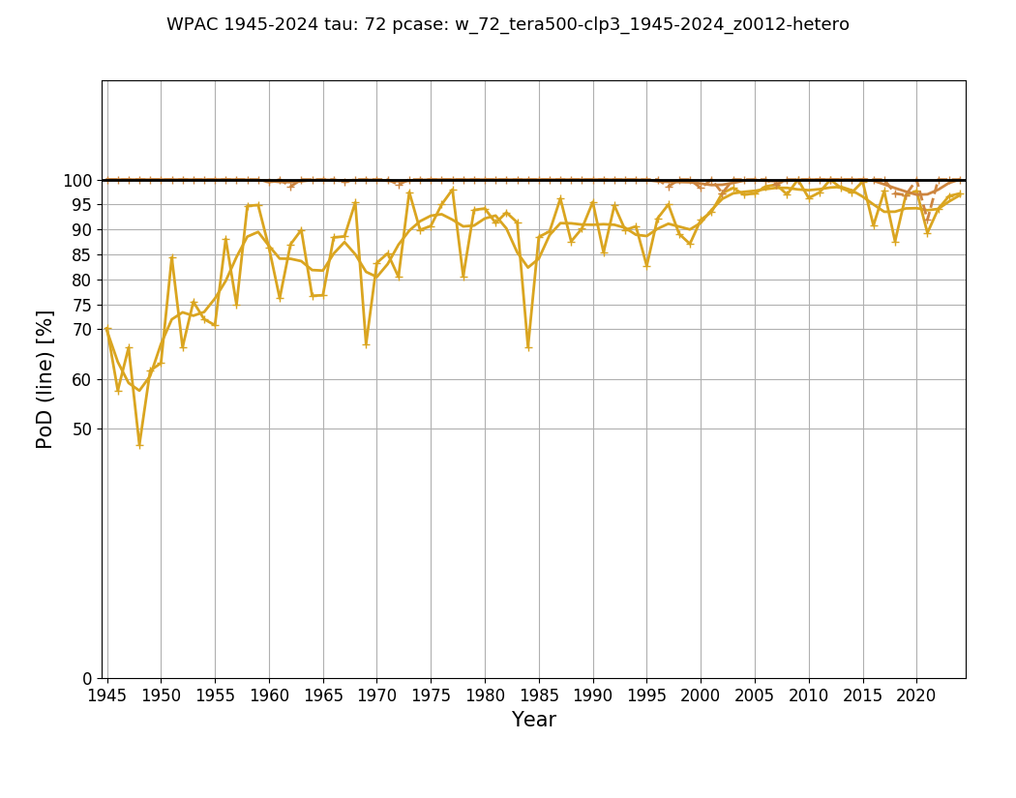
72-h mean PoD WPAC 1945-2024
ERA5 (global NWP) v CLIPER (~99%)
90-95%+ coverage
~ 2000
80%+ coverage
~ 1960

Slide 12
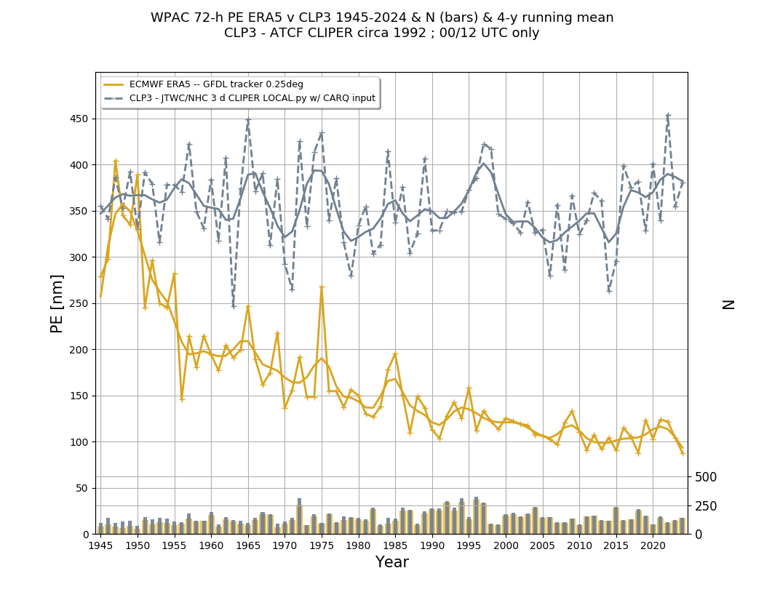
72-h mean PE WPAC 1945-2024
ERA5 (global NWP) v CLIPER
CLP3 ~ 350 nmi
below ‘150’ PACOM goal ~ 1985
ERA5 ~ 200 nmi ~ 1957

Slide 13
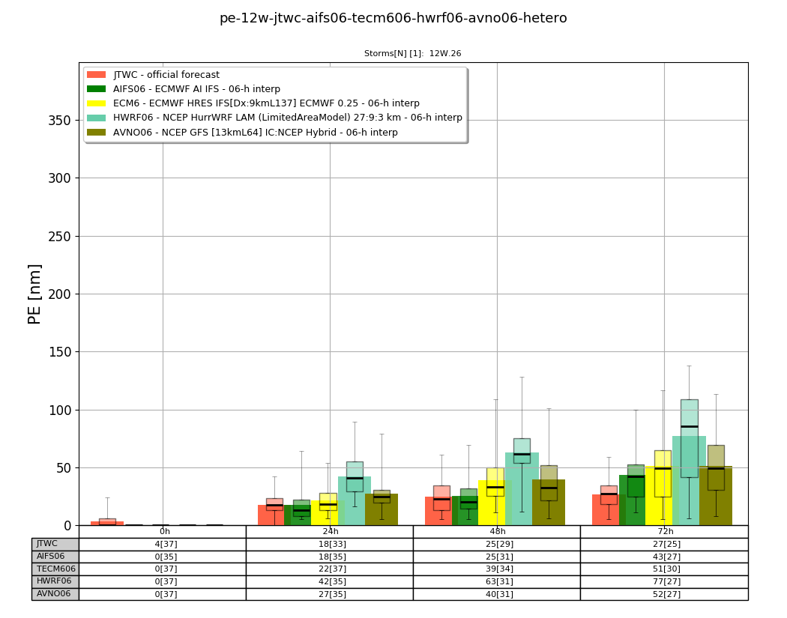
Summary of TC NWP 1945-2024
Summary and What’s Next
the tracks, diag files and precip stats will be made public
5-d 500 hPa NHEM ACC NWP ‘magic’ number
  correlates with general model accuracy in both the mid-lats and tropics
  NHEM → 0.8 (good) in the ERA51960s operationally not achieved until the 2000s
  SHEM → 0.8 with satellite era ~ 1979
  SHEM=NHEM > 0.9 (very good) in modern sat era ~ 2010
72-h PE TCNWP ‘magic’ number’
  CLP3 ~ 350 nmi
  ERA5 → 200 nmi ~1957 →150 nmi ~ 1985
The global model is almost everything…for TC NWP
  TC forecasts that would have been considered impossible even 10 years ago are now possible because of the tremendous improvement in global NWP modeling (not the DA method)
What’s next? – AI to bias correct and downscaling
  2025 72-h PE in WPAC: JTWC 84 nmi AIFS 75 nmi
  72-h PE for 12W (DOLPHIN) – JTWC 27 nmi !!!
72-h PE for 12W DOLPHIN
as of 2026080600
JTWC – 27 nmi
AIFS – 43
ECMWF – 51
HWRF – 77
GFS – 52

Slide 14
Mahalo
どうも
ありがとう
ございました

